Slide 1
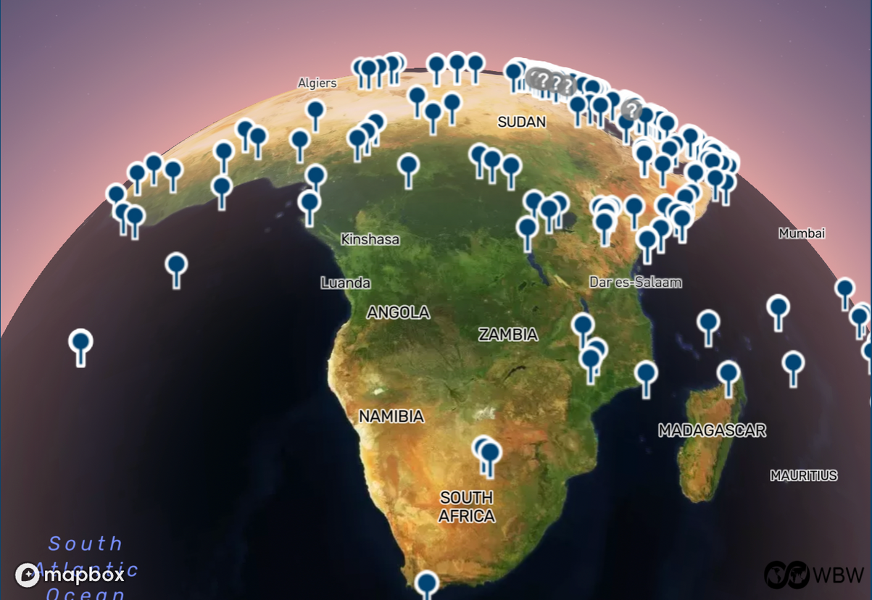


NO BASES IN AFRICA
Notes:
1.7.2013
‹#›

Slide 2

A Base
A Foreign Base
Any installation, facility, or site accommodating military personnel, weapons systems, and/or logistical
infrastructure, used for training, information gathering, operational
planning, command and control, administrative tasks, weapons storage, and/or launching attacks.
Any base located outside the operating country that is financed, operated, leased, rented, or temporarily accessed by that country, even if also used by the host country, and even if not formally labeled a base of the occupying country.
Notes:
1.7.2013
Let's start with definitions.
‹#›

Slide 3
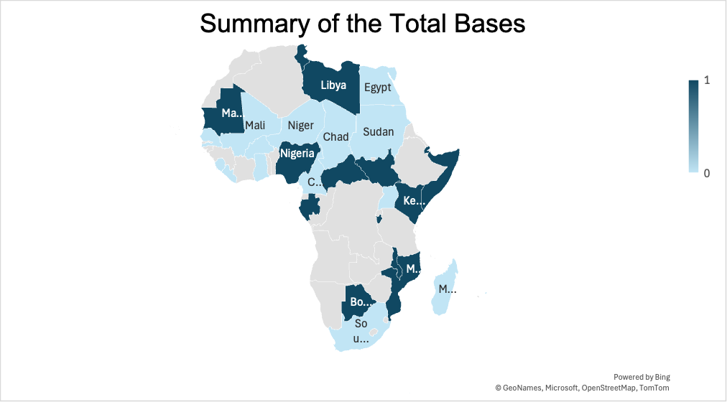
Who Has Foreign
Bases in Africa ?
UNITED STATES 49
TURKIYE 3
UNITED KINGDOM 14
INDIA 4
UNITED ARAB EMIRATES 6
CANADA 1
RUSSIA 1
ITALY 1
SINGAPORE 1
Notes:
1.7.2013
Several world powers maintain military bases in Africa, either permanently or through temporary presences. The official pretexts put forward are that these bases are used to push back terrorists, ensure maritime security, train soldiers, and humanitarian logistics.
The United States has the largest military empire in the world and also almost everywhere in Africa. U.S. military bases in Africa are run by AFRICOM.
Other foreign powers with bases in Africa are the United Kingdom, the United Arab Emirates, Italy, Turkey, India, Canada, Singapore.
Russia is forging military alliances that could soon materialize in the establishment of more bases.
‹#›

Slide 4
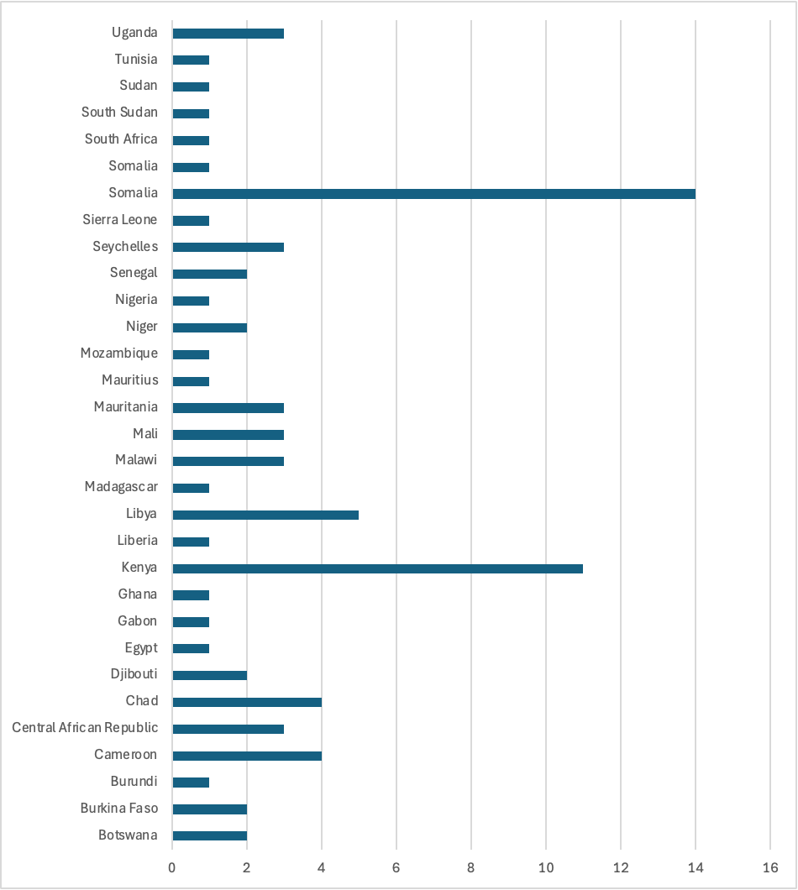
Where are the Foreign
Bases?
Notes:
1.7.2013
‹#›

Slide 5
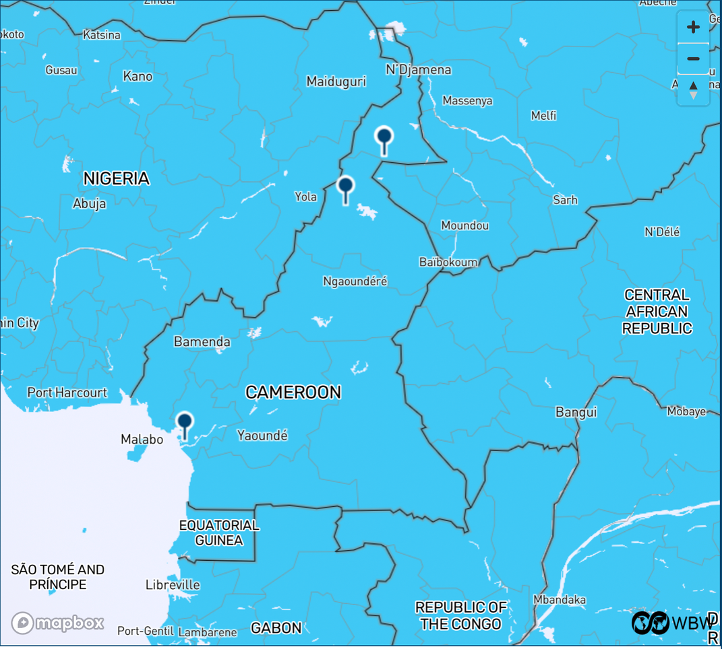
Propping Up Bad Governments
  Foreign bases reinforce authoritarian regimes rather than protecting populations
  They legitimize dictatorships and enable rulers to stay in power for decades.
  The result is repression of citizens and setback for democracy.
Notes:
1.7.2013
Far from maintaining peace and ensuring the security of the population as proclaimed, the foreign military presence rather strengthens the elites in power. Military bases consolidate authoritarian regimes and give them legitimacy.
Cameroon is an example of those African countries whose government uses the army to maintain itself, so as to spend 43 years of rule of the same leader, in a country considered democratic.
Foreign cooperation and military bases ensure the survival of dictatorial regimes disguised as dictatorships, accentuate the repression of citizens and set democracy back.
U.S. foreign bases are located in many of the most oppressive nations, where they support the abusive governments of Bahrain, Egypt, Gabon, Iraq,
Israel, Jordan, Oman, Qatar, Saudi Arabia, Syria, Thailand, Uganda, and United Arab Emirates, among many others.
‹#›

Slide 6
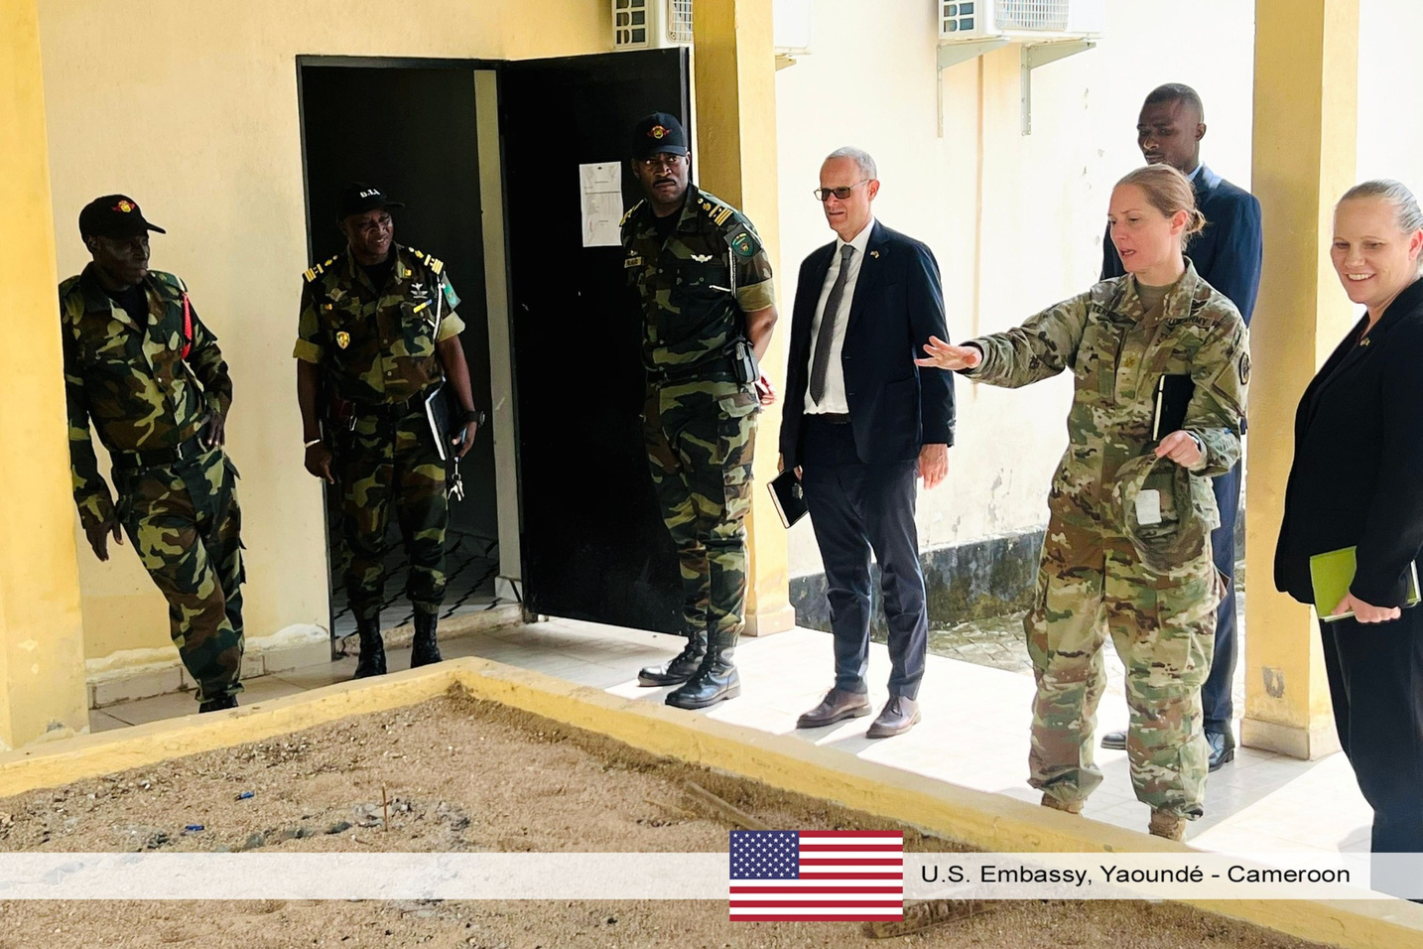
Extending Colonialism
  Foreign bases → external powers keep control
  African states depend on foreign military power
  Rising resistance in Sahel countries (Burkina Faso, Mali, Niger, Chad).
Notes:
1.7.2013
The image (From US Embassy Yaoundé’s Facebook page) shows Deputy Chief of Mission official trip to the Far North Region au Cameroon, visiting the Rapid Intervention Battalion (BIR) in Maroua, where the US has 2 bases.
Foreign bases help to perpetuate neocolonialism, where external powers continue to wield great influence.
The legitimacy and sovereignty of African countries are constantly questioned, due to their weakness to act and decide without the intervention of foreign powers, which hold military force.
Increasingly, popular resentment and anti-imperial rhetoric are taking up space and rejecting colonial power, as in the case of the Sahel countries (Burkina Faso, Mali, Niger, Chad).
‹#›

Slide 7
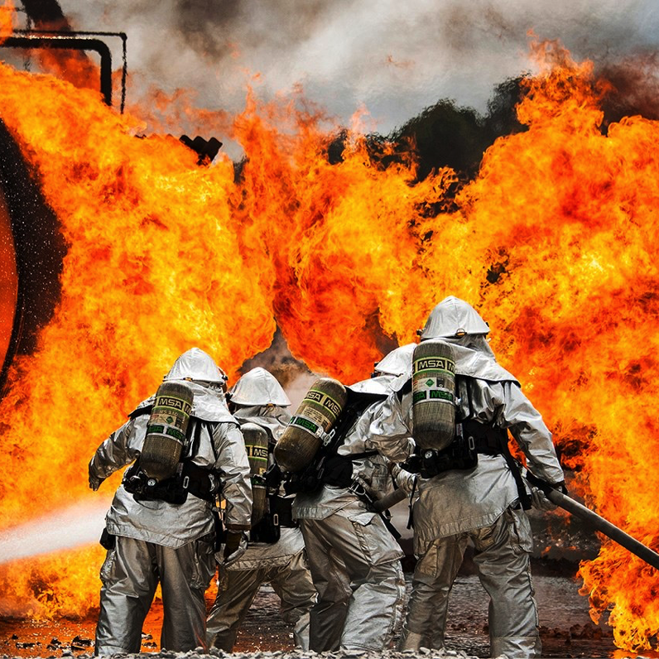
Damaging the Environment
  Pollution and land pressure from bases
  Camp Lemonnier (Djibouti): massive water use in semi-desert country
  Air and hydrocarbon pollution from heavy air traffic and fuel leaks
  Threats to fisheries and agriculture
Notes:
1.7.2013
Military installations contribute to environmental degradation through pollution, land use, and carbon emissions.
The main American base in Djibouti, Camp Lemonnier, is known for using a large amount of water in a semi-desert country, creating pressure on local water resources. Air pollution is also significant, due to heavy air traffic, not to mention the release of hydrocarbons into the land and sea. As in other countries with bases, the risks to the fisheries and agricultural ecosystems on which local African communities depend are increased.
Military activities in peacetime mainly cover military maneuvers, as well as all activities relating to the storage of military equipment, maintenance and preparation for possible conflict. War preparation activities considerably degrade the environment, as evidenced by the plundering of natural resources, deforestation, defoliation, displacement of populations, environmental manipulation, etc. Ecosystems are ravaged, infrastructures are destroyed, soils are contaminated, agricultural cycles are disrupted and natural resources are poorly exploited. These effects lead to famine, drought, population displacement, political and environmental destabilization and insecurity.
‹#›

Slide 8
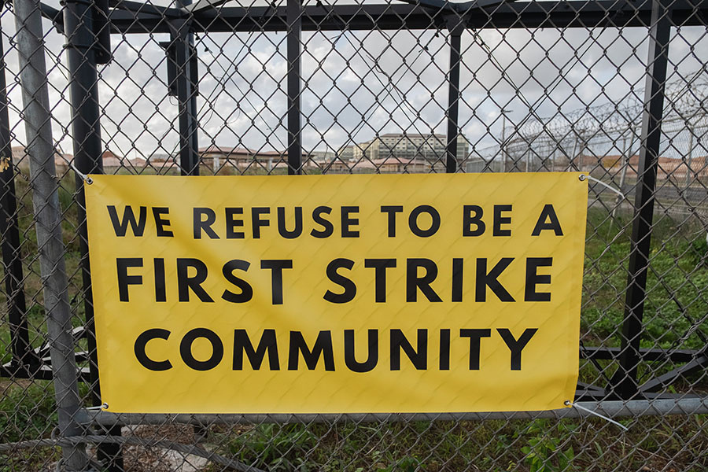
Facilitating Conflict
  Armed conflicts persist across Africa (Sudan, DRC, Somalia, Libya, Chad, CAR, Mali, Burkina Faso, etc.).
  Military bases fuel arms race and deepen conflict dynamics
  External rivalries have been imported like in Sudan: Russia–Ukraine tensions play out on African soil.
Notes:
1.7.2013
Africa is the scene of armed conflicts, which for decades have decimated populations in Sudan, the Democratic Republic of Congo, Somalia, Libya, Chad, Cameroon, the Central African Republic, Côte d'Ivoire, Mali, Burkina Faso and many other countries. Military bases have only accentuated the arms race and conflict dynamics instead of resolving them.
External rivalries are exported to African soil, as in the case of the war in Sudan, where Russia and Ukraine have extended their rivalry.
According to a report by the Pentagon’s Africa Center for Strategic Studies, the number of Africans killed by terrorists has jumped by an astonishing 100,000% in the last ten years. The decade in question is one in which the US came to our continent - supposedly, to bring peace and stability.
In 2023, fatalities from terrorism in Africa soared to “a record level of lethal violence,” says the Center - 23,322 (versus 19,412 in 2022). Compare that with the 23 deaths blamed on terrorism in 2002-2003.
The two main theatres of US operations, the Horn of Africa and the Sahel, have seen large increases in civilian deaths.
‹#›

Slide 9
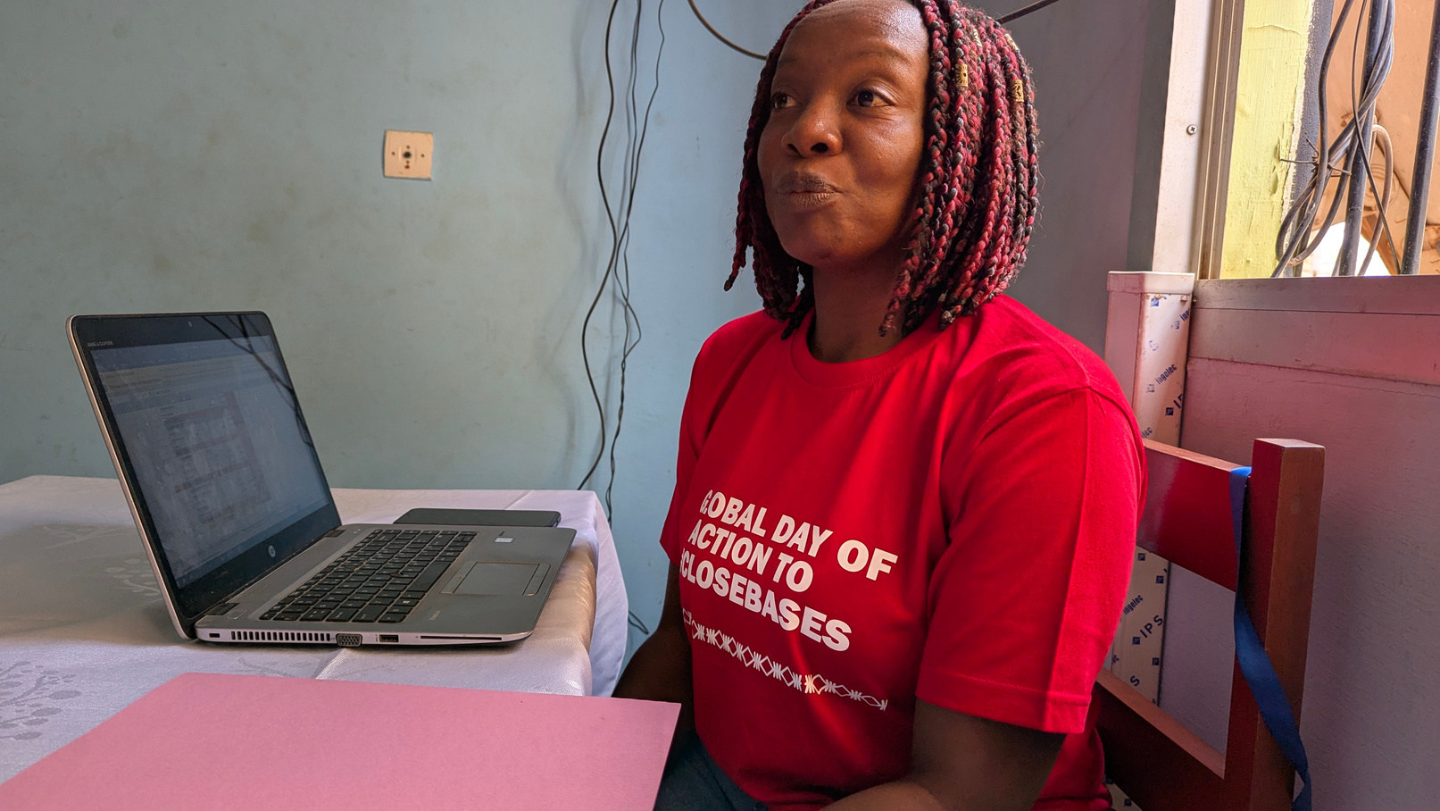
Lack of self-determination of peoples
  Decisions on bases treated as secret-defense.
  Civil society actors silenced or discredited, accused of serving foreign interests.
Notes:
1.7.2013
Decisions about the hosting of bases are often unknown to citizens, because like other security issues, they are considered secret-defense. Civil society organizations that are interested in these issues are instead suspected of being pawns in obtaining information for the benefit of those who fund them.
The WBW chapter in Cameroon approached the U.S. Embassy to learn more about their bases in the country and discuss it, but never got a response.
‹#›

Slide 10

Wasting Desperately Needed Money
    Military presence agreements impose costs at the expense of human development. There is a huge contrast between the level of infrastructure development (health, education, economy) and investment in armaments and preparations for war.
Notes:
1.7.2013
‹#›

Slide 11
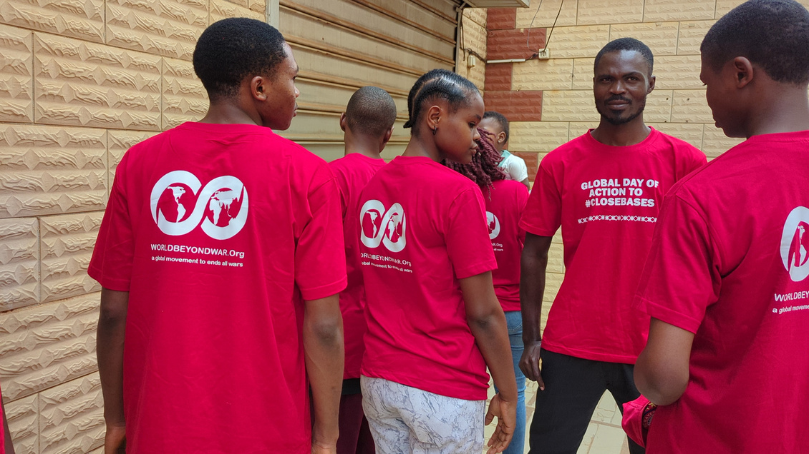
Efforts to Close Bases
    Initiatives in Africa to close foreign military bases are part of a broader movement of decolonization and the reaffirmation of peoples’ sovereignty.
    Bases have been closed or foreign troops withdrawn in Niger, Mali, Burkina Faso, and Chad.
    World BEYOND War chapters are currently leading campaigns to close bases in Djibouti and Cameroon.
Notes:
1.7.2013
Initiatives in Africa calling for closing foreign military bases are part of a broader movement of decolonization and the reaffirmation of African peoples’ sovereignty.
Thanks to the determination of some leaders and popular movements, bases have been closed or foreign troops withdrawn in Niger, Mali, Burkina Faso, and Chad.
Civil society and some African governments have taken action to challenge or end the presence of foreign bases.
Niger, Mali, Burkina Faso, Senegal and Chad have demanded the withdrawal of foreign forces, in this case French, in accordance with the political will and support of the population.
The M62 (Movement 62) in Niger, the "Balai Citoyen" movement in Burkina Faso and the French association “Survie”, have also called on France to close its bases in Africa.
World BEYOND War chapters in Africa, particularly Senegal, Mali and Cameroon, are leading campaigns for the closure of bases in Africa.
Some West African countries have therefore succeeded in reducing the foreign military presence.
‹#›

Slide 12
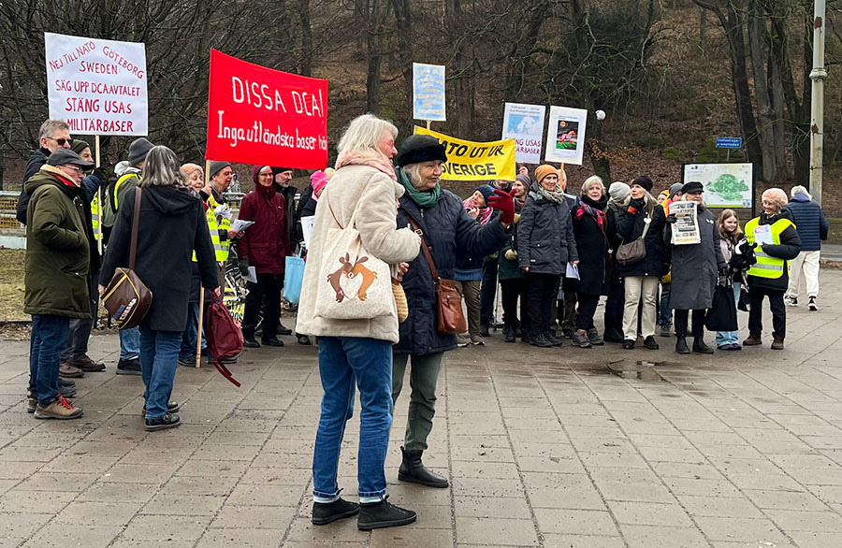
Resources Available
worldbeyondwar.org/bases
    Mapping tools
    Campaigns
    Reports
    Films and videos
    Speakers
    Articles
    Images
Notes:
1.7.2013
We are stronger together.
Share what you are doing through World BEYOND War with others around the world.
‹#›

