Slide 1

Masculinities in Conflict
Demining the spirit of war to create stability

Slide 2
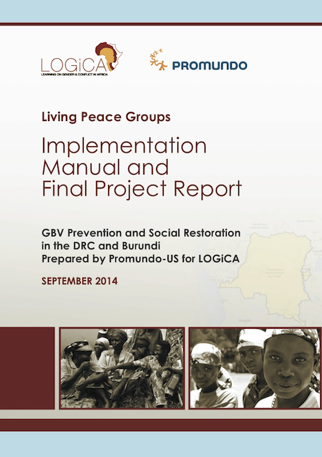
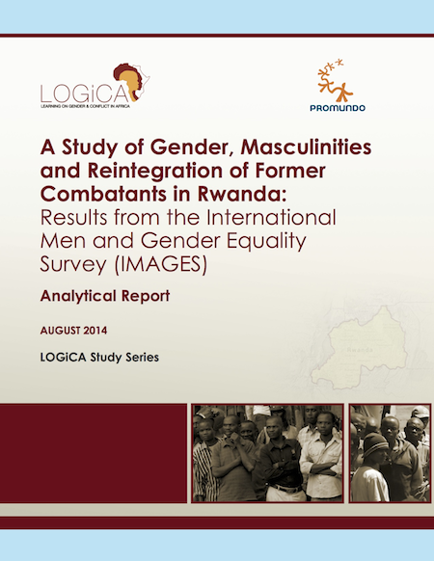
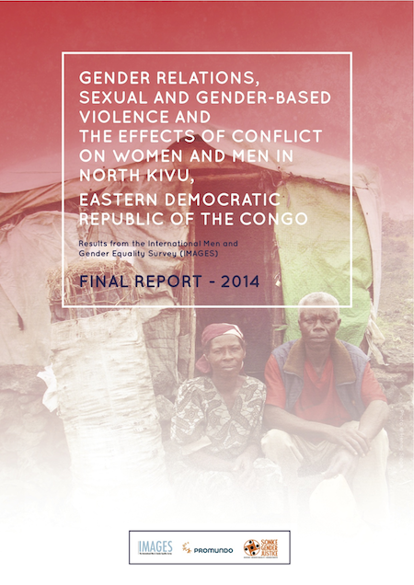
Research 2010-2018 RDC-l’East
Equimundo, Living Peace Institute & World Bank (Banque Mondiale,
Masculinity: chef of the family, responsible, support for the family and protector. In reality; they fail : Poverty, Conflits, pauvreté, conflits,
Men as agressor and victims, psychologically affected, have lost self estim (masculinity);
Wars and conflicts exacerbate the level of IPV ( violence conjugale)
Psychological strategies for the Men to overcome the trauma and stress include the risks of violence/ hide the vulnerability
Notes:
145 survey: X combatants Mutobo
Logica: Learning On Gender in Conflict Areas

Slide 3
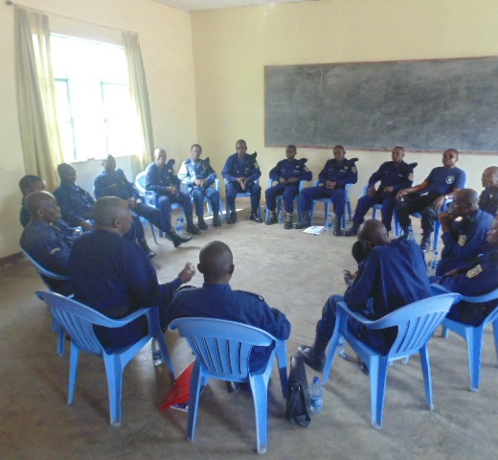
Living Peace groups from 2015
DRC
Military FARDC
Police PNC
Ex combattants
Husbands of SGBV Survivors
Men (civilians) living in Conflict zones
Adolescents in conflit zones
Adolescents/Kuluna- Kinshasa
International
Cameroon, Mali, Liban, Irak

Slide 4

Intervention Areas & Target in 2023
Province/Zone de santé | TARGET 2019-2022 | %
Ituri (3) | 720 | 9%
DJUGU | 360
NYAKASANZA | 180
SHALI | 180
Nord-Kivu (5) | 5280 | 66%
KARISIMBI | 3210
KIROTCHE | 495
MASISI | 675
MWESO | 450
NYIRAGONGO | 450
Sud-Kivu (4) | 2025 | 25%
BAGIRA | 675
IBANDA | 675
LEMERA | 405
WALUNGU | 270
Grand Total | 8025 | 100%

Slide 5
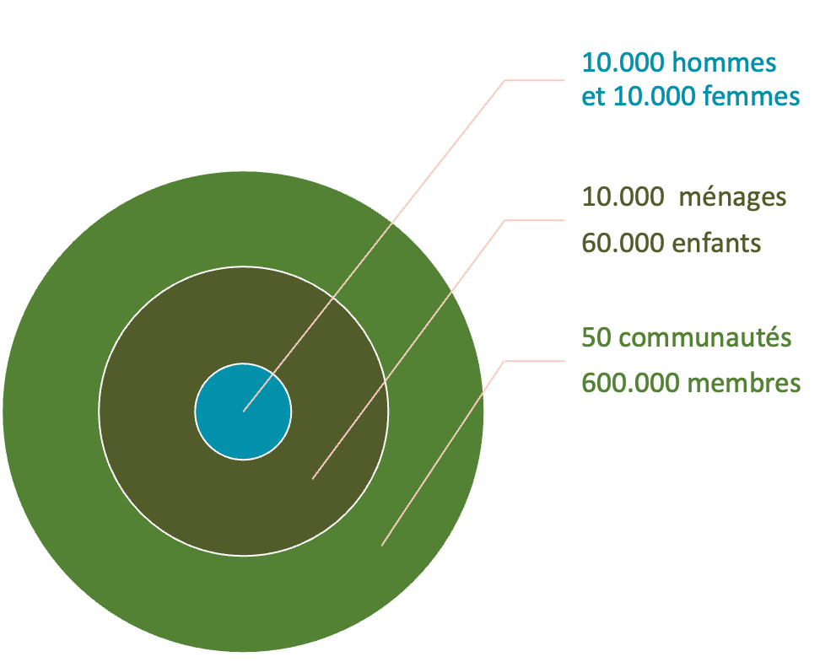
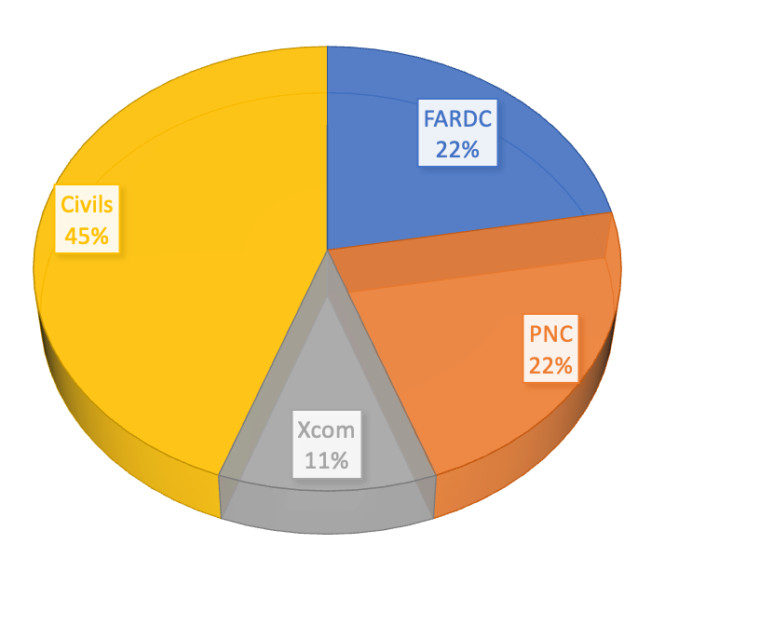
Statistics: 2015-2021
FARDC, PNC: Nord et Sud Kivu
EX COMB: Nord Kivu
CIVILS violent: Ituri, Nord et Sud Kivu
Notes:
50% civil et 50% hommes en uniforme (touché l’armée)

Slide 6
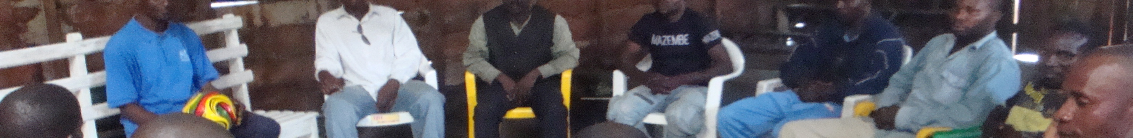
Désarmement psychosocial des hommes
Living Peace methodology : psychosocial support to men, including spouses and the community
15 sessions, 15 weeks, 15 participants in a group
2 facilitators per groupe, clinical supervision
Trauma healing, adopt new copying strategies to manage the stress, non violent attitude, based on gender equality
Evaluations: reduction of violence, reduction of substance abuse, more confidence in the community

Slide 7
The Film
Retrospective
Community intervention tool to talk about trauma and violence
Participants and facilitator are former-LP participants.
They play (not act) based on their personal experiences/memories

Slide 8
Result and Impact
2015-2024

Slide 9
Evaluations: positive impact et sustainable
SVRI/World bank, In-Focus, RCT
Reduction of SGVB
Reduction of PTSD and depression
Improvement of Family health (incl. Wives and children)
Improvement of Socio-economic conditions of the families
Evaluation/Randomized Control Trial (2017-2021)
3000 participants
60 Villages in Nord et Sud- Kivu (30 Control et 30 Living Peace)
Réductions PTSD et depression
Stop GBV
Strengthen social relationships
1,5 year after the intervention : Lpint results are even better than direct after the research (baseline)
Notes:
Evaluation/Recherche Randomisée

Slide 10
Result and Impact
Better management of problems at home: Communication and dialogues between spouses instead of fights.
Stop alcohol abuse and reduce drinking: Many men report to have stopped drinking; this is confirmed by their wives.
Control of frustration and aggression: Many men say that they are able to manage and control anger, communicate instead of fight.
Share income with wife and family: Almost all previous participants adapted income and money management: men share their income with their wives and make decisions together.
Peace at home and happy children: Men spend more time with their children and their wives, many children go to school for the first time.
Improved health conditions: Many men and women report that they were able to gain weight, and feel mentally and physically better.
More gender equality: Men (and women) report positive changes where women become more considered as equal partners.
Healthier sexual relations: men starting to change attitudes to no longer see sex as a men’s right only.

Slide 11
Conclusion/Reflexion
Participants in the Lpint program demonstrate more confidence and stability in managing problems and emotions through non-violent means at home and in the community.
They are better equipped to deal with negative experiences or frustrations they still face without resorting to violence.
The strength of the LP approach: adapting to Congolese culture, targeting injured/traumatized men, integrating gender and masculinity
Notes:
Quelle est la force de cette methodologie? Quelle est l’originalité de cette méthodologie?

