Slide 1
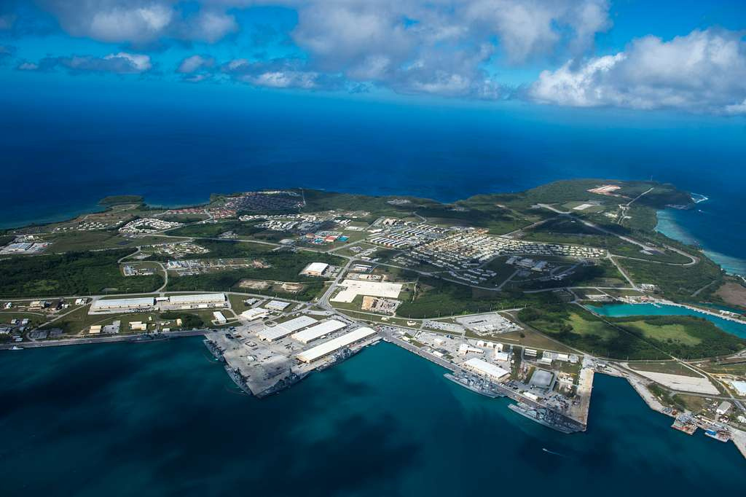


THE CASE AGAINST MILITARY BASES AND HOW TO CLOSE THEM
Notes:
Might be fun to poll the audience for views on military bases before starting (and at the end).

Slide 2

A Base
A Foreign Base
Any installation, facility, or site accommodating military personnel, weapons systems, and/or logistical
infrastructure, used for training, information gathering, operational
planning, command and control, administrative tasks, weapons storage, and/or launching attacks.
Any base located outside the operating country that is financed, operated, leased, rented, or temporarily accessed by that country, even if also used by the host country, and even if not formally labeled a base of the occupying country.
Notes:
Let's start with definitions.

Slide 3
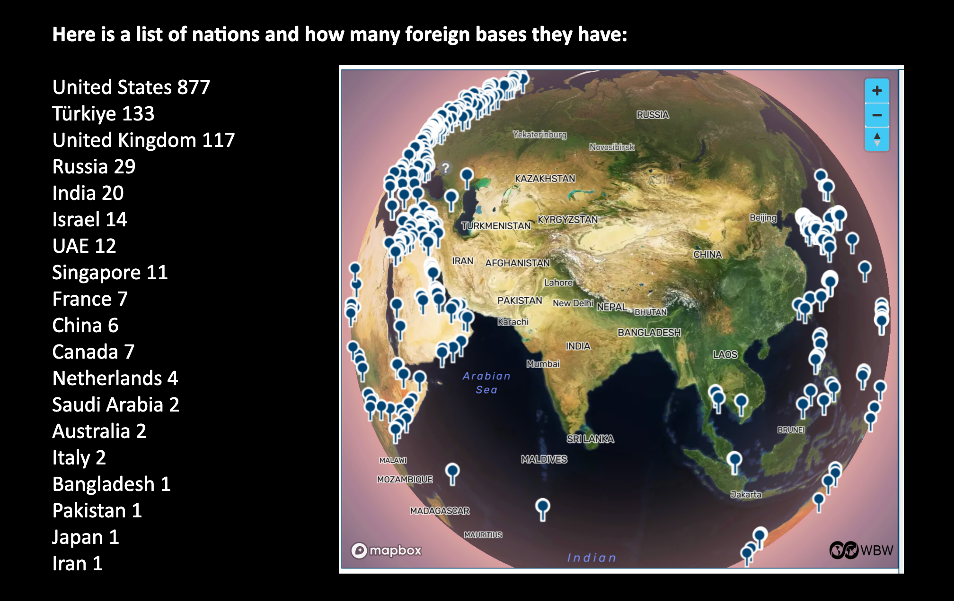
Who Has Foreign
Bases?
Notes:
Of 1,247 foreign military bases in the world, 877 of them, by latest count, are U.S. bases outside of the United States. Eighteen other nations, combined, have 370 bases outside their borders. Maintaining foreign military bases is largely a U.S. activity. By our current count, the United States has 877 foreign military bases -- far more than all other nations on Earth combined. Some are small bases, but some are larger than any belonging to any other nation. Some are massive gated communities with shopping malls, golf courses, and menial labor provided by people with second-class rights on bases in their own countries.

Slide 4
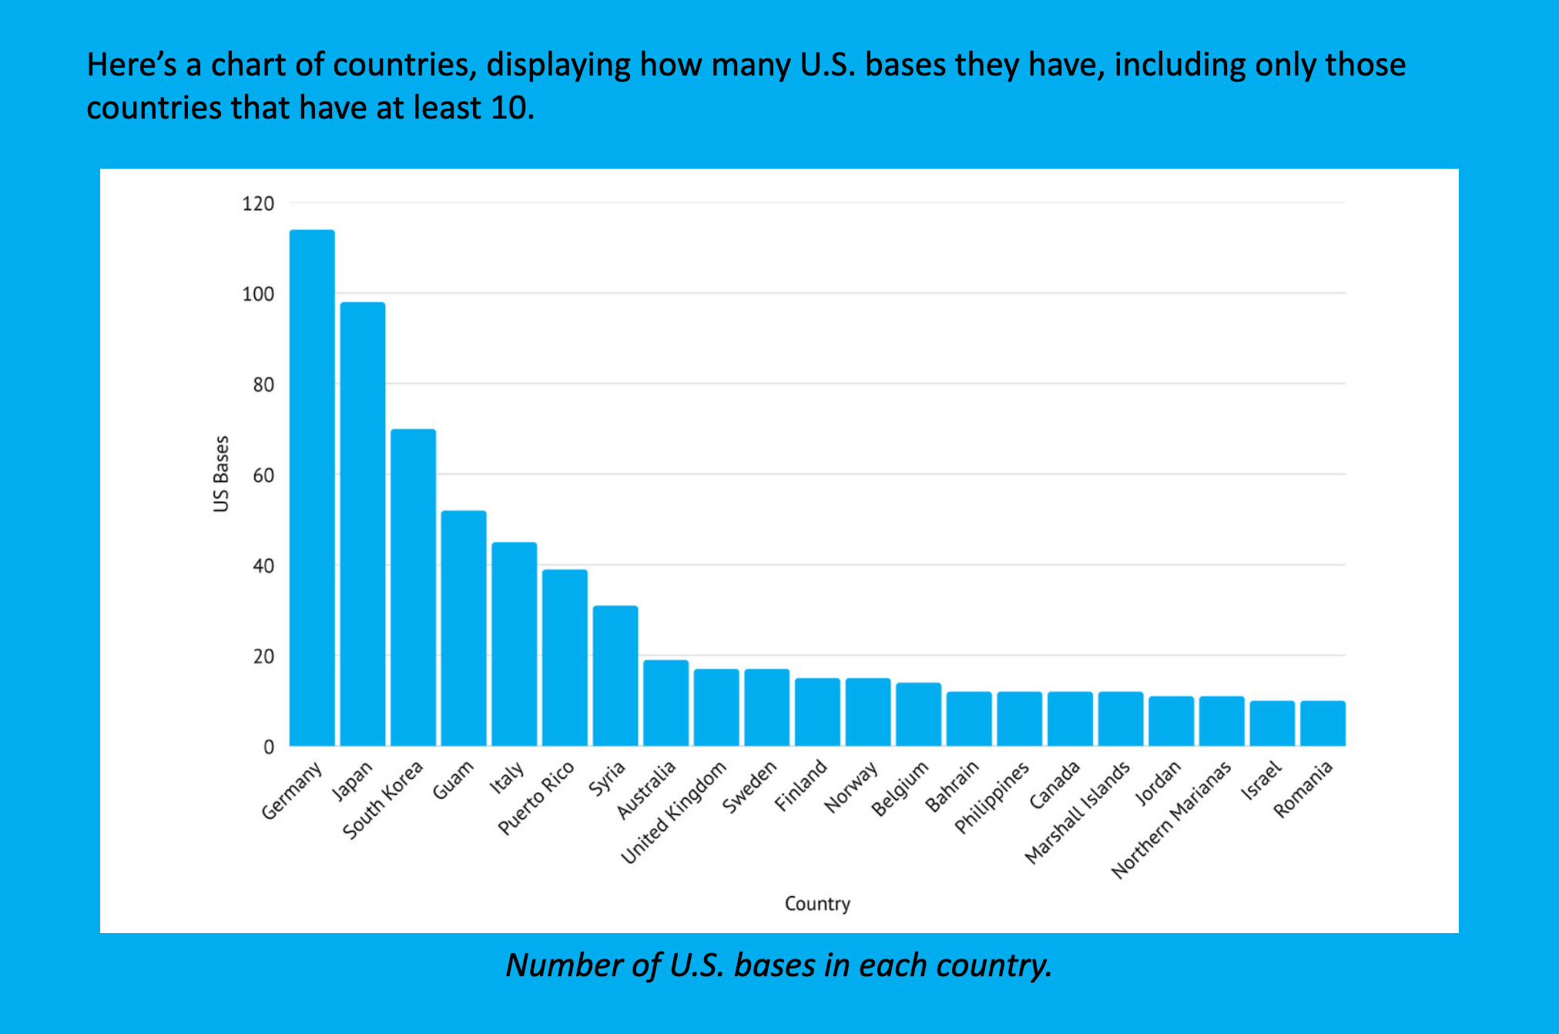
Where are the U.S. Foreign
Bases?
Notes:
U.S. foreign bases are packed heavily into Europe, Africa, Western Asia, East Asia, and the Pacific, as well as scattered across Latin America and Canada. From Iran to North Korea, the nations most often discussed in hostile terms by the U.S. government, including Russia and China, are encircled by hundreds of U.S. bases, stretching in a thick wall from the top of Scandinavia, through those nations bordering Russia and Belarus, and all the way to Oman, dotting the Indian Ocean and South-East Asia, and squeezed most tightly of all into Okinawa, the rest of Japan, and South Korea. Alaskan U.S. bases are not included in a list of foreign U.S. bases, but the U.S. base in Greenland is -- at least for the time being. Even demilitarized Iceland has two
U.S. bases.

Slide 5
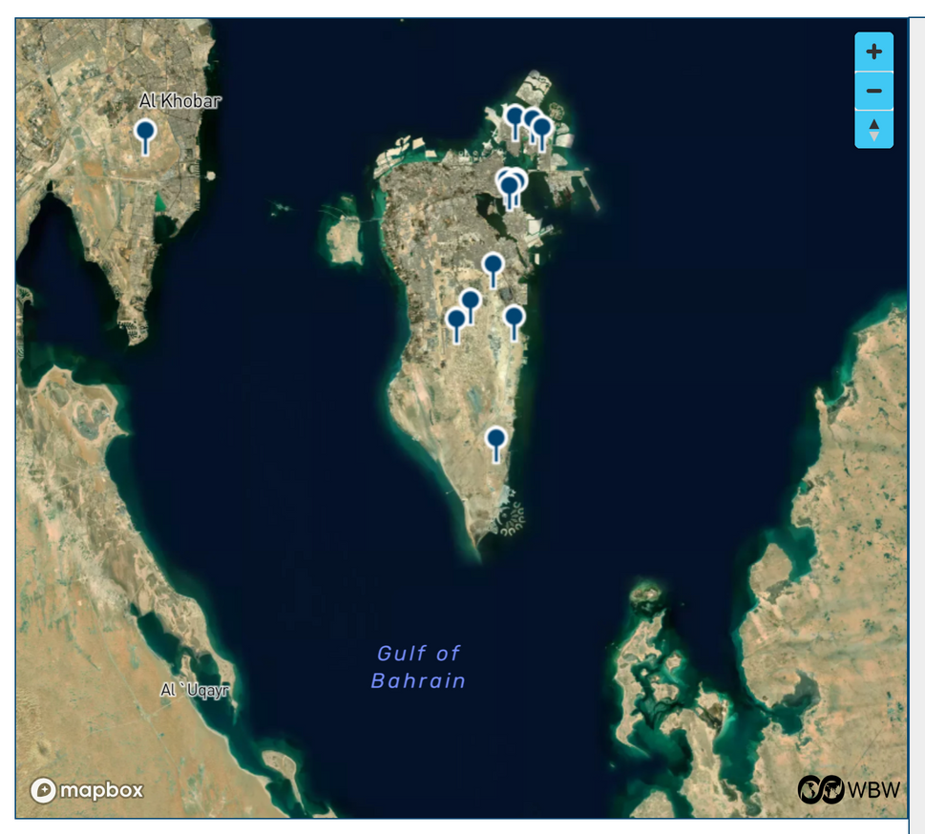
Propping Up Bad Governments
Domestic or foreign, a military base can help an unpopular government stay in power.
Notes:
Domestic bases are often nowhere near borders.
U.S. foreign bases are located in many of the most oppressive nations, where they support the abusive governments of Bahrain, Egypt, Gabon, Iraq,
Israel, Jordan, Oman, Qatar, Saudi Arabia, Syria, Thailand, Uganda, and United Arab Emirates, among many others.
A dozen U.S. bases in a tiny island dictatorship like Bahrain can be a more prominent and impactful presence than a larger number of U.S. bases in a larger nation, such as Italy.

Slide 6
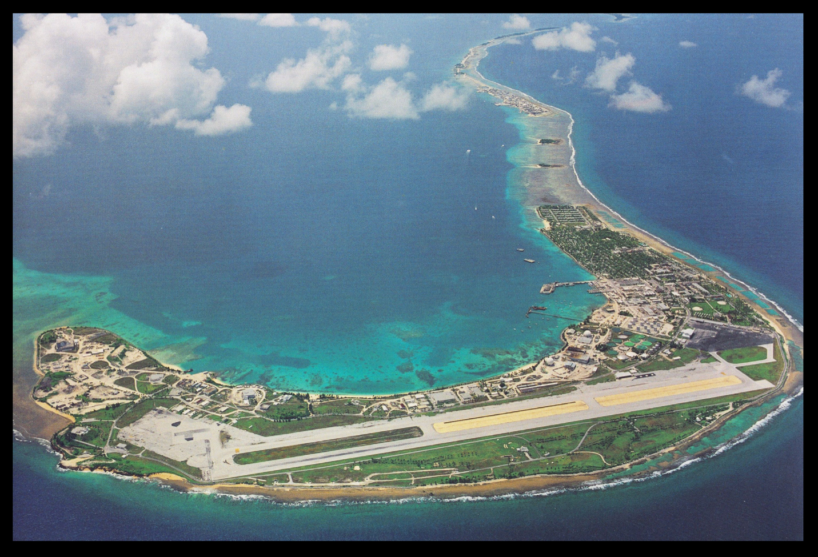
Extending Colonialism
  Stolen land.
  Apartheid zones.
  Criminal immunity.
Notes:
Foreign bases create zones of prostitution, drunkenness, and reckless, abusive, and criminal behavior, including sexual assault and rape. Beyond the obvious, large-scale disasters of airplanes crashing into ski-lifts or buildings, are the small-scale personal crimes that cannot be prosecuted by host countries and add up to something of an epidemic in some areas, such as Okinawa. Interacting with loneliness, frustration, and criminal immunity, is often a culture of superiority, if not contempt, toward local populations -- the people who speak another language, have other customs, are themselves subject to the laws of the land, and are sometimes brought onto a base to do menial labor for low pay while being afforded second-class rights on that base and being forbidden to live there or remain there after dark.

Slide 7
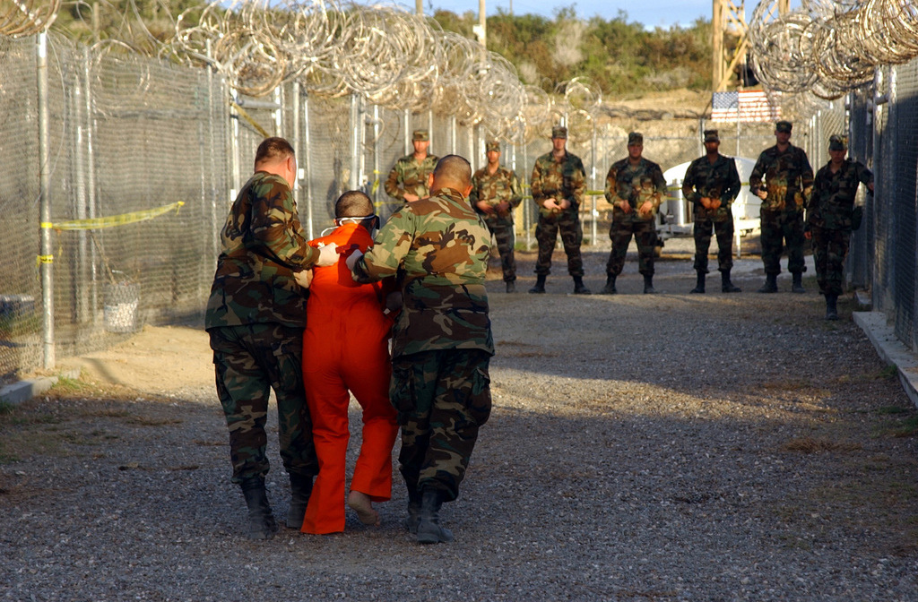
Lawless Zones
  Guantanamo, Abu Ghraib, secret sites.
  Kidnapping people and locking them up at domestic and then foreign bases.

Slide 8
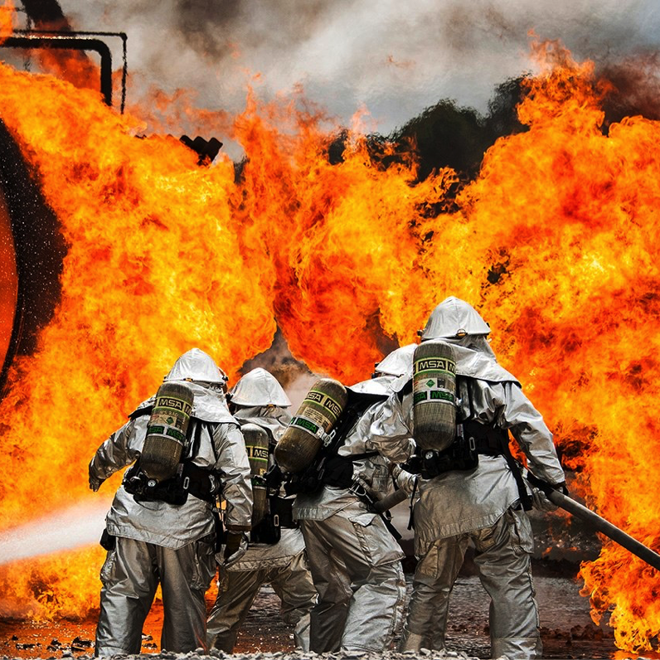
Damaging the Environment
  Climate.
  Impediments to cooperation.
  Air, land, water, noise.
  Land and money needed for wind/solar.
(Bases, already connected by rail lines where power lines could run, could be rapidly made into green energy sites and actually DEFEND people.)
Notes:
Bases -- and the weapons manufacturing, troops and weapons transporting, war re-
hearsals, and wars they facilitate -- cause irreparable environmental damage. The
exhaust of U.S. planes and vehicles causes significant degradation of air quality. U.S. military single biggest institutional consumer of fossil fuels, etc.
Toxic chemicals from the bases enter the local water sources, and jets create enormous noise pollution. The U.S. military is the single biggest consumer of fossil fuels and producer of
greenhouse gas emissions in the world, yet this is rarely acknowledged during discussion of climate change. In fact, the United States insisted on an exemption for reporting military emissions in the 1997 Kyoto Protocol. Most host country agreements were made in the years before many environmental regulations were in place, and even now, the standards and laws that have been created for the U.S. do not apply to U.S. foreign military bases.

Slide 9
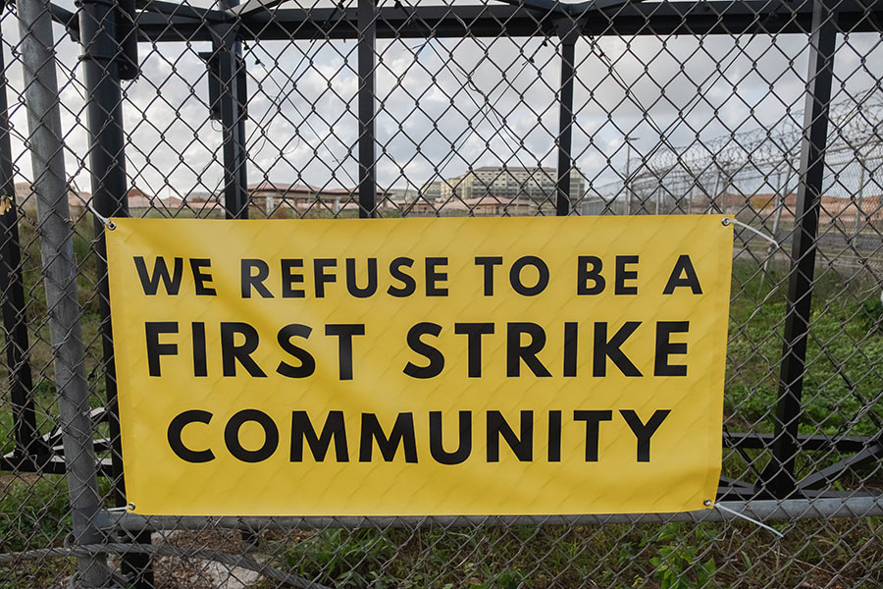
Facilitating Conflict
  Foreign military bases make it easier to launch missiles and wars into nearby nations.
  Domestic bases near borders do the same.
  Bases make the areas they are in targets.
Notes:
While such capability can be described as “defensive,” nothing can cause those in the region’s other nations to believe it. U.S. bases in Romania and Poland significantly increased tensions w/ Russia, contributing to the development of the war in Ukraine. The U.S. government went through the motions of claiming that those bases, capable of launching missiles into Russia, would be either targeting Iran, or were simply jobs programs for U.S. weapons makers, or were purely defensive. These claims went over as well as anything said about Russian missiles in Cuba had gone over in the U.S. during the Cuban Missile Crisis. U.S. bases and troops have provoked terrorist threats, radicalization, and anti-U.S. propaganda. Bases near Muslim holy sites in Saudi Arabia were a major recruiting tool for al-Qaeda, and excuse for the criminal attacks of September 11, 2001. Bases constructed as part of a so-called war on terror have been part of a dramatic, and predictable, increase in terrorism.

Slide 10
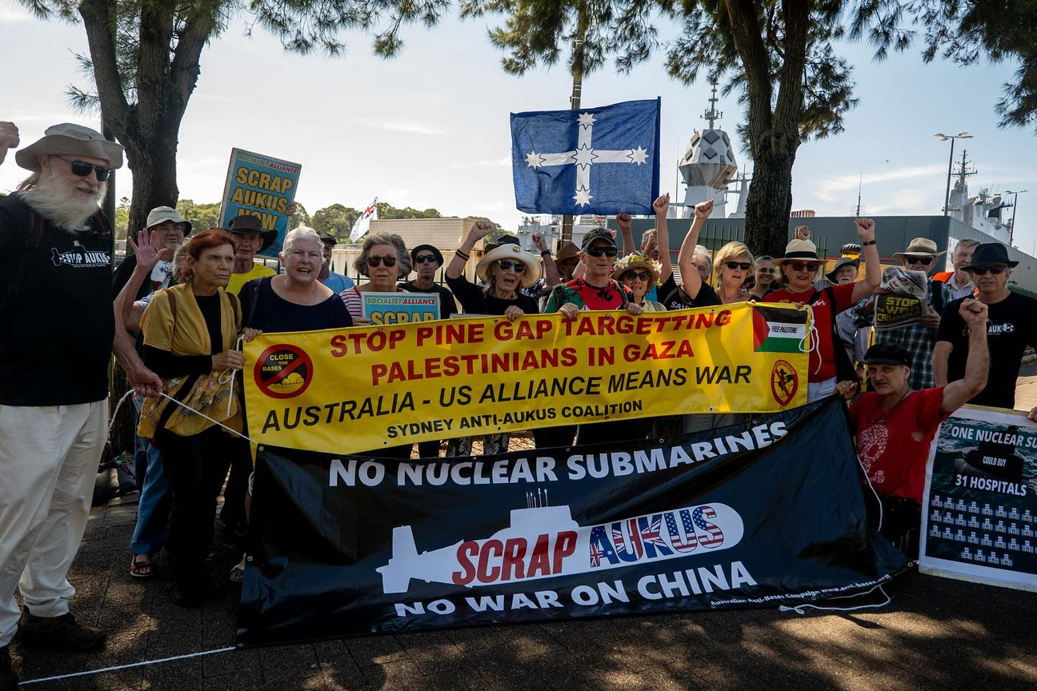
Violating Self-Governance
  Foreign military bases deny the people of “host” nations, and domestic bases deny the people of a locality or region, the right to decide or even know environmental impacts, types of weapons present, war plans.
Notes:
Nations with foreign bases are not even permitted to know what sort of provocation or danger those bases may contain. The Australian government has publicly supported the right of the U.S. government not to tell the Australian public whether or not there have been or will be
nuclear weapons in Australia. Such weapons could be brought into Australia, and the Chinese
or other governments could become aware of it, while the people of Australia -- and perhaps even the government that supposedly represents them -- could remain ignorant. This is a recipe for blowback -- for hostility directed at a country for reasons its population has no knowledge of and certainly never asked for. More provocative than the mere presence of bases, or of weapons of mass destruction on those bases, is the “exercises” or rehearsals for war that troops stationed at such bases spend much of their time on when not engaged in war.

Slide 11

Wasting Desperately Needed Money
  Bases waste funds needed urgently for human and environmental protection.
Notes:
Bases rarely create sustainable, healthy local economies. Compared with other forms of economic activity, they represent unproductive uses of land, employ relatively few people for the expanses occupied, and contribute little to local economic growth. Research has consistently shown that when bases finally close, the economic impact is generally limited and in some cases actually positive — that is, local communities can end up
better off when they trade bases for housing, schools, shopping complexes, and other forms of economic development. To make matters worse for host countries, the U.S. President has recently demanded that more of them pay the U.S. government for the privilege of allowing it to maintain its bases. Bases, and the weapons and troops that go with them, are a huge financial expense for a base-operating country like the United States, whose government officials talk frequently about trying to save money, even while dramatically increasing military spending, which includes at least $80 billion a year for foreign bases. That kind of money could, rather than going into something that nobody asked for, something that endangers us rather than protecting us, could be invested elsewhere and do a world of good.

Slide 12
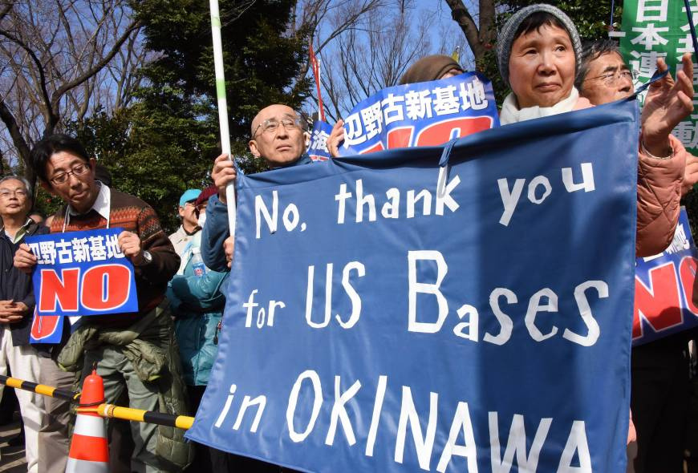
The Movement to Close Bases
  daytoclosebases.org
Notes:
Local people have built popular movements to prevent planned bases and to close existing
bases at many locations around the world, and increasingly they are in touch with each other.
On February 23, 2025, and surrounding days, individuals and organizations around the world took coordinated action in their communities (60+ actions in 27 countries) to call for the closure of all military bases as part of the Global Day of Action to Close Bases.
The Governor of Okinawa has repeatedly visited the United States to insist that military bases be closed. This past September, he remarked in Washington, D.C., “During this visit to the U.S., in addition to the felonious crimes committed by U.S. military personnel, the new Henoko base construction, PFAS issues, and the solid implementation of the U.S. Forces recommission we would like to appeal for efforts to ease tension and build trust through people diplomacy and dialogue so that Okinawa will never become a battleground.” He is up against the governments of the United States and Japan.

Slide 13
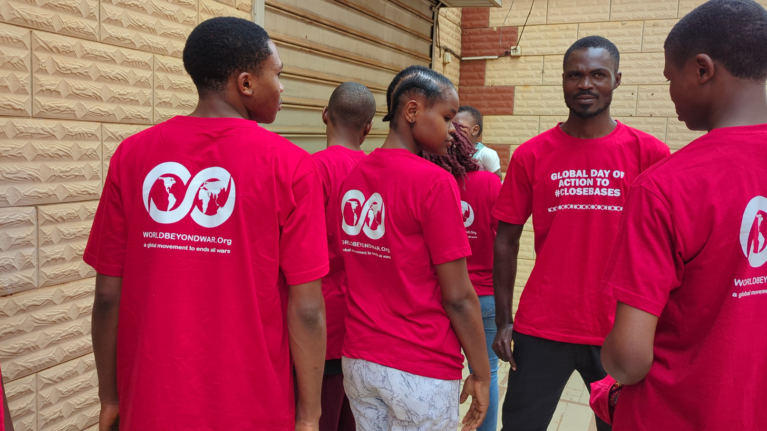
No Bases In Africa
  Initiatives in Africa to close foreign military bases are part of a broader movement of decolonization and the reaffirmation of peoples’ sovereignty.
  Bases have been closed or foreign troops withdrawn in Niger, Mali, Burkina Faso, and Chad.
  World BEYOND War chapters are currently leading campaigns to close bases in Djibouti and Cameroon.
Notes:
Initiatives in Africa calling for closing foreign military bases are part of a broader movement of decolonization and the reaffirmation of African peoples’ sovereignty.
Thanks to the determination of some leaders and popular movements, bases have been closed or foreign troops withdrawn in Niger, Mali, Burkina Faso, and Chad.
In the same spirit, World BEYOND War chapters are currently leading campaigns for the closure of foreign bases in Djibouti and Cameroon.

Slide 14

Success Stories
  Sinjajevina
  Czechia
  Colombia
  Vieques
  Hawaii
Notes:
On February 12, 2024, after years of struggle, supported by World BEYOND War and others, the Save Sinjajevina campaign met with the Prime Minister of Montenegro and gained his promise that there would be no military training ground built at Sinjajevina in Montenegro. This was to have been a massive and destructive project for the benefit of NATO and the U.S. military. It now seems clear that it will not happen.
In 2006, people in the Czech Republic learned of plans to create U.S. bases in their country. They organized and prevented those bases from being built. In 2007 localities in the Czech Republic held referenda that matched national opinion polls and demonstrations; their opposi-
tion moved their government to refuse to host a U.S. base.
In Colombia, a popular movement has prevented construction of a base for use by the U.S. military on Providencia Island, and a new movement to prevent such a base on Gorgona Island is drawing on the lessons from that success.
On Vieques, off Puerto Rico, the U.S. Navy displaced thousands of inhabitants between 1941 and 1947, announced plans to evict the remaining 8,000 in 1961, but was forced to back off and — in 2003 — to stop bomb-
ing the island.
Hawaiians won back a whole island in 2003.

Slide 15
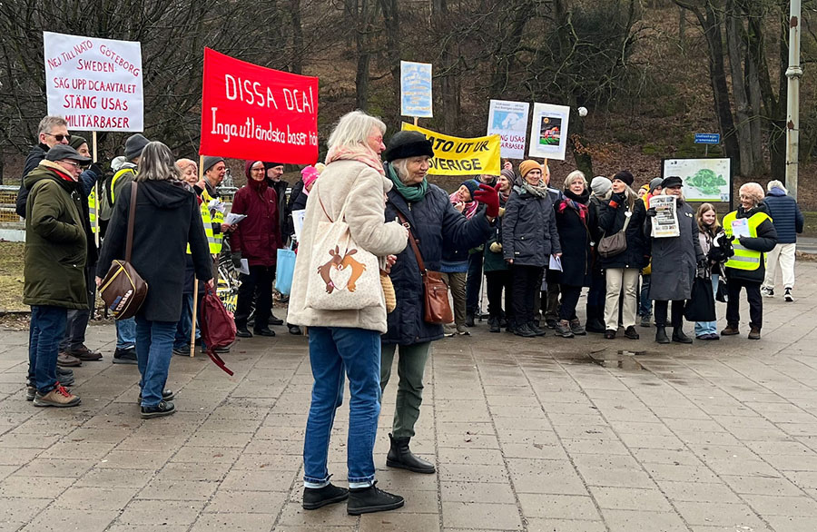
Resources Available
worldbeyondwar.org/bases
  Mapping tools
  Campaigns
  Reports
  Films and videos
  Speakers
  Articles
  Images
Notes:
We are stronger together.
Share what you are doing through World BEYOND War with others around the world.

