Slide 1

AFRICOM & NATO: OUT OF AFRICA
AUGUST 13, 2025
COLONEL (RET) ANN WRIGHT

Slide 2
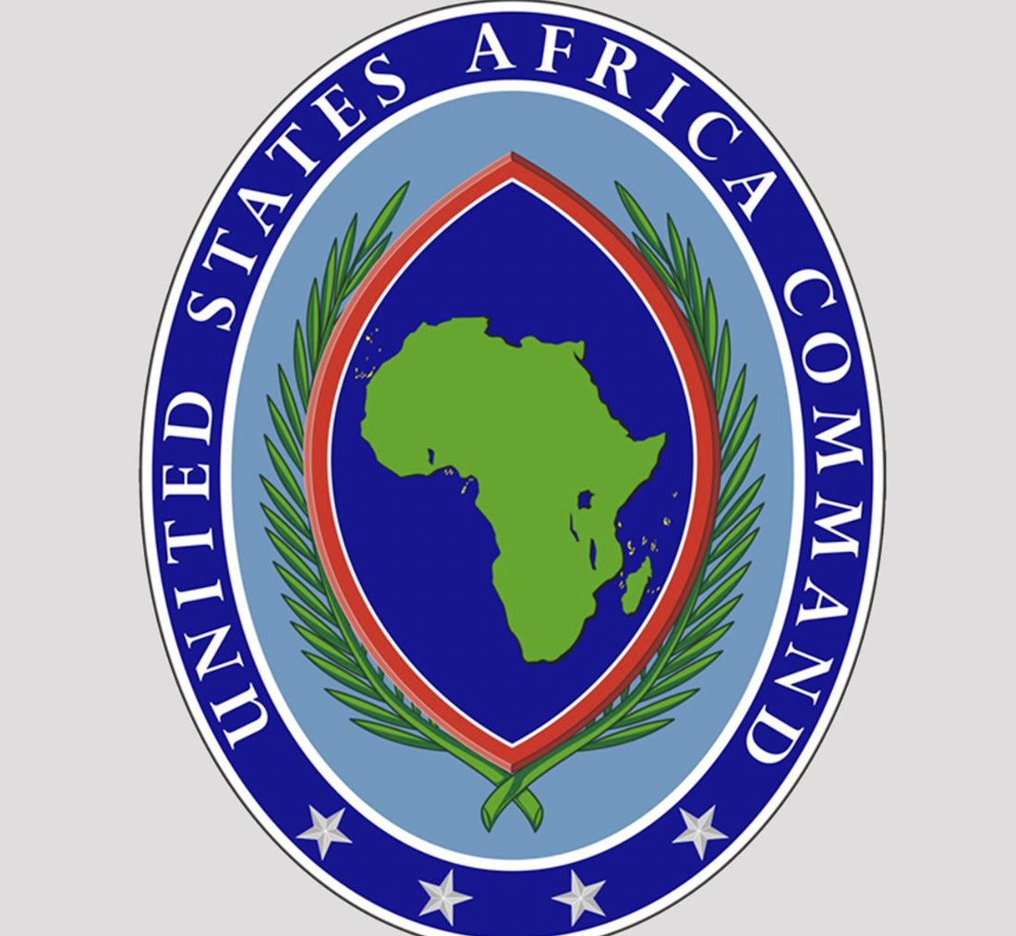

Slide 3
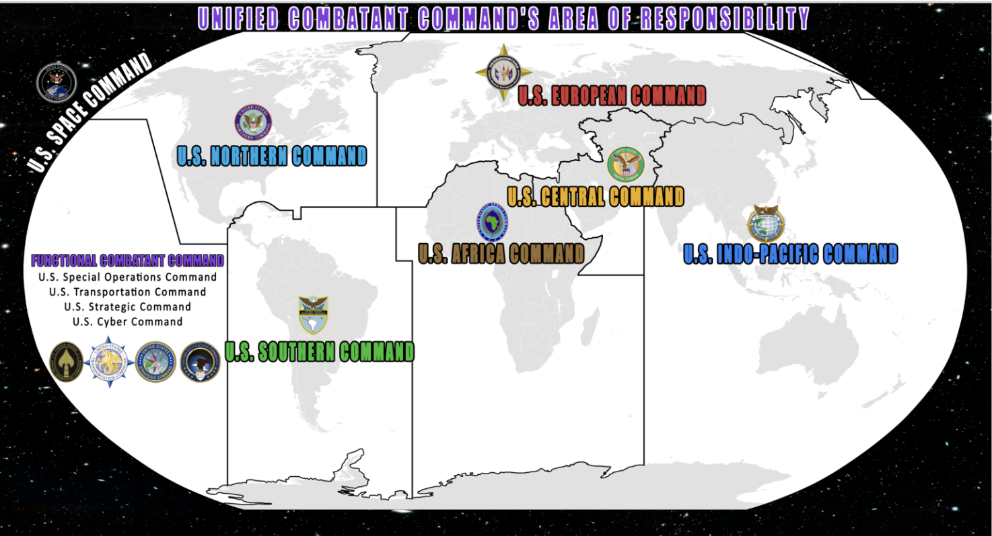
US Military Commands Divide the World

Slide 4
AFRICA COMMAND https://www.africom.mil/
https://www.africom.mil/

Slide 5
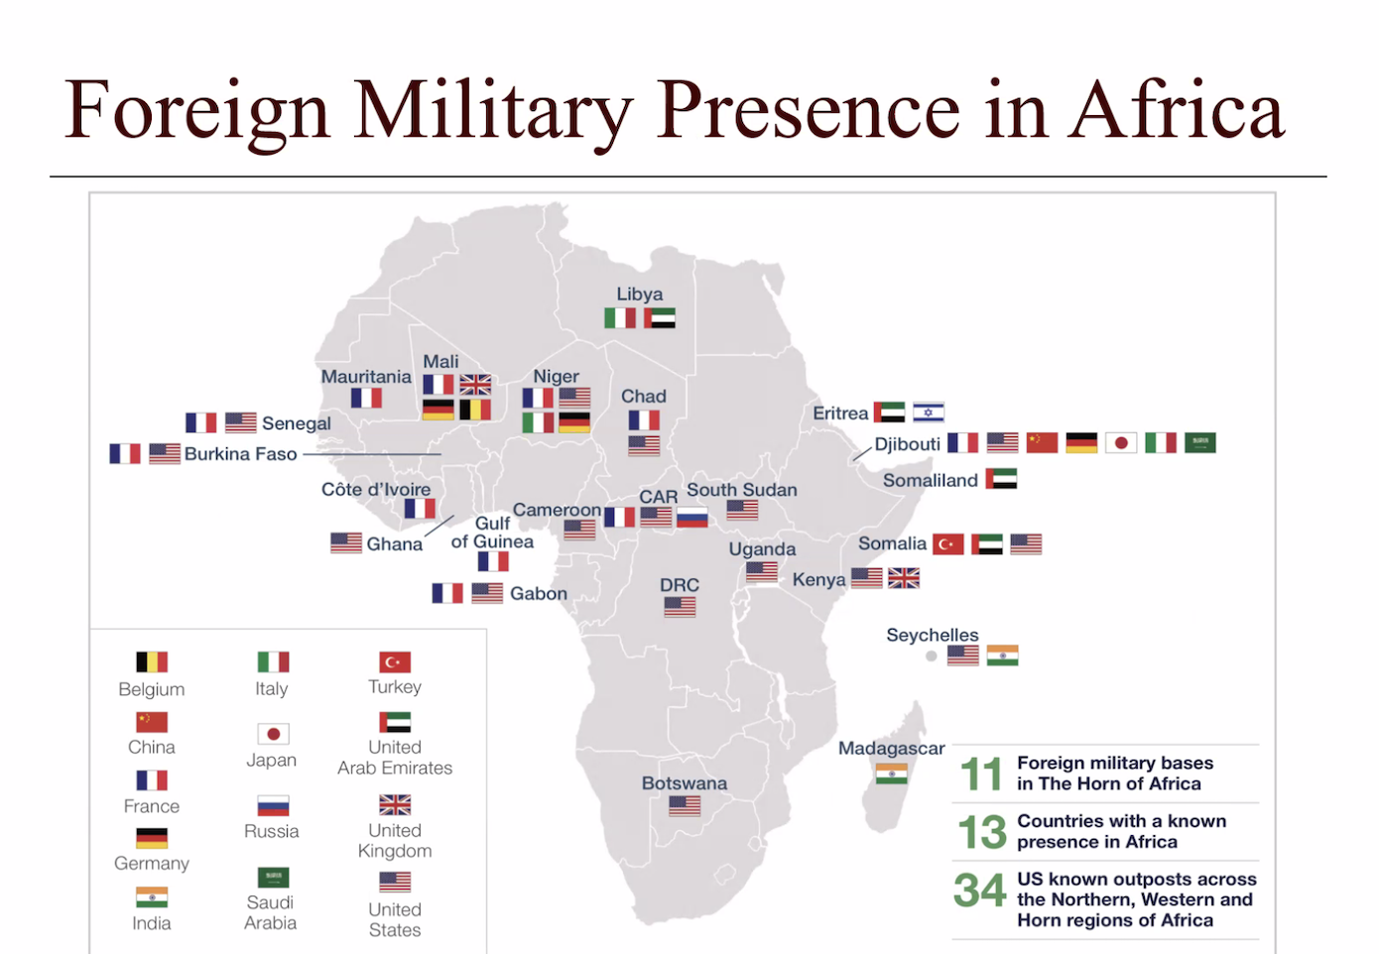

Slide 6

AFRICOM’S STAFF
2,000 assigned personnel, including military, U.S. federal civilian employees, and U.S. contractor employees.
1,400 work at the command's headquarters in Stuttgart, Germany at same location as US European command/NATO
Others are at MacDill Air Force Base, Florida, and RAF Molesworth, U.K.
AFRICOM Programs in US EMBASSY Offices of Security Cooperation and Defense Attaché Offices in approximately 38 nations.
Liaison officers the African Union, the Economic Community of West African States, and the Kofi Annan International Peacekeeping and Training Centre in Ghana.

Slide 7
MORE STAFF OF AFRICOM
Senior Foreign Service officers in key positions as well
More than 30 personnel from more than 10 U.S. government departments and agencies, including the Departments of State and Homeland Security, and the U.S. Agency for International Development
Senior State Department official serves as the deputy to the commander for civil-military engagement.

Slide 8
US/NATO Forces in AFRICOM
U.S. Army Southern European Task Force, Africa - Operating from Vicenza, Italy, SETAF-AF conducts sustained security engagement with African land forces to promote security, stability and peace.
U.S. Naval Forces Africa - Headquartered in Naples, Italy, U.S. Naval Forces Africa's primary mission is to improve the maritime security capability and capacity of African partners. Personnel are shared with U.S. Naval Forces Europe.
U.S. Air Forces Africa - As the air component of U.S. Africa Command, U.S. Air Forces Africa conducts sustained security engagement and operations to promote air safety, security, and development in Africa. Located at Ramstein Air Base, Germany, U.S. Air Forces Africa personnel are combined with U.S. Air Forces Europe
U.S. Marine Corps Forces Africa - Located in Stuttgart, Germany, U.S. Marine Corps Forces Africa conducts operations, exercises, training, and security cooperation activities throughout Africa. Its staff is shared U.S. Marine Corps Forces Europe.
Combined Joint Task Force-Horn of Africa - Headquartered at Camp Lemonnier in Djibouti, Combined Joint Task Force-Horn of Africa is the U.S. Africa Command organization that conducts operations in the region to enhance partner nation capacity, promote regional security and stability, dissuade conflict, and protect U.S. and coalition interests.
U.S. Special Operations Command Africa - Co-located with U.S. Africa Command at Kelley Barracks in Stuttgart, U.S. Special Operations Command Africa aims to build operational capacity, strengthen regional security and capacity initiatives, and eradicate violent extremist organizations.

Slide 9
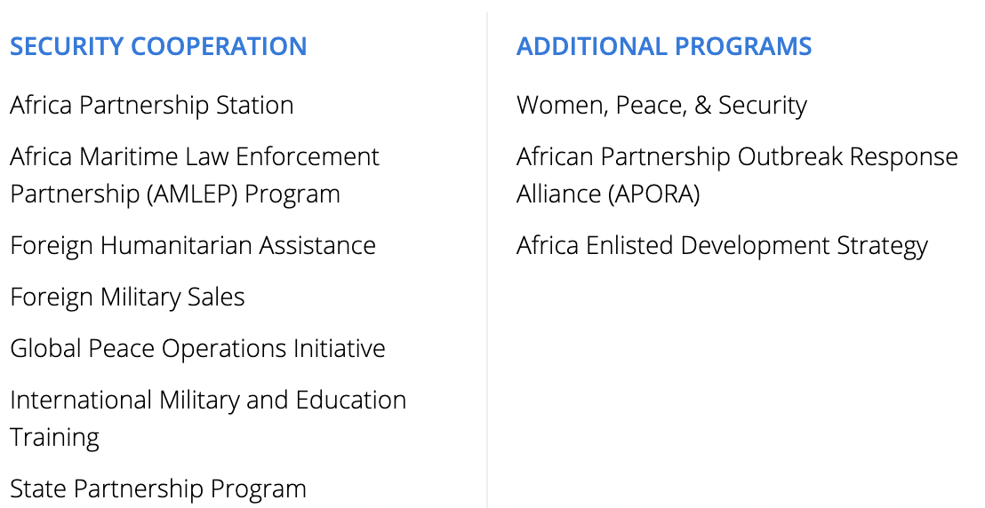
PROGRAMS OF AFRICOM

Slide 10
WITHDRAWL OF US MILITARY FROM NIGER AFTER MILITARY COUP
Withdrawal of U.S. forces from Air Base 101 in Niamey on July 7, 2024
Withdrawal from Air Base 201 in Agadez on Aug. 5, 2024. (1,000)
The U.S. Africa Command Coordination Element, consisting of a two-star General Officer and staff, departed from Niger.
Withdrawal completed September 15, 2024.
Over the past decade, U.S. trained Niger's forces and supported partner-led counterterrorism missions against Islamic State and al Qaeda in the region.
Replaced by Russian trainers from Wagner Group

Slide 11

AFRICOM IN THE NEWS https://www.africom.mil/media-gallery/articles
West Africa Logistics Conference Hosted by U.S. Africa Command, Armed Forces of Liberia
USAFE-AFAFRICA, Algeria Conduct Aeromedical Exchange
EUCOM/AFRICOM Host Joint Industry Forum
U.S. and Kenya Conclude Successful 2025 African Chiefs of Defense Conference in Nairobi
AFRICOM, Kenya, Kickoff 2025 African Chief of Defense Conference
Winning the Peace through Religious Collaboration
U.S. Military Chaplains Increase Readiness at SADC Chaplains Conference

Slide 12
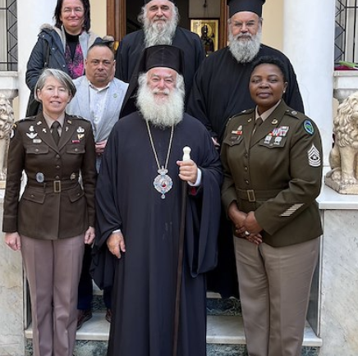
CHAPLAINS FOR “PEACE” THROUGH MILITARY
U.S. chaplain delegation led by U.S. Africa Command Chaplain Colonel Karen Meeker conducted collaborative meetings to bring stability through faith and new avenues of collaboration in support of the warfighter while in Cairo, Egypt, March 17, 2025.

Slide 13
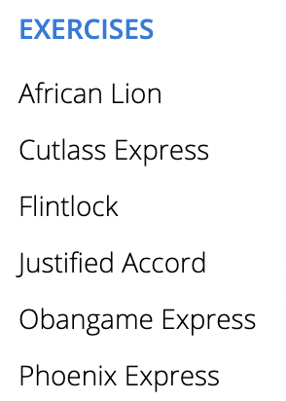
MILITARY EXERCISES OF AFRICOM with NATO forces

Slide 14

AFRICAN LION EXERCISE 2024 with NATO forces
The 2024 edition of AFRICAN LION took place from April 19 to May 31 across Morocco, Ghana, Senegal, and Tunisia,
iover 8,100 participants from 27 nations, including NATO contingents.
between geographic combatant commands—USAFRICOM, USEUCOM, and USCENTCOM—
in close proximity to key maritime chokepoints and global shipping lanes, all of which magnifies the exercise’s significance

Slide 15
FLINTLOCK 2024 with NATO forces
FLINTLOCK, focused on counterterrorism and irregular warfare, brings together special operations forces
More than 30 nations to conduct realistic training, share best practices,

Slide 16
PHOENIX EXPRESS & SILENT WARRIOR
IN TUNISIA
2024-2025, Tunisia hosted the 19th iteration of PHOENIX EXPRESS, a 12-day exercise that brought together North African, European, and U.S. naval forces as part of a global network to enhance cooperation and expertise in maritime security operations in the Southern Mediterranean Sea.
Tunisia also hosted SILENT WARRIOR 2024, an event dedicated to enhancing operational effectiveness and mission success of African Special Operations Forces.

Slide 17
MOROCCO-TRAINING HUB
Morocco serves as a regional leader by providing training to more than 1200 African partners annually, often at zero cost to the trainees.
The training provided includes every level of military education from basic training to War College, spans all services, and includes professional medical, intelligence, airborne, and special operations training.
September 2025 -state-of-the-art Peacekeeping Center of Excellence in Morocco, with the capacity to train thousands of personnel
Moroccan trainers travel to neighboring countries using U.S.-produced C-130 aircraft to transport and train partner personnel in a myriad of tasks and skills.

Slide 18
AIRSTRIKES OF AFRICOM https://www.africom.mil/what-we-do/airstrikes/2025-airstrikes
2025 47+ Airstrikes – 47+ in Somalia
2024 10 Airstrikes – 10 in Somalia
2023 15 Airstrikes- 15 in Somalia
2022 11 Airstrikes – 11 in Somalia
2021 9 Airstrikes -9 in Somalia
2020. 35 Airstrikes - 35 in Somalia
2019 53 Airstrikes - 3 in Libya, 50 in Somalia
2018 35 Airstrikes -all in Somalia
2017 33 Airstrikes -3 in Libya, 30 in Somalia
2016 495 Airstrikes in Libya, 9 in Somalia

Slide 19
How Military Operations in Somalia 25 Years Ago Influence Operations in Afghanistan, Iraq, Syria and Yemen Today
How Military Operations in Somalia 25 Years Ago Influence Operations in Afghanistan, Iraq, Syria and Yemen Today
https://www.codepink.org/how_military_operations_in_somalia_25_years_ago_influence_operations_in_afghanistan_iraq_syria_and_yemen_today

Slide 20
Resources for Webinar on AFRICOM
https://www.africom.mil/media-gallery/articles
https://www.facebook.com/Insideafrica0/posts/african-countries-with-foreign-military-bases/895761646099587/
https://apnews.com/article/niger-united-states-troops-army-military-bases-junta-sahel-coup-1ae5334bc68eb6b45e1e2d612bfb2b6f
https://www.africom.mil/what-we-do/airstrikes/2025-airstrikes

Slide 21
AFRICOM & NATO: OUT OF AFRICA
AUGUST 13, 2025
COLONEL (RET) ANN WRIGHT

Slide 25
AFRICOM & NATO: OUT OF AFRICA
DECEMBER 20, 2022
COLONEL (RET) ANN WRIGHT

Slide 26
U.S. /NATO
MILITARY
FORCES IN
AFRICOM
U.S. Army Southern European Task Force, Africa - Operating from Vicenza, Italy, SETAF-AF (NATO co-located)
U.S. Naval Forces Africa - Headquartered in Naples, Italy, (NATO co-located)
U.S. Air Forces Africa - As the air component of U.S. Africa Command, U.S. Air Forces Africa Located at Ramstein Air Base, Germany
U.S. Marine Corps Forces Africa - Located in Stuttgart, Germany, U.S. Marine Corps Forces Africa conducts operations, exercises, training, and security cooperation activities throughout Africa. (NATO co-located)
Combined Joint Task Force-Horn of Africa - Headquartered at Camp Lemonnier in Djibouti, Combined Joint Task Force-Horn of Africa is the U.S. Africa Command organization that conducts operations in the region to enhance partner nation capacity, promote regional security and stability, dissuade conflict, and protect U.S. and coalition interests.
U.S. Special Operations Command Africa - Co-located with U.S. Africa Command at Kelley Barracks in Stuttgart, U.S. Special Operations Command Africa (NATO co-located)

Slide 27
LAST AFRICOM AIRSTRIKE IN 2022
At the request of the Federal Government of Somalia, U.S. Africa Command conducted two collective self-defense strikes, one each on Dec. 14 and 17, 2022, in support of Somali National Army engagements against al-Shabaab near Cadale, Somalia.
The Dec. 14 strike took place 176 kilometers northeast of Mogadishu, in the vicinity of Cadale. 7 al-Shabaab terrorists were killed.
The Dec. 17 strike took place approximately 220 kilometers northeast of Mogadishu, also in the vicinity of Cadale. The command’s initial assessment is 8 al-Shabaab terrorists were killed.
U.S. Africa Command’s initial assessment is that no civilians were injured or killed in either strike.
U.S. Africa Command takes great measures to prevent civilian casualties. Protecting civilians remains a vital part of the command’s operations to promote greater security for all Africans.

Slide 28
AFRICAN LION EXERCISE with NATO forces
African Lion 22, the 2022 iteration of U.S. Africa Command’s largest and premier annual exercise, involved more than 7,500 service members from June 6 - 30.
African Lion 22 executed in four countries: Morocco, Ghana, Senegal and Tunisia.
Militaries from Brazil, Chad, France, Italy, the Netherlands and the United Kingdom will join U.S. and host nation troops.
U.S. participants come from all service components, including the Reserves and National Guard.

Slide 29
NUMBER OF AFRICOM AIRSTRIKES IN 2022
Date | News release
Dec. 14 & 17, 2022 | Federal Government of Somalia combats terrorists
Nov. 9, 2022 | Federal Government of Somalia combats terrorists with support from U.S. forces
Nov. 3, 2022 | Federal Government of Somalia engages terrorists with support from U.S. force
Oct. 23, 2022 | Federal Government of Somalia engages terrorists with support from U.S. forces
Oct. 1, 2022 | U.S. forces conduct strike in Somalia targeting al-Shabaab leader
Sept. 18, 2022 | Federal Government of Somalia engages terrorists with support from U.S. forces
Aug. 14, 2022 | Somali, U.S. forces engage insurgents in support of the Federal Government of Somalia
Aug. 9, 2022 | Somali, U.S. forces engage insurgents in support of the Federal Government of Somalia
July 17, 2022 | Somali, U.S. forces engage insurgents in support of the Federal Government of Somalia
June 3, 2022 | Somali, U.S. forces engage insurgents in support of the Federal Government of Somalia
Feb. 22, 2022 | Somali, U.S. forces engage insurgents in support of the Federal Government of Somalia

Slide 30
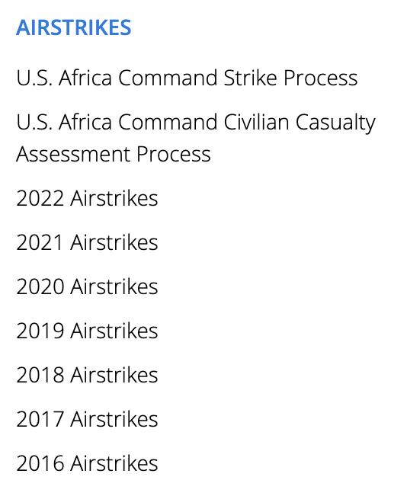
AIRSTRIKES OF
AFRICOM
2022 11 Airstrikes – 11 in Somalia
2021 9 Airstrikes -9 in Somalia
2020. 35 Airstrikes - 35 in Somalia
2019 53 Airstrikes - 3 in Libya, 50 in Somalia
2018 35 Airstrikes -all in Somalia
2017 33 Airstrikes -3 in Libya, 30 in Somalia
2016 495 Airstrikes in Libya, 9 in Somalia

Slide 31
FLINTLOCK with NATO forces
More than 1,300 service members from more than 30 African and partner nations participated in Flintlock 2022 in Senegal and across Africa from Feb. 1-28, 2022.
Flintlock 2022 was hosted by Senegal, with an additional training location hosted for the first time in Cote d’Ivoire.
articipating African nations include Benin, Burkina Faso, Cabo Verde, Cameroon, Chad, Cote d’Ivoire, Gambia, Ghana, Guinea-Bissau, Mauritania, Morocco, Niger, Nigeria, Senegal, and Tunisia.
International participants include Austria, Belgium, Brazil, Canada, the Czech Republic, France, Germany, the Netherlands, Norway, Poland, Portugal, Spain, the United Kingdom, and the United States. Other nations are participating as observers.

Slide 32
How Military Operations in Somalia 25 Years Ago Influence Operations in Afghanistan, Iraq, Syria and Yemen Today
How Military Operations in Somalia 25 Years Ago Influence Operations in Afghanistan, Iraq, Syria and Yemen Today
https://www.codepink.org/how_military_operations_in_somalia_25_years_ago_influence_operations_in_afghanistan_iraq_syria_and_yemen_today

Slide 33
AFRICOM & NATO: OUT OF AFRICA
DECEMBER 20, 2022
COLONEL (RET) ANN WRIGHT

