Slide 1
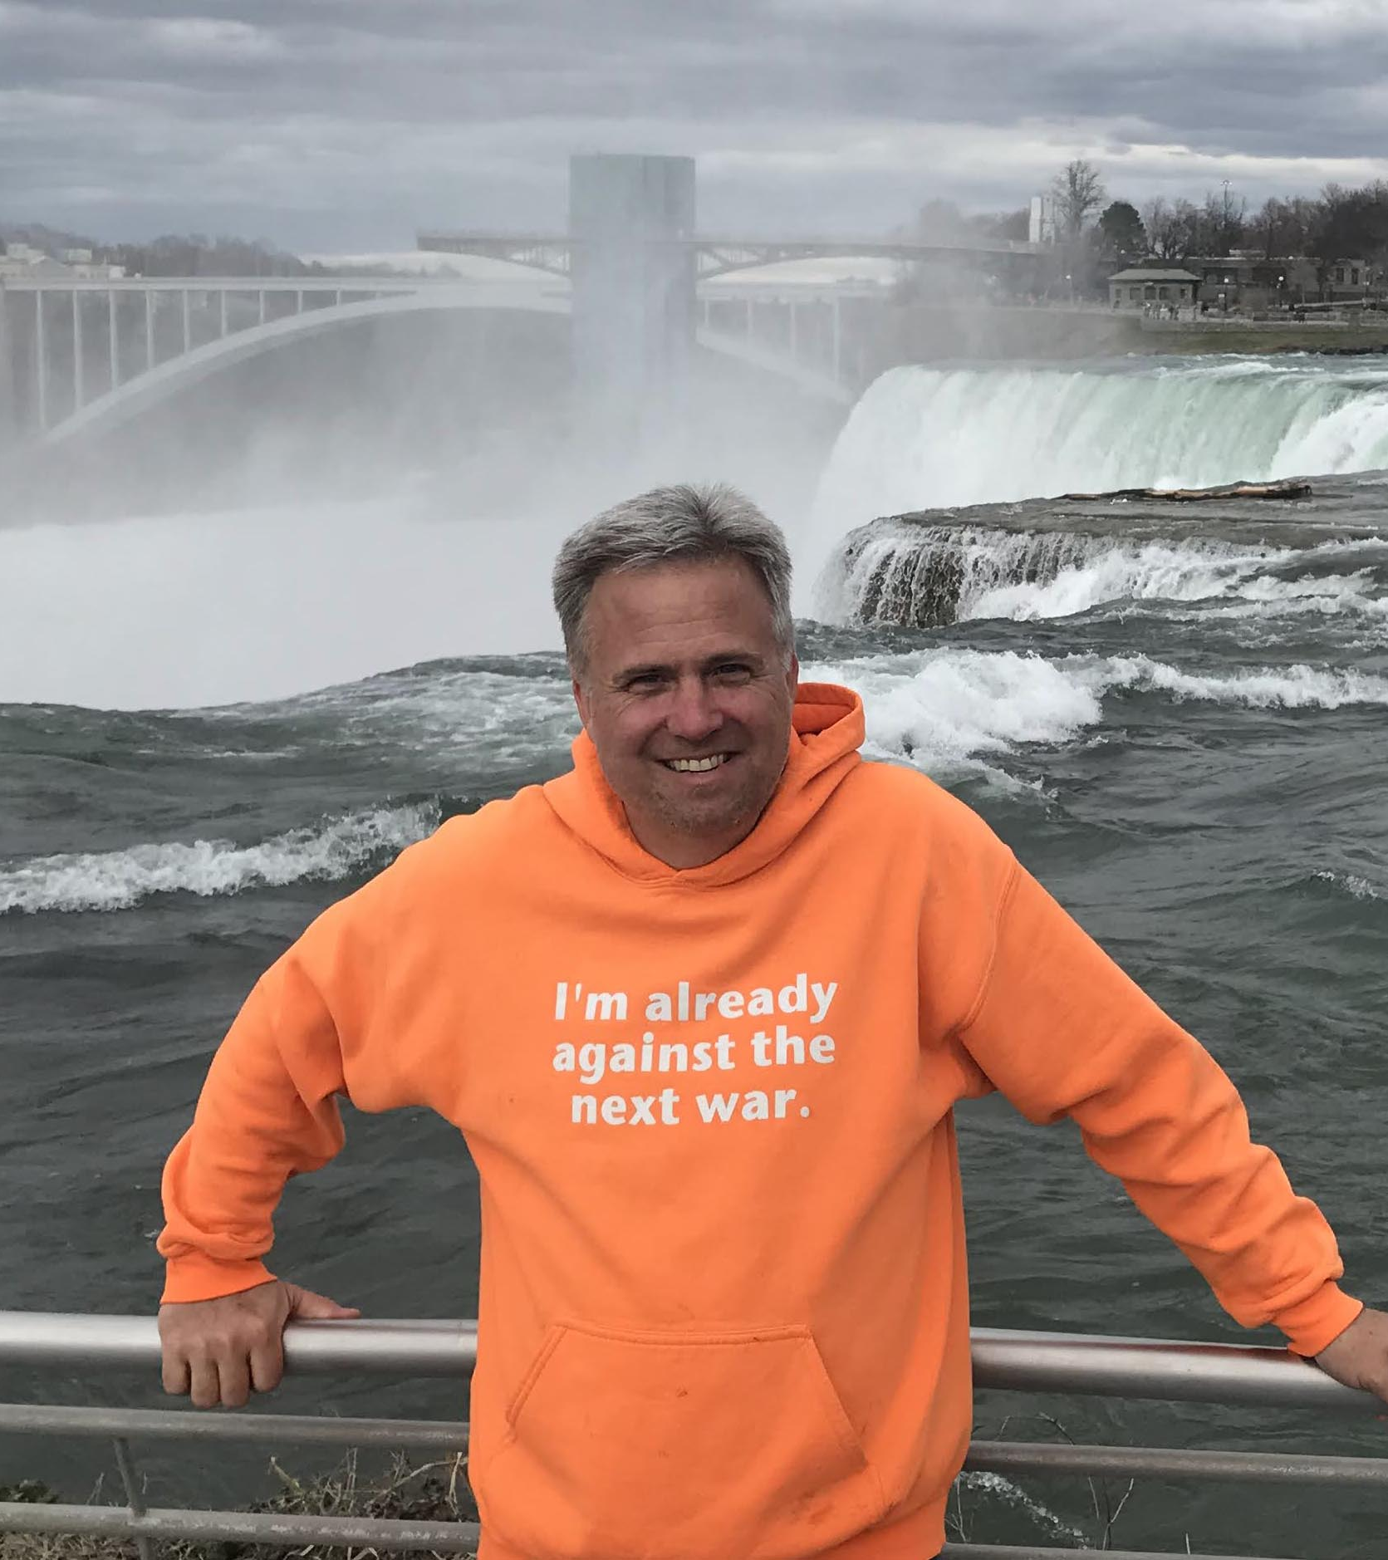
Why I’m Already Against the Next War
David Swanson
April 24, 2022

Slide 2
Starvation
Until wars become nuclear, military budgets kill more than weapons.
Famines generated directly by wars also kill more than weapons.
Famine looms in Africa from Ukraine war.
2010 drought in Ukraine led to hunger and possibly in part to the Arab Spring.
We need to end the war and allow the planting.
The U.S. government needs to stop treating weapons as (40% of its) “aid,” stop starving Yemen, stop stealing needed funds from Afghans, and stop opposing an immediate ceasefire and negotiated peace in Ukraine.

Slide 3
Nuclear Apocalypse
In a recent U.S. poll, almost 70% were concerned that Ukraine war could lead to nuclear war.
No doubt, no more than 1% have done anything about it. Why?
Most people are skillfully and disastrously and absurdly convinced that popular action is powerless.
Most people are skillfully and disastrously and absurdly convinced that nuclear war can be contained to some portion of the globe, that humanity can survive nuclear war, that nuclear war is not all that different from other war, and that morality allows or even requires during times of war the complete abandonment of morality.
We’ve come within minutes of accidental nuclear apocalypse many times.
U.S. Presidents who, like Vladimir Putin, have made specific public or secret nuclear threats to other nations: Truman, Eisenhower, Nixon, Bush I, Clinton, Trump.
Obama, Trump, others have said “All options are on the table.”
Russia and U.S. have 90% of the world’s nukes, missiles pre-armed, and first-use policies.

Slide 4
Climate Collapse
War swallows the funding and attention needed to protect the Earth. Militaries and wars are huge contributors to the destruction of the climate and Earth. They block cooperation between governments. They create suffering through disruption of current fuel sources. They allow the celebration of increased fossil fuel use – releasing reserves, shipping fuels to Europe. They distract obedient media from reports.

Slide 5
Finally War Victims Reported on with Sympathy: But Can it Be Expanded to All?
First article Google finds me for “Ukraine war” is typically different from first one it finds me for “Yemen war.”

Slide 6
Ask the World to Support What U.S. and Russia Do Not
International Court of Justice
International Criminal Court
Treaties on Disarmament
Treaties on Human Rights
Demilitarization
Unarmed Civilian Defense Plans
Peace Education
Democratization of the United Nations
That the world’s leading weapons supplier to the worst oppressive governments, arming and funding almost all of them, can be understood by the people supposedly in charge of it to be leading global efforts to oppose oppressive governments is the greatest propaganda accomplishment there is.

Slide 7
What to Do
Send aid. Support peace. Educate. Organize.
Demand of U.S. government:
no to any no-fly zone
a declaration of no nuclear weapons use
no more weapons shipments
empower Ukraine to negotiate an end to sanctions on Russia
a major push for a ceasefire and negotiated settlement
stop blocking negotiations
stop demanding regime change in Russia
(don’t forget Yeltsin)
stop expanding NATO

Slide 8
Solution Is Not More of What Created Problem
Russia could have prevented the invasion of Ukraine by not invading Ukraine. Europe could have prevented the invasion of Ukraine by telling the U.S. and Russia to mind their own business. The United States could almost certainly have prevented the invasion of Ukraine by any of the following steps, which, in most cases, U.S. experts warned were needed to avoid war with Russia:
Abolishing NATO when the Warsaw Pact was abolished.
Refraining from expanding NATO.
Refraining from supporting color revolutions and coups, accepting Russia’s proposal of Ukrainian neutrality in 2014.
Supporting nonviolent action, training in unarmed resistance, and neutrality.
continued. . .

Slide 9
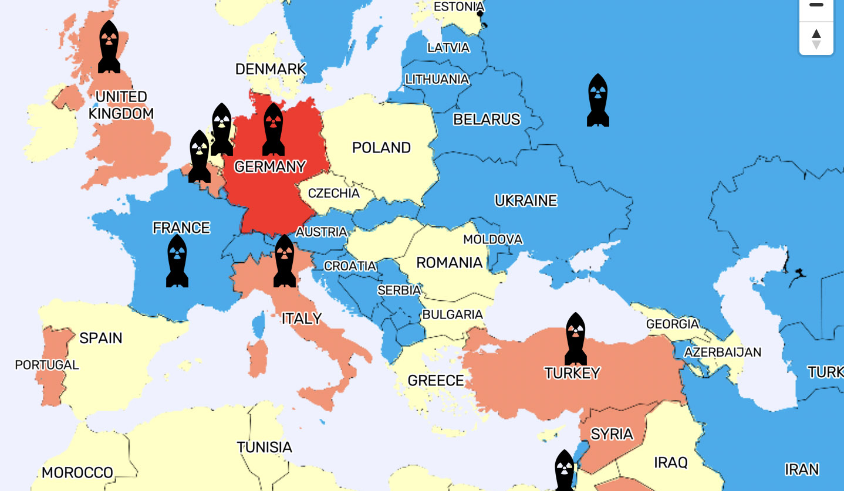
Transitioning from fossil fuels.
Supporting Zelensky on Minsk in 2019.
Refraining from arming Ukraine, weaponizing Eastern Europe, and conducting war rehearsals in Eastern Europe.
Accepting Russia’s perfectly reasonable demands in December 2021.
Refraining from supporting the increased Ukrainian artillery use in Donbas that immediately preceded the Russian invasion.

Slide 10
Imagine what was/is possible
Either the U.S. or Russia or both could have saved money turning Ukraine into a fossil-fuel-free neutral paradise.

Slide 11
But How Do You Stop an Invasion?
Don’t work to create it
Resist it with its opposite, not its mirror image (we reject death penalty because studies prove it ineffective on its own terms, we look at the climate and yell “the science!” – why must we ignore the evidence on nonviolence?)
Be willing to negotiate before and during
In general, support the rule of law, disarmament, and cooperation.

Slide 12
Listen to the Ukrainian Pacifist Movement
“We condemn the Russian decision to invade Ukraine on 24 February 2022, which led to a fatal escalation and thousands of deaths, reiterating our condemnation of the reciprocal violations of the ceasefire envisaged in Minsk agreements by Russian and Ukrainian combatants in Donbas prior to the escalation of Russian aggression. We condemn the mutual labeling of parties to the conflict as Nazi-like enemies and war criminals . . . . We emphasize that the tragic consequences of military brutality must not be used to incite hatred and justify new atrocities, on the contrary, such tragedies should cool the fighting spirit and encourage a persistent search for the most bloodless ways to end the war. We condemn military actions on both sides, the hostilities which harm civilians. We insist that all shooting should be stopped, all sides should honor the memory of killed people and, after due grief, calmly and honestly commit to peace talks.”

Slide 13
Debunk the Myths
https://worldbeyondwar.org/inevitable
https://worldbeyondwar.org/just
https://worldbeyondwar.org/necessary
https://worldbeyondwar.org/beneficial

Slide 14
The reasons to end all war
https://worldbeyondwar.org/immoral https://worldbeyondwar.org/endangers https://worldbeyondwar.org/liberties https://worldbeyondwar.org/bigotry https://worldbeyondwar.org/2trillion https://worldbeyondwar.org/impoverishes https://worldbeyondwar.org/alternative

Slide 15
Resources
Use World BEYOND War events, courses, books, videos, maps, flyers, fact sheets, speakers, chapters, affiliates.
Book Clubs Every Month https://worldbeyondwar.org/bookclubs
Upcoming Online Course: Leaving WWII Behind https://worldbeyondwar.org/education

Slide 16
Billboards
https://worldbeyondwar.org/billboardsproject

Slide 17
Divestment Campaigns
Divest more local governments of weapons and fossil fuels
Educate in the process
Build alliances in the process
Encourage people with a victory
Create an organization
https://worldbeyondwar.org/divest

Slide 18
Dude, where’s your policy?
2020 successful Democratic candidates (incumbents and newcomers) for U.S. House:
22% of campaign websites had no platform at all
71% had no foreign policy
66% of the new Democrats elected had no foreign policy
74% of foreign policy platforms (all incumbents) backed continued or increased militarism
14% of them backed decreased militarism

Slide 19
It’s just the majority of the discretionary spending and 96% of humanity.
Oppose Military Spending
How do you apply for 40% of a job?
The central project of the U.S. government is war.
This makes the U.S. government fundamentally different from local or state governments or the governments of other countries.
Notes:
U.S. military spending dwarfs the cost of most infrastructure and social needs spending legislation, the cost of any other item (or dozen items) of discretionary spending, and the military spending of any other nation.
In 2020, U.S. military spending was more than the military spending of the next 11 biggest spenders combined, nine of which nations were U.S. weapons customers pressed by the U.S. government to increase their military spending. The next 14 biggest spenders below the top 12 were the only others to spend over 1% of U.S. military spending, and of those 14, 11 were U.S. weapons customers. In 2020 military spending per capita, the U.S. government led all others, and 21 of the next 22 were U.S. weapons customers.

