Slide 1
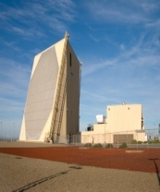
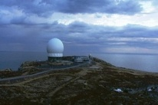
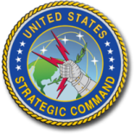
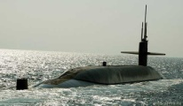
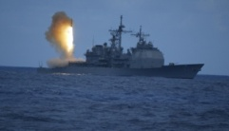
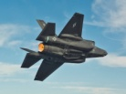
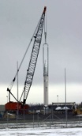
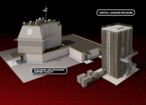
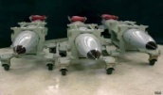
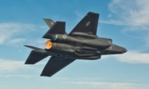
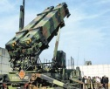
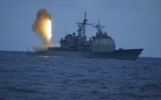
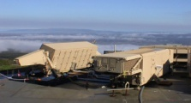
EWR
EWR
DCA
EWR
24 SM-3 in Poland
U.S.B-52
DCA
24 SM-3 in Romania
CVN TF
CVN
24 SM-3 in Romania
AN/TPY-2 in Turkey
4 U.S. AEGIS SHIPS in Spain
1. U.S. MD & TNW in Europe. Biden’s
Presidency

Slide 2
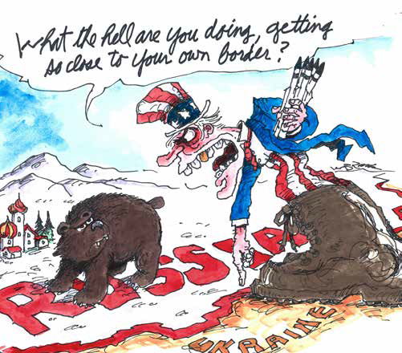

Slide 3
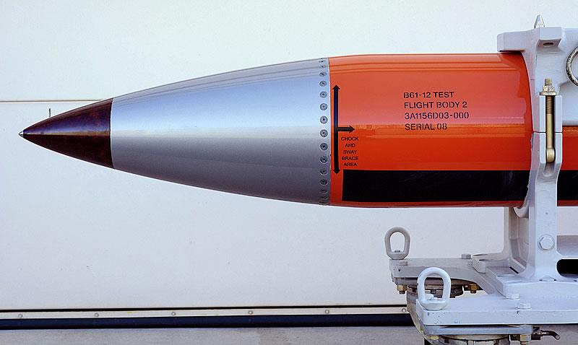
2. NEW U.S. NUCLEAR BOMB
В 61-12 TO BE DEPLOYED IN EUROPE:
FROM 0,3 kt to 50 kt

Slide 4
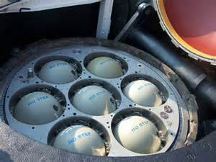
3. U.S. strategic non-nuclear capabilities in SSGN:726-729
154 SLCM x 4
= 616 SLCM
SSGN: Ohio, Michigan, Florida, Georgia
© Vladimir Kozin. 2021

Slide 5
4. U.S. NEGATIVE ATTITUDE TOWARDS ARMS CONTROL TREATIES
NEW START/Договор СНВ-3 (2010) …………………………. violations
INF TREATY/ ДРСМД (1987) ..117 violations & withdrawal in 2019
Open Skies Treaty/ДОН (1992)……violations and withdrawal in 2020
NPT/ДНЯО (1967) ………………………………………………… violations
CWC/ КЗХО (1993) ……………………………………………………violations
JCPOA/СВПД (2015)…………………………………… withdrawal in 2018
ABM TREATY/ ДПРО (1972) …………………………………. withdrawal in 2002
CTBT/ ДВЗЯИ (1996) ……………………………………………………..no-ratification
ARMS TRADE TREATY//МДТО (2013) ………………….. withdrawal in 2019
CFE-1A/ДОВСЕ-1А (1999)………………………………………no-ratification
European Security Treaty/ДЕБ (2009)………………. refusal to debate
PAROS /ДПРОК (2008) ………………………………………………. refusal to debate
INCSEA Extension/ расширение СПИОМ (1972) ……… refusal to debate

Slide 6
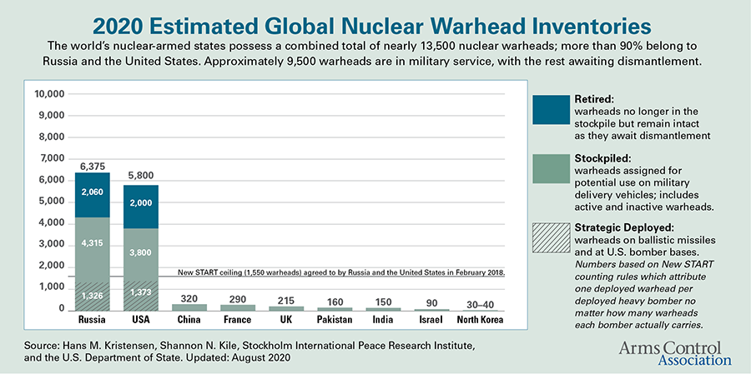
5. NW BALANCE BETWEEN THE USA AND THE PRC (USA) (CHINA)
5800:320=18
Source: ACA. 2021

Slide 7
6. NEW U.S. MEDIUM-RANGE CAPABILITY MISSILES
November 6, 2020 Lockheed Martin and the U.S. Army signed nearly $340 million contract to forge a new medium-range missile prototype. It is to be fielded in FY 2023. The Army has selected variants of the U.S. Navy SM-6 and Tomahawk cruise missiles to be part of the initial prototype.
Some experts claimed that the new missile would have conventional warheads only.
Source: Judson J. “Lockheed Martin to build mid-range missile prototype for US Army// Defence News. November 6, 2020// https://www.defensenews.com/land/2020/11/06/lockheed-martin-to-build-mid-range-missile-prototype-for-us-army/
© Vladimir Kozin. 2021

Slide 8
7. NEW U.S. MEDIUM-RANGE GROUND-BASED MISSILES WILL BE NUCLEAR-TIPPED: SOME REASONS
1. The Pentagon claimed that such missiles will be able to hit enemy targets in the 500-2,000 kilometers range and more, because according to the INF Treaty “medium range” means range from 1,000 to 5,500 kilometers.
2. According to the U.S. officials, such missiles will have “strategic capabilities” that “will change the paradigm against advanced adversaries Russia and China”, and “will changes everything in the European and Pacific theaters of operation”.
3. It is clear the USA will deploy new nuclear medium-range missiles both in Asia Pacific Region and in Europe. It became clear from the U.S. Defense Secretary Mark Esper's remarks at the Atlantic Council October 20, 2020.
4. From the U. S. strategic perpective, it will be irrational to equip such new missiles with conventional warheads.
Source: Judson J. ”Lockheed Martin to build mid-range missile prototype for US Army”// Defence News. November 6, 2020//https://www.defensenews.com/land/2020/11/06/lockheed-martin-to-build-mid-range-missile-prototype-for-us-army/ and “US Army hones in on solution for new mid-range missile pursuit”//Defence News//October 12,2020//https://www.defensenews.com/digital-show-dailies/ausa/2020/10/12/us-army-hones-in-on-solution-for-new-mid-range-missile-pursuit/. U.S. Army Awards Mid-Range Capability Other Transaction Agreement. Issued by U.S. Army Rapid Capabilities and Critical Technologies Office. November 6, 2020 //https://www.army.mil/article/240666/army_awards_mid_range_capability_other_transaction_agreement.
© Vladimir Kozin. 2021

Slide 9
8. THE USA HAS BLOCKED ALL THESE INITIATIVES RELATED TO SPACE
1958: accord on banning of use of space for military purposes
1979: agreements during USSR-USA ASAT talks
1983: proposals on non-militarization of space
1985: an appeal to renounce testing of ASAT weapons
1988: agreements on nuclear and space talks
2001: initiative on banning placement of weapons of any kind in space
2004: not to be the first to launch weapons into space
2008: treaty prohibiting placement of weapons in space
2011: an agreement on banning ASAT weapons in space
2014: revised treaty banning placement of weapons in space
© Vladimir Kozin. 2021

Slide 10
9. KEY TASKS OF THE USA IN SPACE
MILITARY DOMINATION IN SPACE
MAKING SPACE AS A WAR-FIGHTING DOMAIN
CREATION OF SPACE-BASED STRIKE WEAPONS,
INCLUDING MISSILE DEFENSE SYSTEMS
© Vladimir Kozin. 2021

Slide 11
10. THE DIFFERENCE BETWEEN THE COLD WAR 2.0 FROM THE COLD WAR 1.0
IT SLOWED DOWN THE OVERALL ARMS CONTROL PROCESS
TRIGGERED ON A TOUGH WAR-FLAGGING RHETORIC VS RUSSIA
USES SECRET SERVICES WHENEWER IT FEELS THAT THE USE OF MILITARY FORCES WILL BE TOO COSTLY OR TOO RISKY
INTENSIFIED NATO MILITARY ACTIVITY NEAR RUSSIAN TERRITORY BY 5 TIMES
ILLEGAL AND UNJUSTIFIED SANCTIONS HAVE BEEN IMPOSED
©Vladimir Kozin. 2014

Slide 12
11. THREE ARMS RACES: ONE OLD + TWO NEW
NUCLEAR ARMS REDUCTIONS PROCESS HAS STALLED, WITH NO HOPES FOR ITS PROMPT RESUMPTION
CHANCES FOR EMPLOYMENT OF NUCLEAR WEAPONS
IN 2014-2021 HAVE GREATELY INCREASED
20th CENTURY= NUCLEAR ARMS RACE AGE
21st CENTURY= NUCLEAR ARMS RACE AGE, MISSILE DEFENSE ARMS RACE AGE & SPACE ARMS RACE AGE
© Vladimir Kozin. 2021

Slide 13
12. PRACTICAL SUGGESTIONS (FIRST ANNOUNCED BY ME IN 2016 IN ATHENS)
(1) an agreement on the mutual non-use of nuclear weapons in a first strike, and as an intermediate step toward this goal – to formulate a mutually acceptable strategy of “defensive nuclear deterrence that threatens no one”; TPNW should be signed and ratified by all 9 NW states
(2) an accord on complete withdrawal of the U.S. tactical nuclear weapons from the European continent and the Asian part of Turkey;
(3) the USA and Romania should sign an agreement on freezing of the operational use of the U.S. MD complex in Romania and full withdrawal of all BMD interceptors installed there, to the territory of the United States; the USA and Poland have to draft an accord on freezing of construction of a similar MD complex in Poland for an indefinite period of time; a new multilateral ABM Treaty on limiting the number of MD interceptors and their geographical deployments should be also elaborated;
(4) NATO must return all its conventional forces deployed in Eastern and Southern Europe after April 1st, 2014 to their original positions;
(5) NATO must cancel the “Baltic Air Policing” operation in three Baltic nations near the Russian borders;
(6) the USA and NATO should cancel the policy to deploy the space-based weapons in space;
(7) finally, there is a need to hold in Belgrade or in Geneva a qualitatively new Conference on Security and Cooperation in Europe with the participation of all European states, as well as the United States and Canada, which would put an end to unnecessary and dangerous military confrontation on the continent, initiated by the leading countries of the Alliance.
© Vladimir Kozin. 2021

