Slide 1
Ban Killer Drones
David Swanson, May 2, 2021

Slide 2
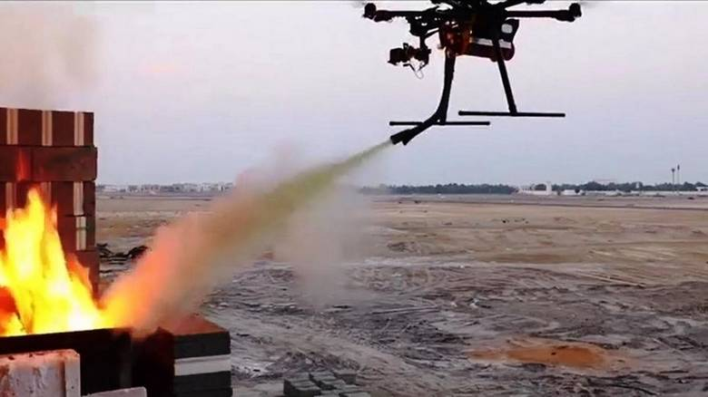
The Good Drones

Slide 3
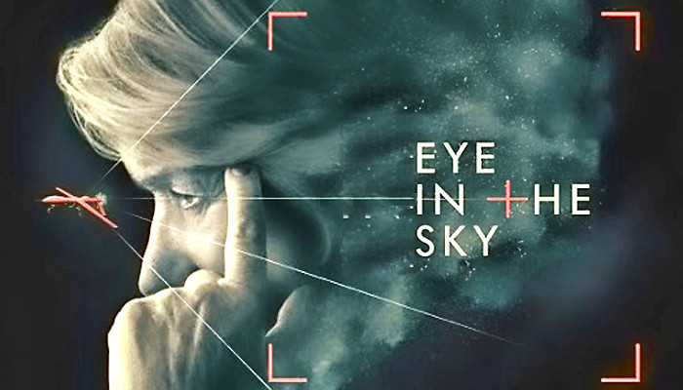
The Imaginary Drones

Slide 4
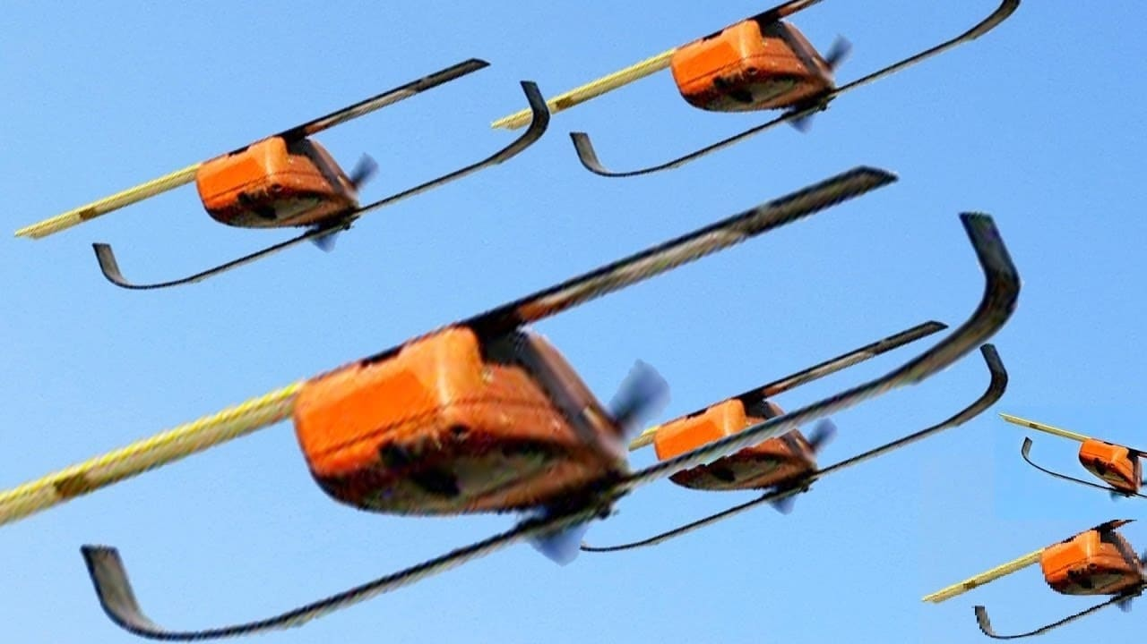
The Smart Drones

Slide 5
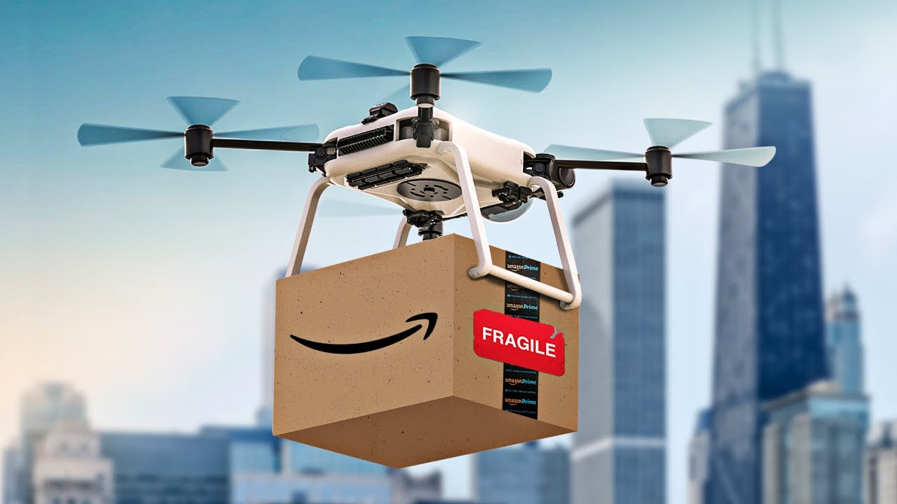
The Normalized Drones

Slide 6
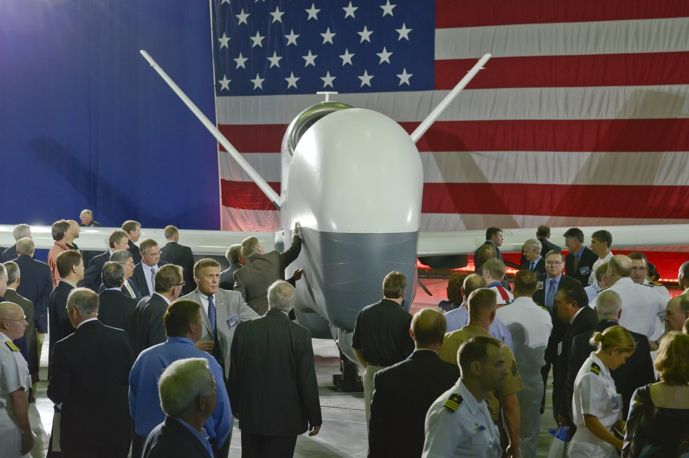
The Patriotic America-First Drones

Slide 7
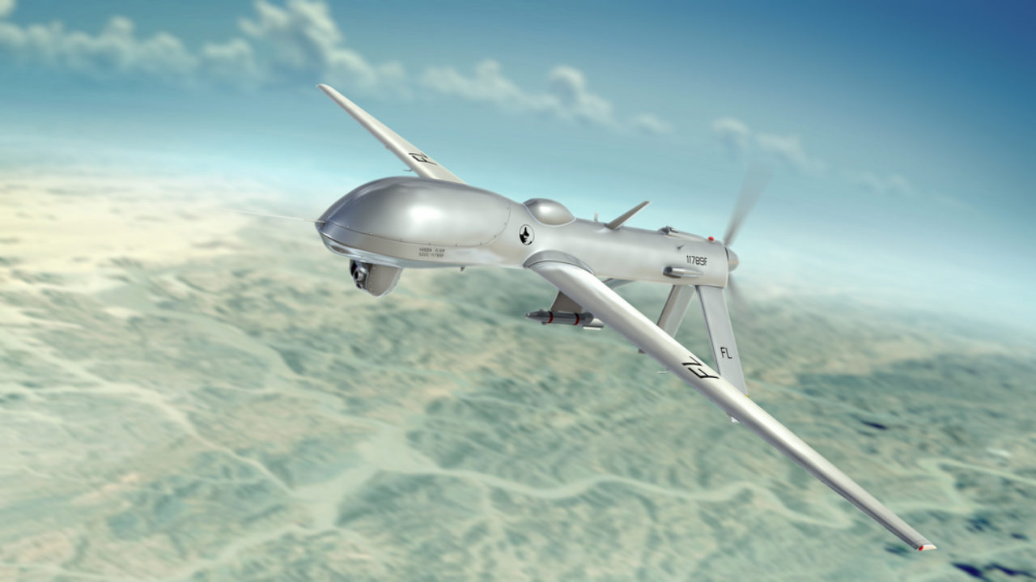
The Distant Drones

Slide 8
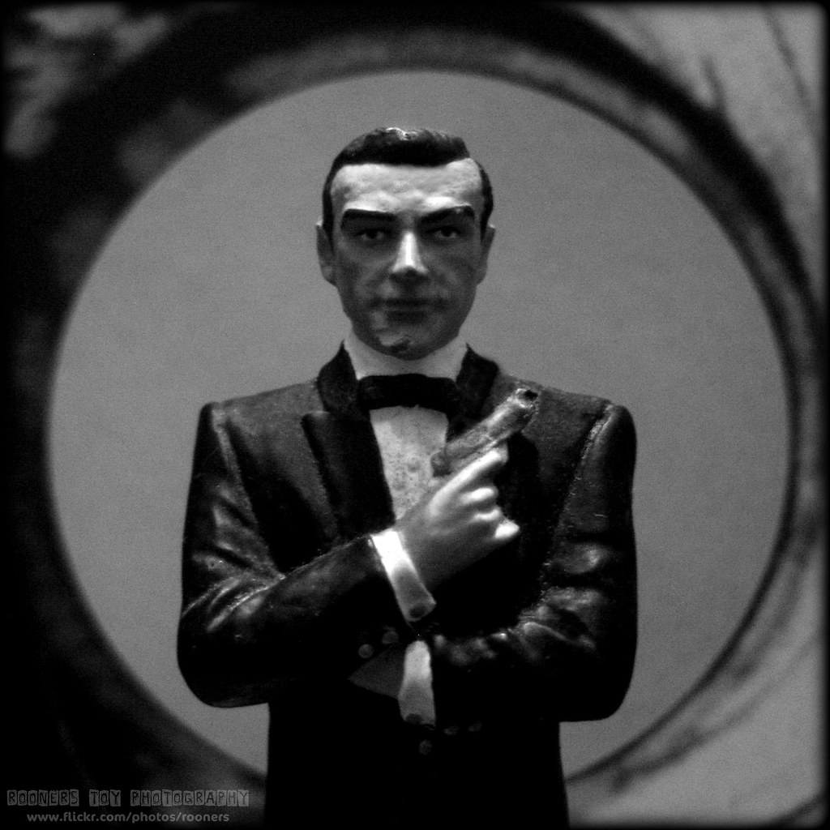
The Top Secret Drones

Slide 9
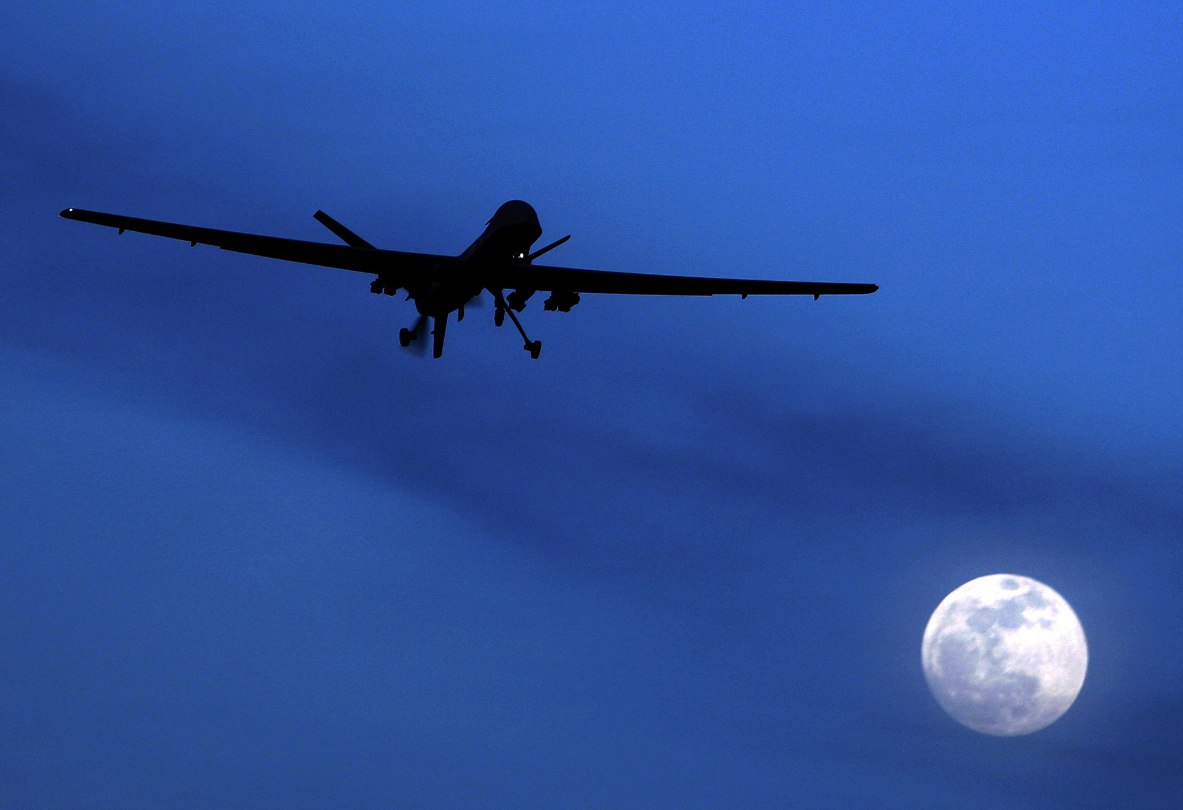
The Drones Above the Law

Slide 10
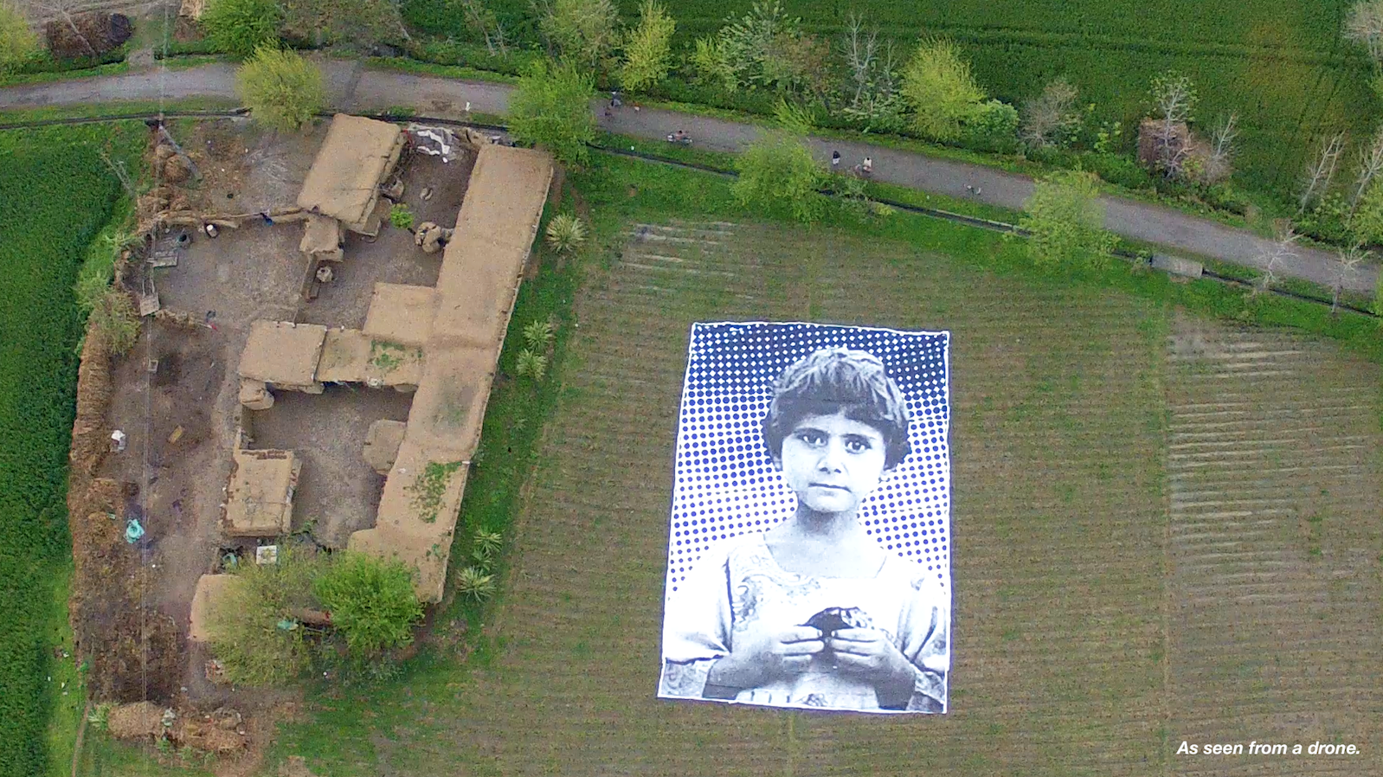
Do Non-US Lives Matter?

Slide 11
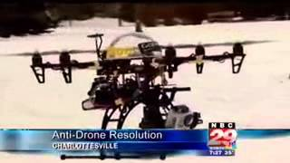
The Supposed Impossibility of Action

