Slide 1
WORLD SOCIAL FORUM 2021
PEACE & WAR
Global NATO – All Countries Are Affected By NATO
By Ann Wright

Slide 2
NATO PARTNERS IN THE PACIFIC

Slide 3
NATO IN THE PACIFIC
In the Pacific, NATO has four partners through bilateral agreements –
Japan, South Korea, Australia and New Zealand.
Australia and New Zealand have deployed many troops under the NATO banner in Afghanistan.
Japan and South Korea have had reconstruction and development projects in Afghanistan.

Slide 4
NATO’S CONCERN ABOUT CHINA
China’s “aggressive” actions in the South China Sea building 9 naval bases on atolls
China has largest navy in the world, 350 ships and submarines including over 130 major surface combatants. In comparison, the U.S. Navy’s has 293 ships as of early 2020.
Increasingly global military footprint—including the development of overseas base in Dijbouti & 9 atolls in South China Sea
Commercial contracts to manage 13 European seaports: Pireaus, Greece; Haifa, Israel & seaports in Spain, Belgium
COSCO Shipping Holdings Co. is the world’s third-biggest container line and has investments in 61 port terminals around the world.
Another Chinese State related corporation, China Merchants, manages 36 ports in 18 countries..

Slide 6
China has only two aircraft carriers-US has 13
This aircraft carrier is a converted 30 year old Soviet aircraft carrier (notice unique upswept bow for launching aircraft)

Slide 7
CHINA “THREAT” --NATO allies United Kingdom & France increased presence in the Indo-Pacific
. The United Kingdom conducted its first joint exercise with the United States in the South China Sea in 2019 and deployed the HMS Albion to conduct Freedom of Navigation (FON) exercises near the Paracel islands in August 2018.
At the Shangri-La Dialogue in 2018, French and British defense ministers announced they would sail warships through the South China Sea to challenge China‘s military expansion.
NATO countries participate in the largest naval exercise in the world every two years off Hawai’i-Rim Of the Pacific RIMPAC

Slide 8
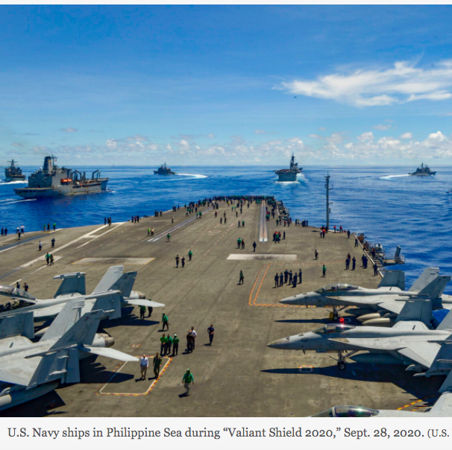
US Military Operations off Philippines in 2020

Slide 9
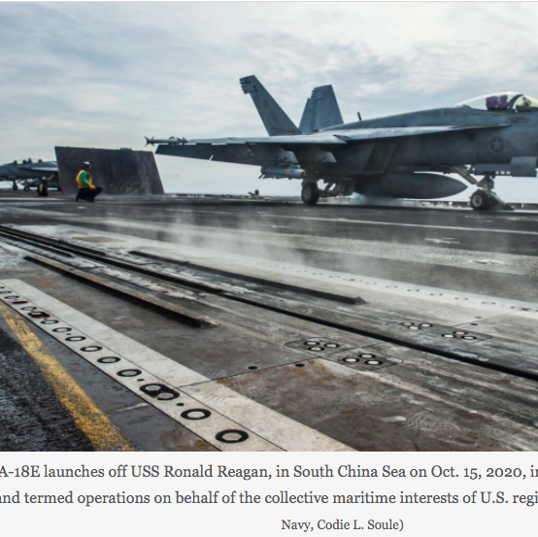
“Freedom of Navigation” in the South China Sea

Slide 14
Articles by Ann Wright on NATO/US in Pacific
Danger in the South China Sea
https://bit.ly/39g3469
US War Maneuvers in Pacific & Europe during COVID
https://bit.ly/3c7oBjh

Slide 15
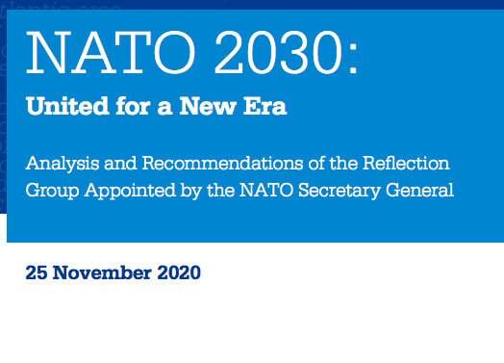
NATO’s 2030 REPORT
https://bit.ly/2MphckA

