Slide 1
Ending War Presentation for Dallas but Moved Online
David Swanson

Slide 2
The Zoom Poll we just took . . .
you think war is never ever justified.
you think some wars are sometimes justified for some participants.
Notes:
How about if you know someone who thinks some wars are sometimes justified for some participants? We’re going to come back to this.

Slide 3
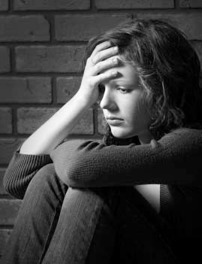
What about this one?
“Humans just can’t be rid of war, whether or not it’s ever justifiable.”
Notes:
Explain why you think that.

Slide 5
Things That Used to Be “Inevitable”
cannibalism, human sacrifice, trial by ordeal, blood feuds, dueling, polygamy, capital punishment, serfdom, plantation slavery, an all-male electorate, Jim Crow segregation, an all-male military, bans on homosexuality, the election of Hillary Clinton, safety in going outside your house, politicians at least bothering to lie about wars for oil or about caring about your life, etc.

Slide 6
War is not inevitable
Absent for most of human prehistory.
Sporadic since its creation.
Unknown to many societies.
Unlike its current form until virtually this moment.
Avoided by most who can.
Damaging to most who take part.

Slide 7
0
Number of recorded cases of post traumatic stress disorder, brain injury, moral injury, loss of limb, or suicidal tendencies as a result of war deprivation.

Slide 8
96%
Percent of humanity whose governments each spend a fraction of what the U.S. government does on war, and whose governments combined spend about what the U.S. government does on war.

Slide 9
Human Nature does not exist.

Slide 10
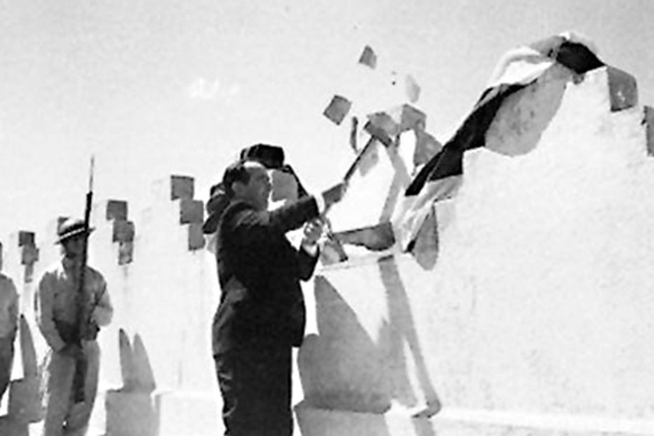
Countries with no standing army
Costa Rica, Iceland, Mauritius, Monaco, Panama, Vanuatu, Andorra, Dominica, Grenada, Kiribati, Liechtenstein, Marshall Islands, Federated States of Micronesia, Nauru, Palau, Saint Lucia, Saint Vincent and the Grenadines, Samoa, Solomon Islands, Tuvalu, Vatican City.

Slide 11
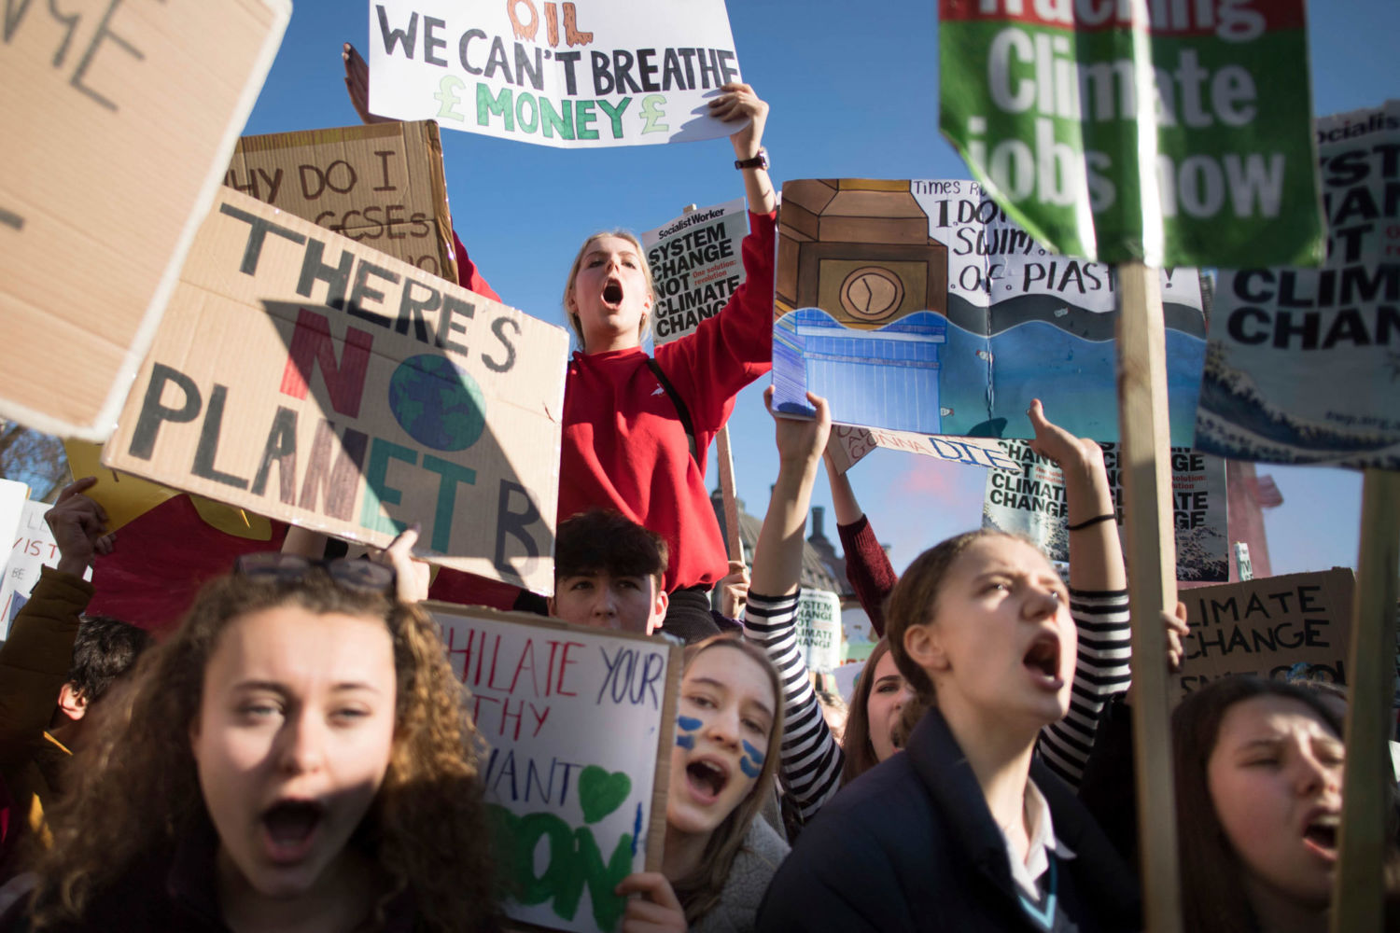
War can be ended with or without ending . . .
Capitalism,
Racism,
Carnivorism,
Environmental destruction.
But we have a larger movement if we take on multiple interlocking evils together.

Slide 13
Can the fact that politicians are openly proposing that people be sacrificed to coronavirus for profits help us to recognize that equally evil motivations drive military foreign policy?
If Joe Biden didn’t back a war on Iraq in order to avoid a war on Iraq, what did he back it for?

Slide 14
Nonviolence Denial is as dangerous as climate denial
What happened in . . . ?
Germany 1920, Germany 1923, Algeria 1961, Czechoslovakia 1968, Soviet Union 1991,

Slide 15
POP QUIZ
What tends to be present where wars are begun?
—resource scarcity,
—human rights violations in need of response,
—raw fossil fuels.

Slide 16
Notes:
Polls in the United States through the 2003-2011 war on Iraq found that a majority in the U.S. believed Iraqis were better off as the result of a war that severely damaged — even destroyed — Iraq[1]. A majority of Iraqis, in contrast, believed they were worse off.[2] A majority in the United States believed Iraqis were grateful.[3] This is a disagreement over facts, not ideology. We have yet to see a humanitarian war benefit humanity. Often those pointed to are wars that “should have happened.”

Slide 17
If 2.2 million die of coronavirus in the United States that will be 0.6% of people.
That compares to 5% of people in Iraq killed by violence in excess of the already high death rate by the war launched in 2003.
And it compares to 0.3% of people in the U.S. killed in World War II.
Notes:
First 45 seconds

Slide 18
Now a Magic Trick
If you said that some wars are sometimes justified, think of the name of one such war and shout it out.

Slide 19
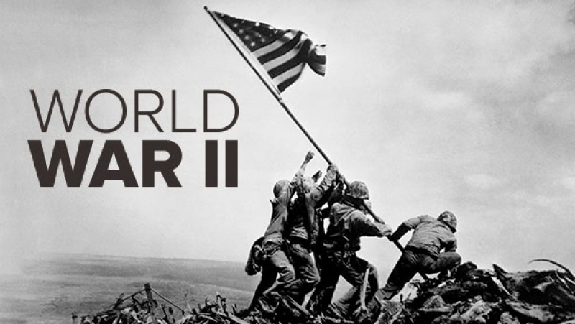
Now a Magic Trick
If you said that some wars are sometimes justified, think of the name of one such war and shout it out.

Slide 20
WWII was the worst war, not the good war
Greatest damage, cure worse than disease. Continuation of WWI. No surprise. No humanitarianism -- What is Evian? Not defensive. 80% did not fire. Total war. U.S. Nazi roots. Origins of “good war.” Never ending bombs, spending, taxes, bases. Irrelevance to today.

Slide 21
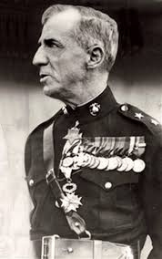
Who is this guy?

Slide 22
Smedley Butler
“Have you ever heard a leader roundly condemned for preserving peace?” —speech at UVA, 1937
The perversity of the world of the WWII myth.
No way left to end wars.

Slide 23
“No war by any nation in any age has ever been declared by the people.”
Who said that?

Slide 24
POP QUIZ
The U.S. sells or gives weapons to, or trains, or funds the military of this % of the most oppressive governments on earth:
12%
52%
96%

Slide 25
A future without zombie ideas
Only the future matters.
Would anyone repeat the U.S. Civil War?
Raise your hand if you can imagine a justifiable war in the future.

Slide 27
The problem with Just War Theory
Where it comes from. What it does. Its criteria: Immeasurable: Right intention, just cause, proportionality
Impossible: Last resort, reasonable prospect of success, noncombatants free from attack, enemy soldiers respected, prisoners treated as noncombatants.
Amoral: Publicly declared, legitimate authority
Justifying the institution.
What does more damage, war or preparations for war?

Slide 28
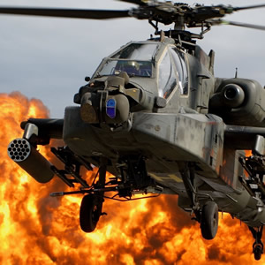
We need $2 trillion/year for other things War threatens our environment War erodes liberties War promotes bigotry War endangers us War impoverishes us War is immoral
We need to abolish the whole institution.

Slide 30
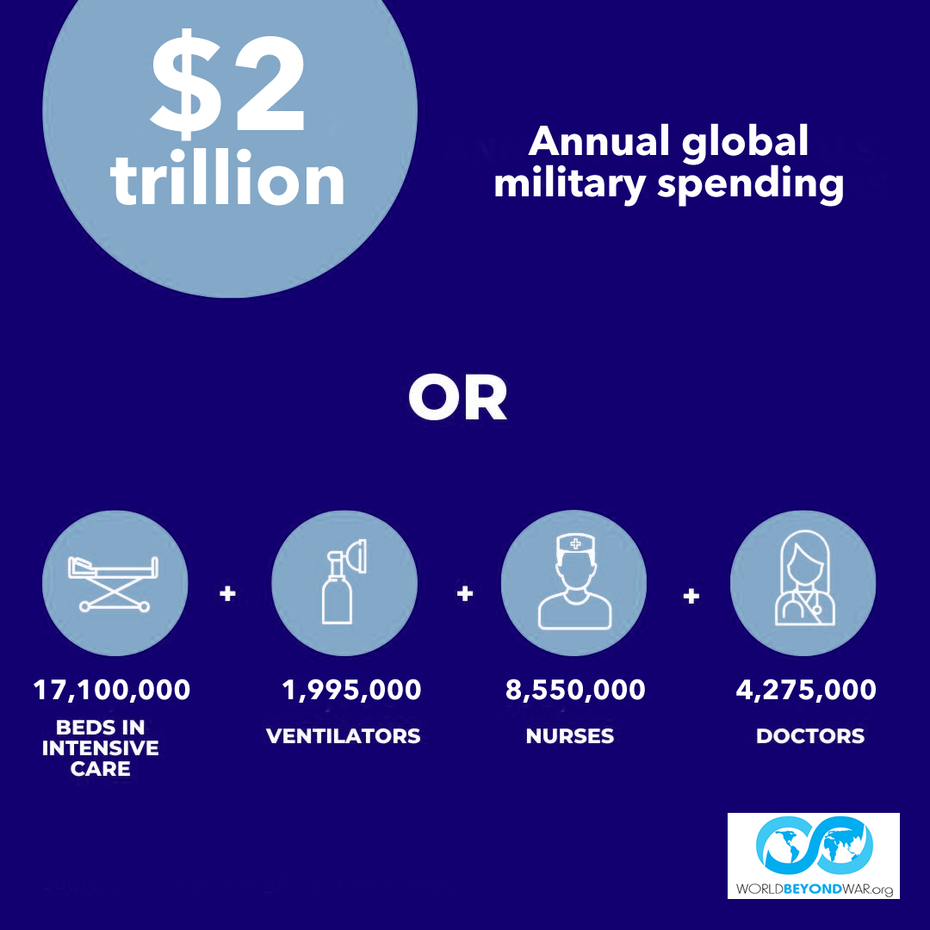

Slide 31
Peace has to be carefully avoided
It takes extreme efforts to create war.
Mexico Spain Vietnam Iraq Afghanistan Iraq Libya Syria Iran Drones
Peace has to be constructed
Unless we change the systems and structures and culture we live in, people will go on making those extreme efforts and creating wars. Reverse arms race International law and democracy Aid, cooperation, diplomacy Unarmed, civilian peacekeeping A culture of peace Replacing exceptionalism with humanism

Slide 32
POP QUIZ
What % of top 4 weapons-dealing nations are permanent members of UN Security Council?
0%
25%
50%
100%

Slide 33
What can we do?
Reverse Arms Race
Close Foreign Bases
International law
Aid, diplomacy
Unarmed peacekeeping
Culture of peace
Cure exceptionalism
Prevent and end particular wars
Cease fire during coronavirus
Divestment
Conversion
Education

Slide 34
Not Predictions, Not Optimism, Not Pessimism
ACTIVISM! – World BEYOND War – RootsAction – Education, Divestment, Bases, Lobbying, Protesting, Coalition Building, Chapter forming!

Slide 35
“When I rise it will be with the ranks, not from the ranks.”
Who said that?

Slide 36
The Declaration of Peace has been signed in almost every country: I understand that wars and militarism make us less safe rather than protect us, that they kill, injure and traumatize adults, children and infants, severely damage the natural environment, erode civil liberties, and drain our economies, siphoning resources from life-affirming activities. I commit to engage in and support nonviolent efforts to end all war and preparations for war and to create a sustainable and just peace.
Sign at worldbeyondwar.org/individual
worldbeyondwar.org/organization

Slide 37
BOOKS War Is A Lie Peace Almanac Curing Exceptionalism When the World Outlawed War War Is Never Just 20 Dictators Currently Supported by the U.S. sky blue scarves $20 for anything, $30 for two things davidswanson.org/donate

Slide 38
The Zoom Poll We’re About to Do
You’re more inclined to believe that we can / should / must end all war than you were when we started.
Or you think that more time studying this material might move you.
Or not.
Or you think others not on this call might be moved in the right direction with the right information.

