Slide 1
Civilian-Based
Defense
Presented for World Beyond War
Nov 7, 2019

Slide 2
Civilian-Based Defense
(aka social defense and civil defense)
Nonviolent, unarmed defense used by civilians to protect citizens, society, organizations or government bodies; land/water, resources, or communities from threats both foreign and domestic.

Slide 3
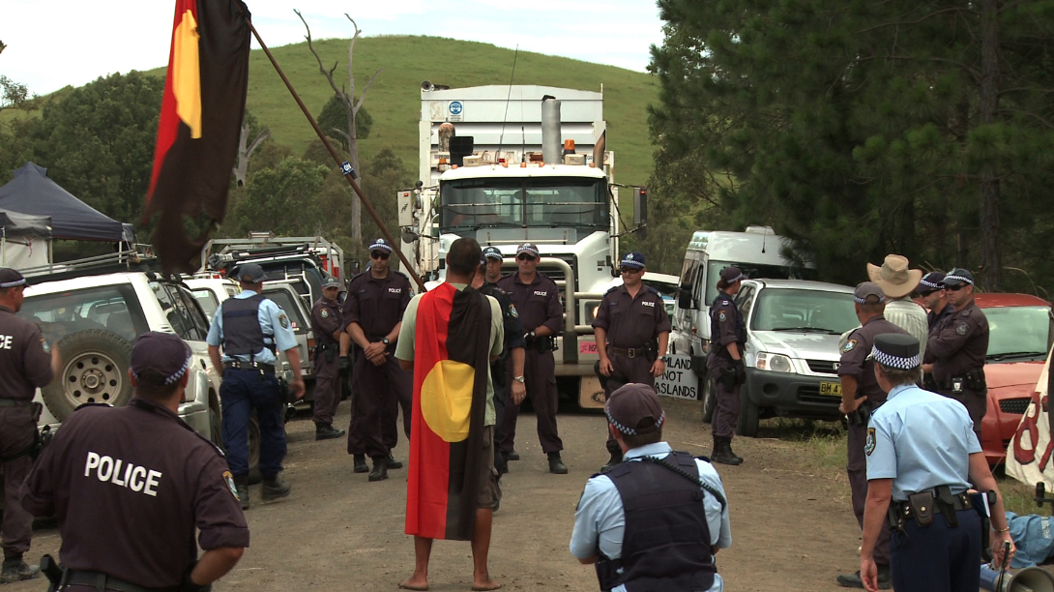
Image from “The Bentley Effect” documentary on anti-gas and coal seam mining campaign in Northern Rivers, Australia.
Notes:
The Bentley Effect

Slide 4
Civilian-Based Defense
draws upon the notion that
"governments rule by the consent of the governed".
If you withhold or refuse consent and cooperation, those who seek to rule you cannot do so.

Slide 5
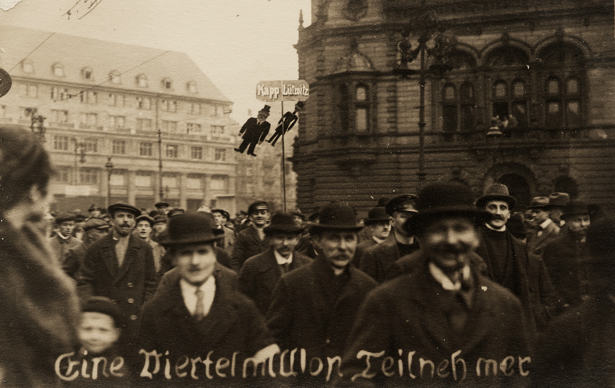
Demonstration in Berlin against the Kapp Putsch.
Caption reads: “A quarter of a million participants”.
Notes:
Photo from Wikipedia By Original photograph uncredited. Scan by Ning-ning. - Original silver gelatine print, postcard-sized, no attribution., Public Domain, https://commons.wikimedia.org/w/index.php?curid=4125364

Slide 6
Civilian-Based Defense
Is marked by planning, preparation, and training.
Is a plan of defense, not an ad hoc struggle.
Ideally, can work as a deterrent.
Can thwart invasions, coups, occupations and defend people and the earth against harm.

Slide 7
Civilian-Based Defense
thwarts threats by demonstrating (in advance or in action) that the populace is prepared to:
deny aggressors their objectives
mobilize widespread defiance
cause maximum local and international problems for aggressors
subvert reliability of troops and functionaries
deter and defeat aggressors

Slide 8
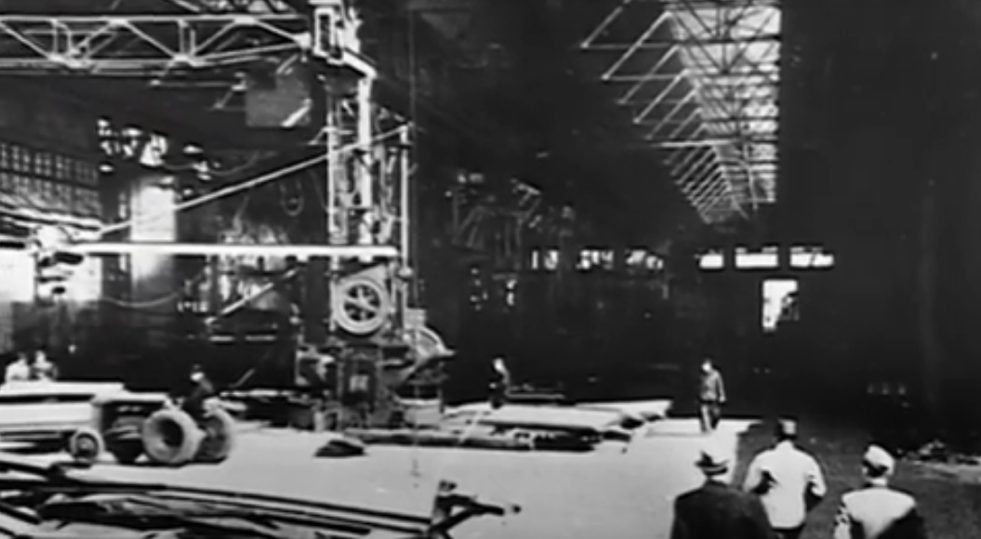
Shipyard Inspection, Denmark, 1940s
Photo from “A Force More Powerful” documentary
Notes:
Photo from “A Force More Powerful”

Slide 9
Knowledge:
Intentions of aggressors, type of struggle (invasion, coup, corporate assault, etc.)
Civil resistance (aka nonviolent struggle)
Military strategy (or strategies of aggressors)
Current best practices for conflict transformation

Slide 10
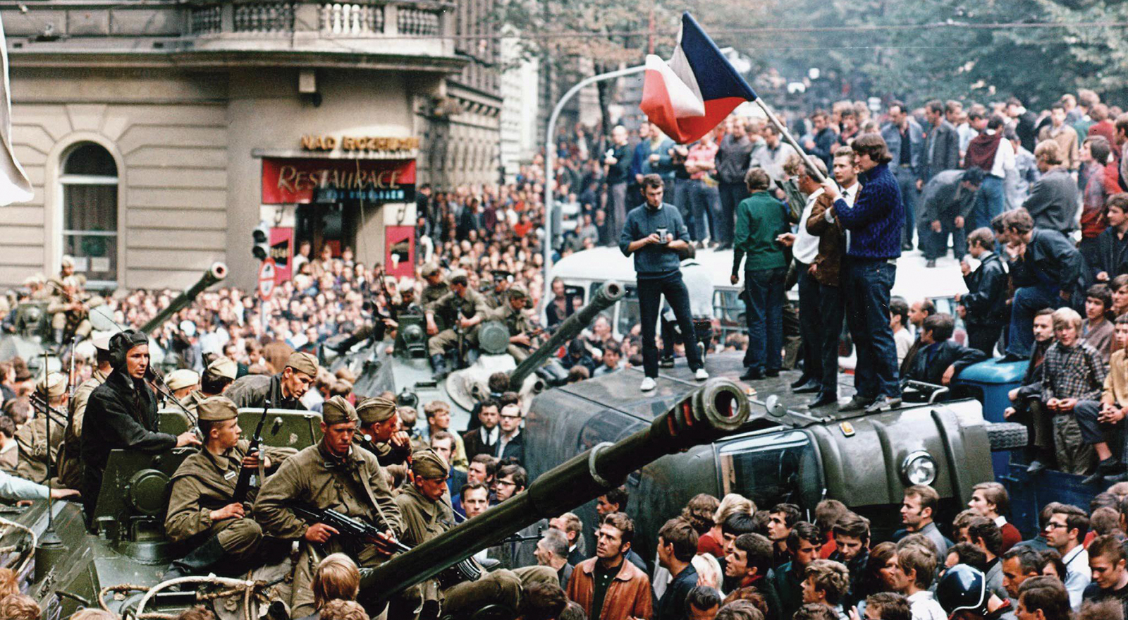
Czechs confronting Soviet troops in Prague, Aug 21, 1968
Notes:
Photo from britannica.com/event/Prague-Spring

Slide 11
Czech 10 Commandments
When a Soviet soldier comes to you, YOU:
1. Don’t know
2. Don’t care
3. Don’t tell
4. Don’t have
5. Don’t know how to
6. Don’t give
7. Can’t do
8. Don’t sell
9. Don’t show
10. Do nothing

Slide 12
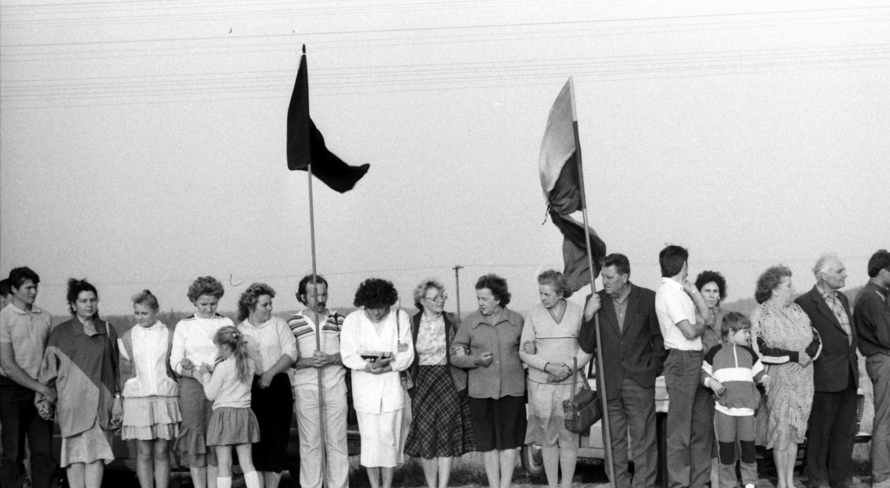
Baltic Way – Lithuania, 1989.
Photo by Rimantas Lazdynas - Own work, CC BY-SA 3.0
Notes:
Photo from Naomi Waltham Smith wired.com/2017/01/rogue-scientists-race-save-climate-data-trump/

Slide 13

Switzerland’s Cold War-Era
“Total Defense”
Integrated civil resistance and nonviolent action into a military and non-military anti-invasion framework.
Used “hedgehog” as metaphor – prickly and notoriously hard to swallow.
Switzerland hedgehog
postage stamp, 1965
Notes:
www.rt.com/news/423051-seed-bank-escapes-syrian-war/

Slide 14
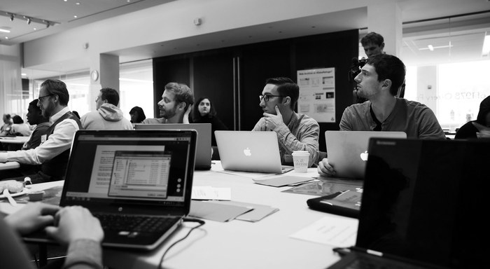
Rogue scientists hack NASA to save climate data
from Trump Administration, 2016.
Notes:
Photo from Naomi Waltham Smith wired.com/2017/01/rogue-scientists-race-save-climate-data-trump/

Slide 15
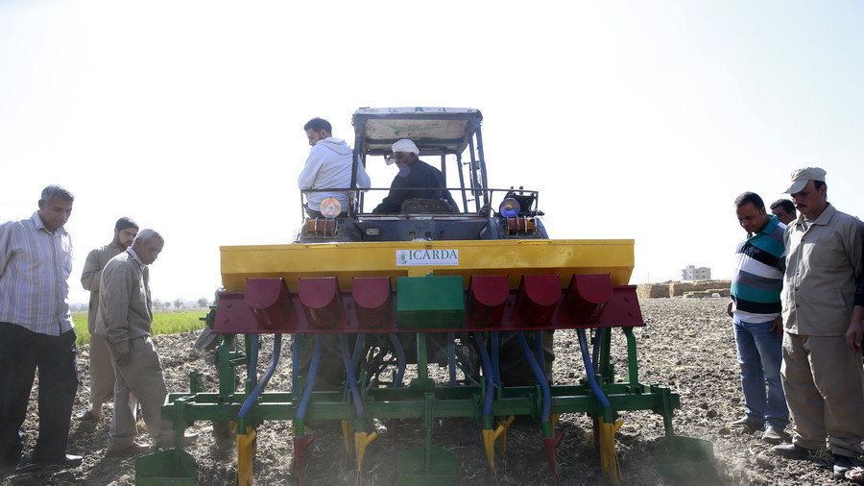
Syrian seedbank saved from war by citizen action is now replanting Syrian fields destroyed by war.
Notes:
www.rt.com/news/423051-seed-bank-escapes-syrian-war/

Slide 16
Civilian-Based Defense Plans
should include:
WHO will resist?
WHAT will they do?
WHERE will these struggles occur?
WHEN will they take action? (before/during/after events)
WHY will these actions succeed? (Strategy)
PLUS:
HOW will they know what to do? (Training)
HOW are people prepared? (Drills, trainings, prep.)

Slide 17
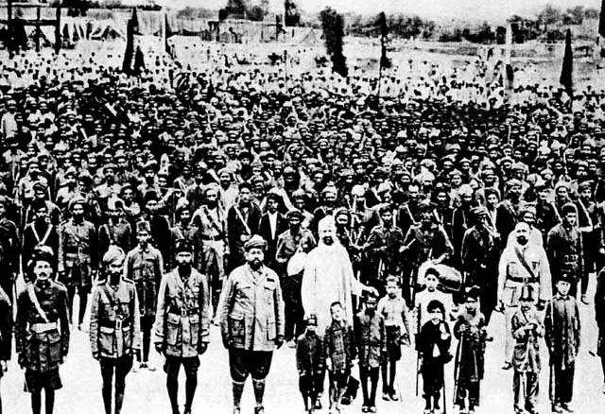
Khudai Khidmatgar – Servants of God,
Northwest Province, India, 1930s
Notes:
Photo from Wikipedia By British India - British India, Public Domain, https://commons.wikimedia.org/w/index.php?curid=7230788

Slide 18
Northern Wisconsin
Campaigns
Anishinabe Treaty Rights, 1986-1994
Crandon Mine, 1980-2003
Sulfuric acid trains, 1996
ELF naval base, 1969-2004
Iron Mine, 2013-2015
Currently working on a CAFO and Enbridge Line 3

Slide 19
Effectiveness of CBD based on 7 factors
Willingness to defend against attack
Strength, number, and independence of society’s institutions and organizations
Ability to work together to defend society
Ability to deny attackers needed resources/objectives
Skill in using nonviolent struggle effectively, including withstanding repression.
Strategic ability of defenders
Ability to weaken attackers both locally and internationally
* Adapted from Gene Sharp, “Civilian-Based Defense”
Notes:
Adapted from Sharp, Civilian-Based Defense

Slide 20
Civilian-Based Defense
is strengthened and supported by:
building self-sufficiency
decentralizing industry
increasing resiliency
social movements
peacebuilding, diplomacy, peace-based foreign policy, and best practices for peace

Slide 21
Further Readings:
World Beyond War’s Global Security System, pgs. 101-102
“Civilian-Based Defense” by Gene Sharp
“Social Defense” by Brian Martin and Jorgen Johansen

