Slide 1
Debunking the Myths of War

Slide 2
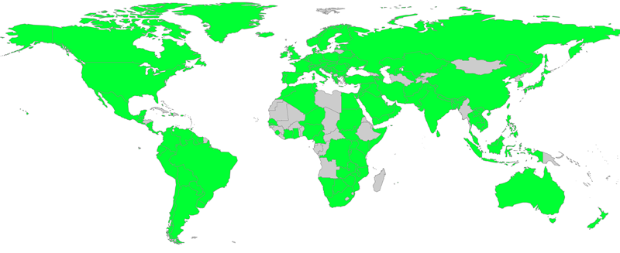
About World BEYOND War
Notes:
-WBW is a global grassroots decentralized network with membership in 175 countries and counting around the world
-Mission to abolish the institution of war; oppose all wars, weapons, and violence
-Replace war with what we call the AGSS: the alternative global security system based on peace and demilitarization
-No centralized office - 5 part-time remote staff persons plus a Board of Directors run by volunteers
-Powered by volunteers and small-dollar donations from individuals who give as little as $5/month
-A central piece of our mission is to debunk the myths of war, then explain its alternatives.
-So that’s what we’re going to explore today: the myths of war.

Slide 3
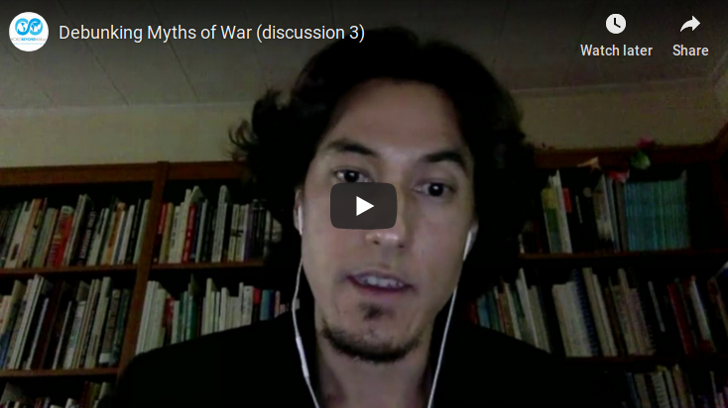
globalsecurity.worldbeyondwar.org
Notes:
Play video:
http://globalsecurity.worldbeyondwar.org/debunking-myths/
-Excerpt from our study guide, Study War No More, which includes short video clips, discussion questions, and action ideas, based on our book

Slide 4
What is the war system?
Sustained coordinated combat between groups leading to large numbers of casualties
Highly organized, pre-planned mobilizations of forces prepared long in advance
Institutions + policies + war technologies/industries + set of interlocked beliefs and values that are mostly unquestioned
Self-perpetuating
What are we talking about when we say “the institution of war”?
Notes:
-Self-perpetuating because countries believe the world is a dangerous place so arm themselves and act belligerently, proving to other nations that the world is a dangerous place and they must be armed and act likewise. Threatening armed violence in the hopes that it will deter the other side often fails.
-What else? Invite audience comments (5 min)

Slide 6
Myth #1:
War Is Inevitable
War is not in our genes
War is not natural
War is not a permanent part of our culture
War is not created by crises beyond our control
Ending war is possible
Notes:
*War is not in our genes: War is an invention of the last 5% of human existence. Archeology finds little evidence of weapons or dominator societies before 4,000 BC. War has been sporadic; some societies have not known war; some don’t have militaries. Some have known it and abandoned it. War is a social, not biological event.
*War is not natural: A great deal of conditioning is needed to prepare most people to take part in war, and a great deal of mental suffering is common among those who have taken part. In contrast, not a single person is known to have suffered deep moral regret or post-traumatic stress disorder from war deprivation. The U.S. military works with psychiatrists to develop methodologies to better prepare assassins to kill, such as psychological techniques to present the enemy as less than human. Mass killing is not part of our nature – quite the opposite is true. A 2015 study found that veterans commit suicide at a rate 50% higher than their civilian counterparts. And mass shootings/mass killings in this country are disproportionately committed by veterans. This speaks volumes about the damaging psychological impact of war.
*War is not permanent part of our culture: any aspect of society that necessitates war can be changed and is not itself inevitable. War is a social invention, a choice, not something imposed by a law of nature.
*War is not created by crises beyond our control: Up to this point in history, war has not been correlated with population density or resource scarcity. Thus, the idea that climate change and resulting catastrophes will inevitably generate wars is not based on fact.
*Ending war is possible: Human societies have been known to abolish institutions that were widely considered permanent, including slavery, the death penalty, human sacrifice, blood feuds, duelling, and more. Ending all war is an idea that has found great acceptance in various times and places. It was more popular in the U.S. in the 1920s and 1930s than now. Now, many buy into the new notion that war is somehow permanent.

Slide 8
Myth #2:
War Is Necessary
War is not “defense”
War preparation is not “defense”
Defense need not involve violence
“But if the term has any meaning, it cannot be stretched to cover offensive war making or aggressive militarism. If ‘defense’ is to mean something other than ‘offense,’ then attacking another nation ‘so that they can’t attack us first’ or to ‘send a message’ or to ‘punish’ a crime is not defensive and not necessary.”
- David Swanson, WBW Director
Notes:
*War is not “defense”
*Preparation is not “defense”
Defense means to protect one’s borders from invasion, as opposed to aggression, which is to cross another nation’s borders to attack. Establishing military bases around the world is offensive and counterproductive, stimulating hostility and threats rather than eliminating them. It makes us less secure. Current defense spending by the U.S. is almost wholly for projecting military power worldwide: offense, not defense. U.S. War Dept renamed Defense Department in 1947. deter war” with one that pledges to “provide a lethal Joint Force to defend the security of our country and sustain American influence abroad.” An example of how war preparations are not actually about defense: While the U.S. is increasing its annual military spending, Russia has actually been reducing its military spending each year. U.S. annual increases have sometimes exceeded Russia's entire military budget.
*Defense Need Not Involve Violence
Nonviolent resistance is always a choice, as are negotiation, economic sanctions, and other responses to aggression. In fact, Erica Chenoweth & Maria Stephan’s research shows that between 1900-2006, campaigns of nonviolent civil resistance were twice as successful as violent campaigns.
*War makes us less safe: War mythology would have us believe that war kills evil people who need to be killed to protect us and our freedoms. But the reality is that the victims of most modern wars are civilians. In fact, the majority of those killed by drone strikes have been unidentified.
Another stat that shows that war is not necessary, that it provokes more than it deters: The majority of suicide terrorist attacks are aimed at getting a military to cease occupying a foreign country. According to the Global Terrorism Index, terrorism has increased during the war on terror. From Peace Science Digest: Deployment of troops and weapons exports to another country increase the chance of attacks from terror organizations from that country. In 2006, U.S. experts concluded that threat from terrorists had spread in numbers and geographic reach. General Stanley McChrystal, then commander of U.S. and NATO forces in Afghanistan in June 2010 said that “for every innocent person you kill, you create 10 new enemies.” There are numerous other examples of experts, including U.S. military officials, explaining the blowback that comes from war. War isn’t necessary for defense; it makes us less safe.
This is why a 2014 Gallup poll of 65 nations found the U.S. to be the greatest threat to peace in the world. Damaging reputation, creating more blowback.

Slide 10
Myth #3:
War Is Beneficial
War doesn’t benefit its victims
War does not bring stability
War doesn’t benefit the aggressor
War motives are not noble
Notes:
*War doesn’t benefit its victims: Majority of deaths = civilians. Scholars at both Carnegie Endowment for Peace and RAND Corporation have found that wars aimed at nation-building have an extremely low to nonexistent success rate in creating stable democracies.
During the Iraq War, polls found that a majority in the U.S. believed Iraqis were better off as the result of a war and that Iraqis were grateful for the war. A majority of Iraqis, in contrast, believed they were worse off.
Aftermath: The most deadly weapons left behind by war are landmines and cluster bombs. A 1993 U.S. State Department report called landmines “perhaps the most toxic and widespread pollution facing mankind.” Millions of hectares in Europe, North Africa, and Asia are under interdiction because of tens of millions of landmines and cluster bombs left behind by war. In Libya, ⅓ of its land mass is considered contaminated by landmines and unexploded munitions from World War II.
*War does not bring stability: Making war creates resentment, new enemies, distrust, and further wars. Preparation for war makes other nations feel they must also prepare and so a vicious circle is created which perpetuates the war system. War can be imagined as a tool for enforcing the rule of law, but in fact war often violates international and domestic laws and encourages further violations.
*War doesn’t benefit aggressor: Already talked about the Gallup poll where the U.S. was seen as the greatest threat to peace; the U.S.’s reputation is not benefited by the wars it wages. War and war preparations drain and weaken economies. Leads to more economic inequality: Enriches a small number of influential profiteers, by investing trillions of public dollars into a handful of corporations. Not good for economy: Dollar for dollar, a University of Massachusetts study documents that investing in peacetime industries like health care, education, mass transit, and construction would produce more jobs and in some cases, better-paying jobs, than would spending that money on the military. Fouling our own nest: The U.S. military is among the top 3 largest polluters of U.S. waterways. The majority of “Superfund” sites in the U.S. are current or former military-related installations, sites designated by the U.S. Environmental Protection Agency where extreme hazardous waste threatens human health and the environment.
Since 1990s, $5 billion dollars of military grade weapons and equipment have been transferred to local police forces.
*War motives are not noble: Former U.S. Marine Officer, Matthew Hoh, resigned in protest to the Afghan War and commented, “I think we’re engendering more hostility. We’re wasting a lot of very good assets going after midlevel guys who don’t threaten the United States or have no capacity to threaten the United States.”
Then why are we waging war? We already mentioned that studies show that wars are not beneficial to the victims, and are not successful in creating stable democracies. The biggest motive is profit.
In 2017, the CEOs of the top five U.S. weapons manufacturers collected salaries that totaled $96 million. Lockheed Martin alone received more than $36 billion in military contracts – an amount higher than the budgets of 22 of the 50 states. Between 2012-2016, U.S. arms producers were responsible for 1/3 of major global arms exports. U.S. now supplies military assistance (in the form of military or weapons training, military arms financing, and weapons transfers) to 73% of the world’s dictatorships.

Slide 12
Myth #4:
War Is Just
Wars are not fought with proportionate means
Wars target & kill civilians
War is often deployed as a first, not last, resort
Notes:
*Doctrine of Just War comes out of 4th century rejection of the Christian practice of pacifism. This doctrine stated that in order to go to war many criteria had to be satisfied, including that the war had to be fought with proportionate means (the evil of the destruction could not outweigh the evil of not going to war), and that civilians were never to be attacked.
WWII not just: The purposeful slaughter of civilians by mass aerial bombardment and the use of nuclear weapons - violates both criteria.
Modern warfare kills many more innocents than combatants.
A scholarly study found that the U.S. public believes that whenever the U.S. government proposes a war, it has already exhausted all other possibilities. Not the case. Here are a few real-world examples of the U.S. choosing war as a first resort, when it wasn’t the only option possible:
In 2013, U.S. President Obama told us of the urgent “last resort” need to launch a major bombing campaign on Syria. Then he reversed his decision, largely because of public resistance to it. It turned out the option of not bombing Syria was also available.
In 2001, the Taliban was willing to turn Osama bin Laden over to a third nation to be tried for crimes the United States was alleging he’d committed. Instead of pursuing legal prosecutions for crimes, the United States and NATO chose an illegal war that did far more damage than the crimes, continued after bin Laden was said to have left the nation, continued after bin Laden’s death was announced, and did serious lasting damage to Afghanistan and to Pakistan. So, war was not a last resort. U.S. didn’t try to pursue legal prosecutions.
According to a transcript of a meeting in February 2003 between U.S. President George W. Bush and the Prime Minister of Spain, Bush said that President Saddam Hussein had offered to leave Iraq, and to go into exile, if he could keep $1 billion. Instead, Bush’s government claimed a war was needed to defend the United States against weapons that did not exist. Rather than losing a billion dollars, the people of Iraq saw the loss of hundreds of thousands of lives, millions made refugees, their nation’s infrastructure and education and health systems destroyed, vast environmental destruction, and epidemics of disease and birth defects — all of which cost the United States $800 billion. This is yet another example in which an option besides war existed, but it was not even offered to the public and war was presented as the only option that existed.
The notion of war as the only resort ignores numerous evidence of the efficacy of nonviolence, as mentioned earlier. Nonviolent resistance has successfully challenged not only civil wars, but also foreign military occupation. For example, Lithuania, Latvia, and Estonia freed themselves from Soviet occupation through nonviolent resistance prior to the USSR’s collapse. In Lebanon, a nation ravaged by war for decades, thirty years of Syrian domination was ended through a large-scale, nonviolent uprising in 2005.
Were a war to meet all the criteria of just war theory, in order to actually be just, it would also have to outweigh all the damage done by keeping the institution of war around. For example, war is a leading contributor to climate change and the refugee crisis. U.S. Department of Defense emits more metric tons of CO2 annually than 160 other nations worldwide combined. It would be near impossible for one just war to outweigh all of the lasting damage of the war system.

Slide 13
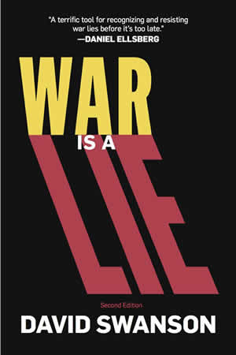
Resources
worldbeyondwar.org/onlinelearning
worldbeyondwar.org/myths
worldbeyondwar.org/resources
worldbeyondwar.org/alternative
Books
Online courses
Study guide
Powerpoints
Articles & fact sheets
Videos & films
Webinars
Conferences & events
Peace Almanac
Mapping Militarism
Speakers Bureau

Slide 14
Myths
Why
How (AGSS)
War is Inevitable
War is Necessary
War is Beneficial
War is Just
War Is Immoral
War Endangers Us
War Threatens the Environment
War Erodes Liberties
War Impoverishes Us
War Promotes Bigotry
We Need $2 Trillion/Year for Other Things
Demilitarize Security
Manage Conflict Nonviolently
Create a Culture of Peace

Slide 15
Discussion Questions
*Pick a myth of war: war is just, inevitable, beneficial, or necessary.
As a group, develop a 1-3 minute elevator pitch to debunk that myth. What would be your key talking points for debunking it? (15 min)
Break off into small groups of 5-10
Assign a notetaker in your group
Assign a person to report back

Slide 16
Discussion Questions
*Discuss: Where did these myths come from? How were they created? How have they been sustained? (15 min)
OR
*Prepare a list of the ways that war makes us less safe – from the local to the global. Turn this list into a mind map or visual infographic and use it as a public education tool. (15 min)
Break off into small groups of 5-10
Assign a notetaker in your group
Assign a person to report back

Slide 17
Discussion Questions
*Take the war abolition quiz (10 min)
Break off into small groups of 5-10
Assign a notetaker in your group
Assign a person to report back
Notes:
Print off copies of the quiz here: https://worldbeyondwar.org/wp-content/uploads/2018/10/Quiz-BEYOND-War.pdf

Slide 18
Report Back
Resources:
worldbeyondwar.org/quiz
bit.ly/mappingmilitarism
overseasbases.net
worldbeyondwar.org/explained

Slide 19
Contact Us
Greta Zarro
greta@worldbeyondwar.org
worldbeyondwar.org
@worldbeyondwar

