Slide 1
Employment Effects of Military and Domestic Spending Priorities
What are our national priorities?
Notes:
This presentation focuses on research done on the employment effects of spending on the military versus other segments of the economy.
I will also raise questions about what are our national priorities.
Up front though, I’d like to put this in the context of where our country is financially.

Slide 2
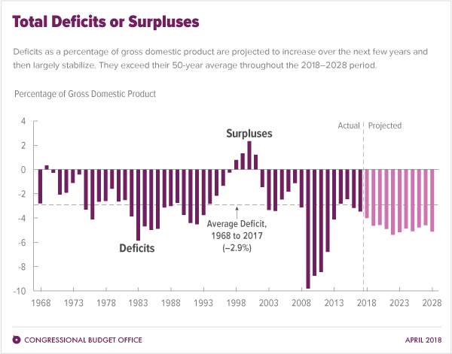
BUDGET DEFICIT AS A PERCENTAGE OF GDP
Source: Congressional Budget Office, April 2018
Notes:
This graph shows budget deficits as a % of Gross Domestic Product.
In July, the White House projected a deficit of more than $1 Trillion which would be 5.1% of GDP.
The Wall Street Journal stated that $ Trillion dollar deficits may be the norm for the forseeable future.
An article in Forbe magazine 11.29.18
It is quite likely that fiscal 2019 will see a $1.5 trillion deficit (assuming no recession

Slide 3
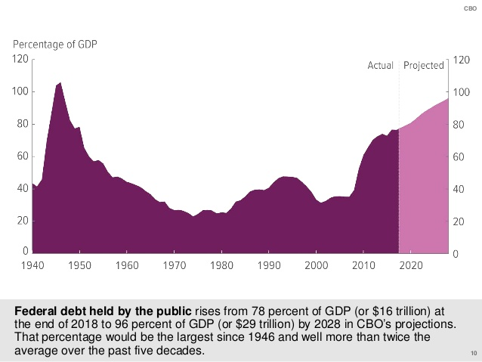
FEDERAL DEBT AS A PERCENT OF GDP
Source: Congressional Budget Office, April 2018
Notes:
Total U.S. debt is now over $21 trillion.
Wikipedia says:
The aggregate, gross amount that Treasury can borrow is limited by the United States debt ceiling. As of October 28, 2018, debt held by the public was$15.8 trillion and intragovernmental holdings were$5.8 trillion, for a total or "National Debt" of $21.6 trillion.
Forbes says Last year, interest on the federal debt was $263 billion, or 1.4% of GDP.

Slide 4
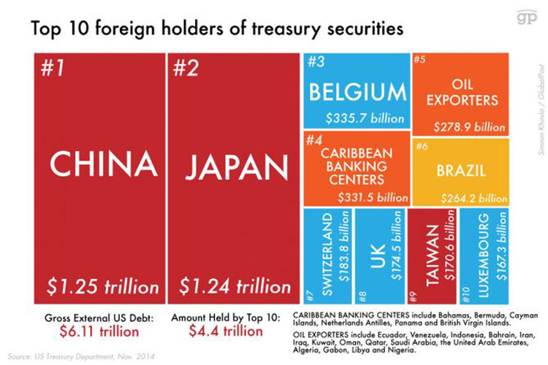
Notes:
Look at the trusted friends who hold our debt.

Slide 5
As he told Norah O’Donnell of CBS This Morning, “I’m the king of debt. I’m great with debt. Nobody knows debt better than me. I’ve made a fortune by using debt and if things don’t work out I renegotiate the debt.”
Notes:
According to the Forbes article, it’s very likely that by the mid-2020s we will have $30 trillion worth of debt—and see that $915 billion interest expense projected for the end of the decade.

Slide 6
Notes:
One seventh of government spending is financed by deficits.

Slide 7
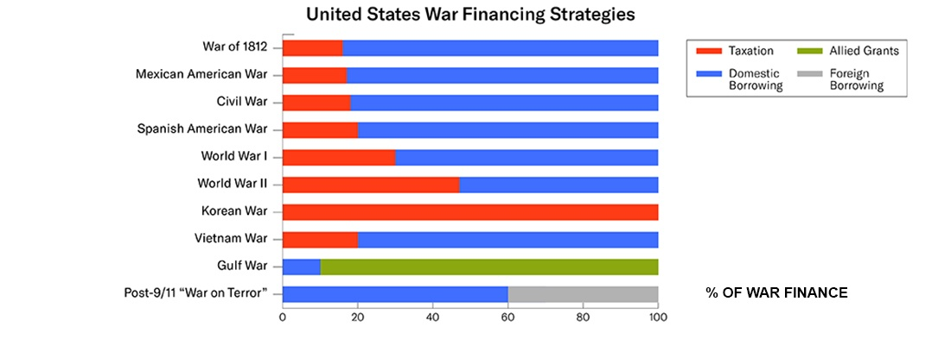
https://watson.brown.edu/costsofwar/
Notes:
That goes for our Wars too.
Some have called the “War on Terror” the credit card war.
We’re going to let future generations pay for this.

Slide 8
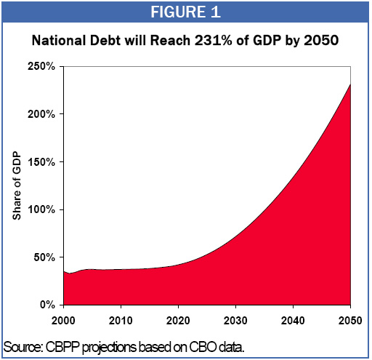
Notes:
Center on Budget and Policy Priorities projections.
Here’s the debt projection for 2050.
Fortunately for us, we’ll all probably be dead by 2050.
My youngest grandchild will 40 years old but humankind will have colonized Mars so U.S. debt won’t be a problem.

Slide 9
THE U.S. EMPLOYMENT EFFECTS OF MILITARY AND DOMESTIC SPENDING PRIORITIES: 2011 UPDATE
Robert Pollin & Heidi Garrett-Peltier
Political Economy Research Institute, University of Massachusetts, Amherst
December 2011
www.peri.umass.edu/publication/item/449-the-u-s-employment-effects-of-military-and-domestic-spending-priorities-2011-update
Notes:
Drs. Pollin and Garrett-Peltier first published this research in 2007.
This is the most recent version of their work.
In 2010 the military budget provided the funding for nearly 6 million jobs both within the military itself and in all the civilian industries connected to the military
And our local Chambers of Commerce, Economic Development Commissions, churches, schools, hospitals, State Legislators, Governors and Members of Congress know that and do all they can to promote and preserve those jobs.
Anyone from central Illinois? In 1993, I lived in Champaign, IL and I remember the huge outcry when Chanute AFB was closed in our county. You would have thought it was the end for Champaign County.
Secretary of Defense Robert Gates (2006-11) announced closing the Joint Force Command in Norfolk, Virginia, that employees 6,324 people and relies on 3,300 private contractors. This prompted Virginia Democratic Senator Jim Webb, a member of the Senate Armed Services Committee, to warn that the closure “would be a step backward.”
He wants to stop production of the C-17 cargo jet he says is no longer needed. But it keeps 4,000 people working at Boeing’s Long Beach assembly plant and 30,000 others at Boeing suppliers strategically located in 40 states. So despite Gates’s protests the Senate has approved ten new orders

Slide 10
World’s Largest Employers
U.S. Department of Defense | 3.2 million
Peoples Liberation Army- China | 2.3 million
Walmart | 2.1 million
McDonald’s | 1.9 million
Source: https://en.wikipedia.org/wiki/List_of_largest_employers

Slide 11
DoD Office of Economic Adjustment Study (FY 2015)
STATE | DEFENSE SPENDING (Billions) | % OF STATE GDP | DEFENSE PERSONNEL
Florida | $17.6 | 2% | 126,292
New York | $9.1 | 0.6% | 61,765
New Jersey | $6.6 | 1.2% | 33,834
Pennsylvania | $12.7 | 1.9% | 57,919
Ohio | $6.9 | 1.2% | 60,224
Michigan | $2.9 | 0.6% | 25,689
Massachusetts | $12.2 | 2.6% | 24,174
Illinois | $7.0 | 0.9% | 57,078
Indiana | $3.9 | 1.2% | 31,376
Virginia | $53.0 | 11.2% | 246,553
http://www.ncsl.org/research/military-and-veterans-affairs/military-s-impact-on-state-economies.aspx
Notes:
So there’s no doubt that military expenditures create jobs.
But how does that compare with other sectors of the economy?

Slide 12
Input-output model of U.S. economy, produced every five years and updated annually by the Department of Commerce.
Input-output analytic framework first developed in the 1930s by Nobel Laureate economist Wassily Leontief
Traces all the factors—inputs that go into producing a given output. For example how many workers, what equipment, how much energy—all inputs—go into producing a fighter jet, a hospital, a school, etc.—the outputs.
Also what inputs and outputs are needed to keep the fighter jet, hospital or school functioning.

Slide 13
Three factors in the input-output model:
Direct effects
Indirect effects
Induced effects
Notes:
Direct effects are the jobs created by producing the fighter bomber, the school, the windmill
Indirect effects are the jobs associated with industries that supply intermediate goods for building a fighter bomber, school or any other direct spending target. These would include the metals, the plastics, glass, tires, electronic industries for the avionics, etc.; the concrete, glass and water fountains, etc.to build the school.
Induced effects. This is the expansion of employment that results when people who are paid to build the fighter bomber or school spend the money they have earned on other products in the economy.
How could one spending target create more jobs for a given amount of expenditure than another? There are three factors…

Slide 14
How can more jobs be created from one expenditure target than another?
Labor Intensity
Domestic content
Compensation per worker
Notes:
Labor intensity. When proportionally more money of a given overall amount of funds is spent on hiring people, as opposed to spending on machinery, buildings, energy, land and other inputs, then spending this given amount of overall funds will create more jobs. The average labor intensity of the education-related industries—i.e. number of jobs created per dollar of spending, as opposed to the amount spent on machinery, buildings, energy, land and other inputs—is higher than the labor intensity of military related industries.
Domestic content. If we are considering job creation within the U.S. economy, when a higher proportion of a given amount of funds is spent within the U.S. as opposed to spending on imports or activities in other countries, the given amount of money, will, again, create more jobs. The overall level of spending within the U.S. economy—as opposed to the rest of the world—is higher for education than the military. For example, we estimated that U.S. military personnel spend only 43 percent of their income on domestic goods and services, while the civilian population on average spends78% of domestic products.
Compensation per worker. If there is $1 million to spend and 1 employee gets paid $1 million, only 1 job is created. If the average is $50k then 20 jobs are created. The average pay for all the industries associated with education—including direct, indirect and induced effects—is lower than the average pay for the military-related industries, then more jobs will be created through spending a given amount of money on education as opposed to the military.

Slide 15
EMPLOYMENT CREATION THROUGH SPENDING $1 BILLION FOR ALTERNATIVE SECTORS OF THE U.S. ECONOMY, 2009
 | Direct Jobs | Indirect Jobs | Direct + Indirect Jobs | Induced Jobs | Total Job Creation | Job Creation Relative to Defense Spending
Military | 6,800 | 1,800 | 8,600 | 2,600 | 11,200
Tax cuts for personal consumption
Clean energy
Health care
Education
Notes:
Focus on this especially the percentage differences.
The researchers also looked at the wage levels of the direct, indirect and induced jobs that would be created.

Slide 16
EMPLOYMENT CREATION THROUGH SPENDING $1 BILLION FOR ALTERNATIVE SECTORS OF THE U.S. ECONOMY, 2009
 | Direct Jobs | Indirect Jobs | Direct + Indirect Jobs | Induced Jobs | Total Job Creation | Job Creation Relative to Defense Spending
Military | 6,800 | 1,800 | 8,600 | 2,600 | 11,200
Tax cuts for personal consumption | 7,300 | 3,500 | 10,800 | 4,300 | 15,100 | +35%
Clean energy
Health care
Education
Notes:
Focus on this especially the percentage differences.
The researchers also looked at the wage levels of the direct, indirect and induced jobs that would be created.

Slide 17
EMPLOYMENT CREATION THROUGH SPENDING $1 BILLION FOR ALTERNATIVE SECTORS OF THE U.S. ECONOMY, 2009
 | Direct Jobs | Indirect Jobs | Direct + Indirect Jobs | Induced Jobs | Total Job Creation | Job Creation Relative to Defense Spending
Military | 6,800 | 1,800 | 8,600 | 2,600 | 11,200
Tax cuts for personal consumption | 7,300 | 3,500 | 10,800 | 4,300 | 15,100 | +35%
Clean energy | 7,900 | 4,100 | 12,000 | 4,800 | 16,800 | +50%
Health care
Education
Notes:
Focus on this especially the percentage differences.
The researchers also looked at the wage levels of the direct, indirect and induced jobs that would be created.

Slide 18
EMPLOYMENT CREATION THROUGH SPENDING $1 BILLION FOR ALTERNATIVE SECTORS OF THE U.S. ECONOMY, 2009
 | Direct Jobs | Indirect Jobs | Direct + Indirect Jobs | Induced Jobs | Total Job Creation | Job Creation Relative to Defense Spending
Military | 6,800 | 1,800 | 8,600 | 2,600 | 11,200
Tax cuts for personal consumption | 7,300 | 3,500 | 10,800 | 4,300 | 15,100 | +35%
Clean energy | 7,900 | 4,100 | 12,000 | 4,800 | 16,800 | +50%
Health care | 8,400 | 3,900 | 12,300 | 4,900 | 17,200 | +54%
Education
Notes:
Focus on this especially the percentage differences.
The researchers also looked at the wage levels of the direct, indirect and induced jobs that would be created.

Slide 19
EMPLOYMENT CREATION THROUGH SPENDING $1 BILLION FOR ALTERNATIVE SECTORS OF THE U.S. ECONOMY, 2009
 | Direct Jobs | Indirect Jobs | Direct + Indirect Jobs | Induced Jobs | Total Job Creation | Job Creation Relative to Defense Spending
Military | 6,800 | 1,800 | 8,600 | 2,600 | 11,200
Tax cuts for personal consumption | 7,300 | 3,500 | 10,800 | 4,300 | 15,100 | +35%
Clean energy | 7,900 | 4,100 | 12,000 | 4,800 | 16,800 | +50%
Health care | 8,400 | 3,900 | 12,300 | 4,900 | 17,200 | +54%
Education | 15,300 | 3,800 | 19,100 | 7,600 | 26,700 | +138%
Notes:
Focus on this especially the percentage differences.
The researchers also looked at the wage levels of the direct, indirect and induced jobs that would be created.

Slide 20
DISTRIBUTION OF JOBS BY WAGE LEVELS
 | Total Jobs Created | Jobs with Wages Below $32,000 | Jobs with Wages between $32k-$64K | Jobs with Wages above $64,000 | Jobs with Wages $32k and above
Military | 11,200 | 4,133 | 4,715 | 2,352 | 7,067
Tax cuts for personal consumption | 15,100 | 8,592 | 4,590 | 1,918 | 6,508
Clean energy | 16,800 | 8,467 | 5,998 | 2,335 | 8,333
Health care | 17,200 | 9,649 | 5,315 | 2,236 | 7,551
Education | 26,700 | 11,214 | 10,867 | 4,619 | 15,486
Notes:
Data from 2010 so these numbers might be different now.
The data show that while more jobs are created in clean energy, health care and education overall, it’s also true that more jobs are created in the middle wage (above $32,000) sector.
Now let’s look at the jobs created by spending $60billion rather than $1billion.

Slide 21
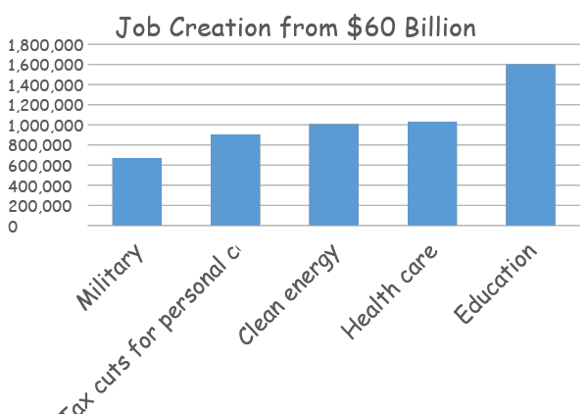
Notes:
This graph shows the comparative jobs that could be created if our nation spent the $60 billion that the bipartisan Commission on Wartime Contracting concluded was lost due to fraud and waste on projects in Iraq and Afghanistan over the last 10 years.
In Afghanistan, the commission found the United States is indirectly funding the Taliban as money diverted from U.S.-backed projects has been paid out to militants to ensure safety.
The Pentagon’s use of no-bid contracts has tripled since the United States was attacked on 9/11, in spite of promises to reform the controversial practice.
We could create 1.6 million jobs in education, a million in health car or a million jobs for clean energy.
But we’re told that because of budget priorities, the deficits and the national debt, we don’t have the funds available.
Forbes article Dec 8, 2017 Has Our Government Spent $21 Trillion Of Our Money Without Telling Us?
$6.5 trillion for the U.S. Army alone
https://www.forbes.com/sites/kotlikoff/2017/12/08/has-our-government-spent-21-trillion-of-our-money-without-telling-us/#124a07b57aef

Slide 22
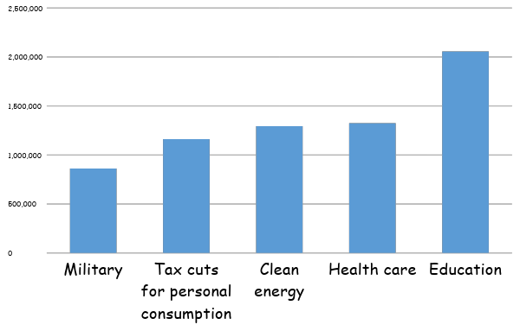
Job Creation from $77 Billion
Notes:
The $77 billion figure is more realistic, for FY2018 President Trump proposed a $54 billion increase in military spending.
Our representatives in Congress then increased that amount by $23 billion.
FOCUS ON THIS. THE NUMBER OF JOBS,
So regardless of the budget deficits that have led to a U.S. debt of $21 TRILLION, Congress agreed to spend $77 Billion more for the military.
For 2019 Congress has authorized $717 Billion up from $610 Billion in 2017.
Now we’re hearing about 5% cuts in government spending—maybe less of a cut for the military.

Slide 23
"Just signed Bill, Our Military will now be stronger than ever before. We love and need our Military and gave them everything — and more. First time this has happened in a long time. Also means JOBS, JOBS, JOBS!"
Notes:
Yes, military spending crates jobs.
To cite an example, one of the goals of Saudi Arabia’s economic reform plan -- unveiled in 2017 -- is to ensure that, by 2030, half the value of the kingdom’s arms purchases will be produced in Saudi Arabia. U.S. firms have scrambled to comply, setting up affiliates in the Saudi capital, Riyadh, and in the case of Lockheed Martin’s Sikorsky unit, agreeing to begin assembling military helicopters there. McClatchy news service summed up the situation in this headline: “Trump’s Historic Arms Deal Is a Likely Jobs Creator -- In Saudi Arabia.”
Crain’s Indianapolis 11.26.18 “The U.S. Department of Defense has awarded major contracts to two manufacturers in Indianapolis. Rolls-Royce Corp. will receive nearly $41 million for the production of marine turbine engines and Allison Transmission Holdings Inc.will receive nearly $21 million for transmission overhaul kits”
CNBC 10.15.18 During the Oval Office talks, Trump touted a creation of 40,000 U.S. jobs due to Saudi military sales. The president used several maps and charts of Saudi acquisitions to further make his point.
"Saudi Arabia is a very wealthy nation, and they're going to give the United States some of that wealth, hopefully, in the form of jobs, in the form of the purchase of the finest military equipment anywhere in the world," Trump said at the time.

Slide 24
Trump Calls U.S. Defense Spending “Crazy” in Apparent Change of Heart on Military Budget
Source: Fortune, December 3, 2018
Notes:
Ok so this is old new. December 3.
Now we hear that the Pentagon chiefs said $718 billion was not enough and they needed $733 billion.
President Trump now thinks that’s not enough and has agreed to $750 billion for FY 2020.
$716 billion for FY 2019 was crazy. He wanted $700 billion.
Now the Pentagon says $733 billion and the president says $750 billion.
Source Politico 12.09.18
$30 billion to end world hunger (UN Food and Agriculture Organization)
Other estimates range from $6 billion to $265 billion (International Food Policy Research Institute)
http://www.ifpri.org/blog/multibillion-dollar-question-how-much-will-it-cost-end-hunger-and-undernutrition
$10 billion for safe drinking water NY Times. Other estimates up to $150 billion.
.

Slide 25
So, what are our priorities?
Where do we spend our money?

Slide 26
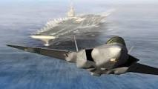
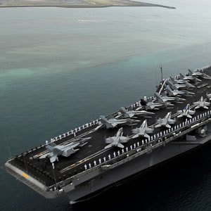
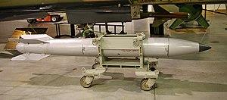
Military
Notes:
F-35 fighter bombers, aircraft carriers, nuclear bombs
Now it looks like suicide is the leading cause of death for military personnel.

Slide 27
Military Expenditures by Country 2017
Rank | Country | Spending $Billions | % of GDP | % of World Share
1 | USA | $610 | 3.1 | 35.0
2 | China | $235 | 2.0 | 13.0
3 | Saudi Arabia | $69.4 | 10.0 | 4.0
4 | Russia | $66.3 | 4.3 | 3.8
5 | India | $63.9 | 2.5 | 3.7
6 | France | $57.8 | 2.3 | 3.3
7 | United Kingdom | $47.2 | 1.8 | 2.7
8 | Japan | $45.4 | 0.9 | 2.6
9 | Germany | $44.3 | 1.2 | 2.5
10 | South Korea | $39.2 | 2.6 | 2.3
11 | Brazil | $29.3 | 1.4 | 1.7
12 | Italy | $29.2 | 1.5 | 1.7
13 | Australia | $27.5 | 2.0 | 1.6
Source: Stockholm International Peace Research Institute
Notes:
This table is from Stockholm. I’ve seen higher U.S. military expenditures elsewhere.
WE’RE NUMBER 1 BY FAR IN MILITARY SPENDING. ACCORDING TO THIS TABLE WE SPEND MORE THAN THE NEXT 7 COUNTRIES COMBINED.
LOOK AT THE LIST. MOST OF THE COUNTRIES ON THE LIST ARE OUR ALLIES.
THE $610 BILLION SPENT IN 2017 WILL INCREASE TO $717 BILLION IN 2019
WE’RE NUMBER 1!
WE’RE ALSO THE LEADING EXPORTER OF ARMS WORLDWIDE ACCOUNTING FOR 34% OF THE WORLD’S TOTAL, WITH 49% OF OUR WEAPONS SALES GOING TO THE MIDDLE EAST.
ACCORDING TO THE UNITED NATIONS, THAT AMONG INDUSTRIALIZED COUNTRIES, THE US IS ALSO NUMBER 1 IN CHILDHOOD POVERTY, INFANT MORTALITY, INCARCERATION, INCOME INEQUALITY, AND OBESITY.

Slide 28
Personal Consumption
35% More Jobs
Notes:
Or we could reduce taxes for consumers and let them spend their money as they wish.

Slide 29
Clean Energy
50% More Jobs
Notes:
Solar, wind, hydroelectric, geothermal, use of ocean currents

Slide 30
Renewable Energy Generation
Country | Year | Renewables as a % of total generation | Generation GWh | Total Renewable | Hydropower | Windpower | Biomass and Waste | Solar Power | Geothermal | Wave and Tide
China | 2015 | 25.00% | 5,581,739 | 1,398,207 | 1,103,325 | 185,770 | 63,729 | 45,250 | 125 | 8
United States | 2015 | 14.00% | 4,097,027 | 572,409 | 249,080 | 190,719 | 77,660 | 39,032 | 15,918 | -
India | 2015 | 15.10% | 1,294,503 | 195,242 | 120,270 | 42,790 | 26,542 | 5,640 | - | -
Russia | 2015 | 16.90% | 1,008,360 | 170,077 | 166,313 | 150 | 2,819 | 335 | 460 | -
Japan | 2015 | 17.40% | 976,393 | 169,660 | 84,845 | 5,160 | 41,460 | 35,858 | 2,337 | -
Canada | 2015 | 64.70% | 647,045 | 418,679 | 376,838 | 26,184 | 12,776 | 2,866 | - | 15
Germany | 2015 | 31.80% | 610,171 | 193,735 | 18,667 | 78,871 | 57,379 | 38,726 | 92 | -
Brazil | 2015 | 75.00% | 568,650 | 426,638 | 356,146 | 21,630 | 48,802 | 60 |  | -
France | 2015 | 16.80% | 540,123 | 90,940 | 53,774 | 21,249 | 8,171 | 7,259 | - | 487
South Korea | 2015 | 2.10% | 516,545 | 10,878 | 2,118 | 1,201 | 3,150 | 3,880 | - | 529
United Kingdom | 2015 | 27.40% | 318,150 | 87,083 | 6,238 | 40,310 | 32,972 | 7,561 | - | 2
Saudi Arabia | 2015 | 0.00% | 318,036 | 1 | - | - | - | 1 | - | -
Mexico | 2015 | 16.00% | 294,818 | 47,095 | 30,614 | 8,453 | 1,788 | 245 | 5,995 | -
Italy | 2015 | 40.90% | 268,939 | 109,962 | 45,018 | 14,706 | 21,826 | 22,588 | 5,824 | -
Iran | 2015 | 5.40% | 264,971 | 14,184 | 13,949 | 220 | 14 | 1 | - | -
Spain | 2015 | 36.20% | 264,197 | 95,660 | 27,656 | 48,122 | 6,532 | 13,350 | - | -
Turkey | 2015 | 32.90% | 248,863 | 81,911 | 65,856 | 11,591 | 1,349 | 191 | 2,924 | -
Taiwan | 2015 | 4.40% | 240,404 | 10,563 | 4,425 | 1,526 | 3,788 | 824 | - | -
Australia | 2015 | 14.40% | 239,145 | 34,405 | 13,361 | 11,467 | 3,608 | 5,968 | 1 | -
South Africa | 2015 | 2.40% | 230,590 | 5,553 | 793 | 2,270 | 310 | 2,180 | - | -
Notes:
This table shows renewable energy use.
In a recently released report from Yale University…
The United States ranked 27th out of 180 countries in an environmental performance review, compiled this year by Yale and Columbia University researchers in collaboration with the World Economic Forum. Switzerland topped the list.
https://epi.envirocenter.yale.edu/epi-topline

Slide 31
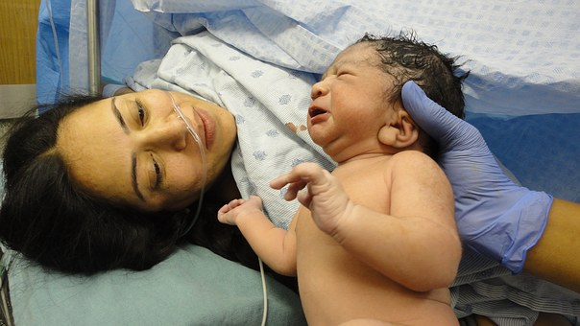
Healthcare
54%More Jobs
Notes:
Or healthcare…including prenatal care, pediatric and preventive care, mental health services, care for substance use disorder, care for the elderly and disabled, community health centers, public health, safe water.

Slide 32
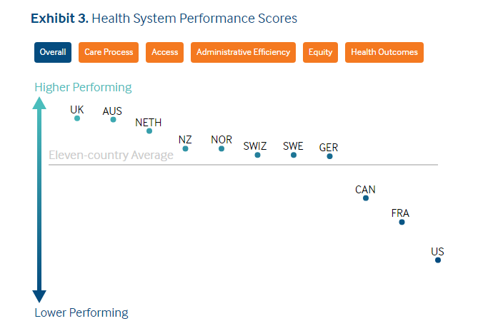
Source: Newsweek, July 17, 2017

Slide 33
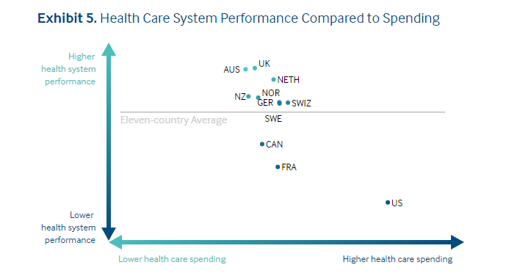
Source: Newsweek, July 17, 2017

Slide 34
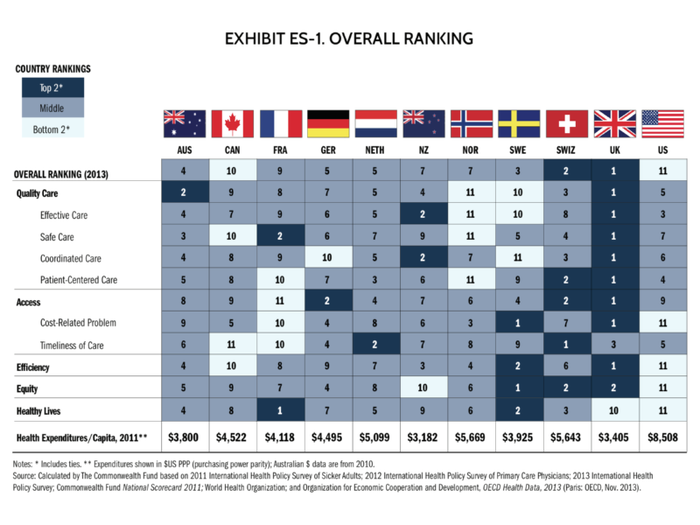
Notes:
THIS CHART SHOWS HOW THE U.S. HEALTH SYSTEM RANKS COMPARED WITH OTHER HIGH INCOME COUNTRIES.
COMPARED TO ALL COUNTRIES, THE U.S. RANKS NUMBER 37 JUST AHEAD OF SLOVENIA AND CUBA AND JUST BEHIND COST RICA AND DOMINICA.

Slide 35
Education
138%More Jobs
Notes:
Or we could spend the money on education—more teachers, more pre-school, more schools, safer schools, more School Resource Officers, lower college tuition, less expensive trade and professional schools, more teacher assistants, STEM classes, arts, music, physical education

Slide 36
The full list of the top educational systems in the world:
South Korea
Japan
Singapore
Hong Kong
Finland
The United Kingdom
Canada
The Netherlands
Ireland
Poland
Denmark
Germany
Russia
The United States
Australia
New Zealand
Israel
Belgium
Czech Republic
Switzerland
https://www.master-and-more.eu/en/top-40-education-systems-in-the-world/

Slide 37
How do we spend taxpayer dollars?

Slide 38
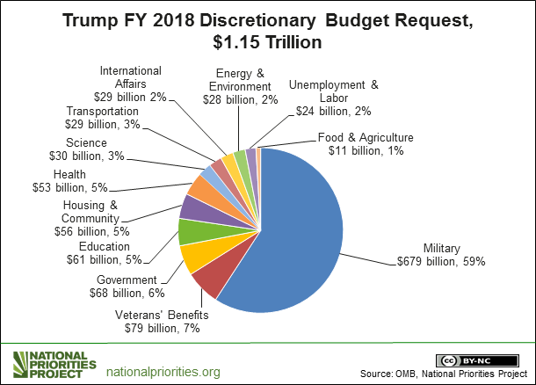

Slide 39
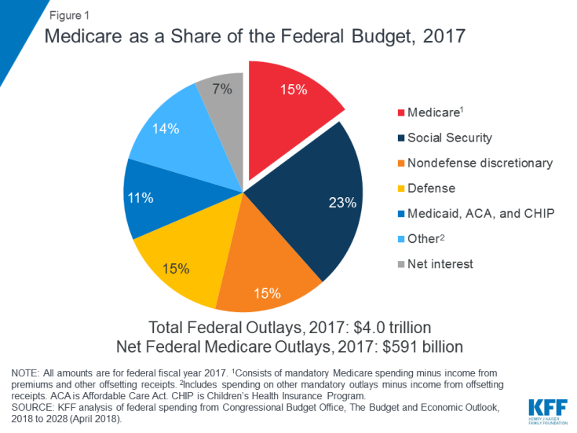
Notes:
Chairman of Joint Chiefs of Staff, General Joseph Dunford, says the Taliban are not losing right now, I think that is fair to say, CNN reported on November 17.
Seventeen years of war.

Slide 40
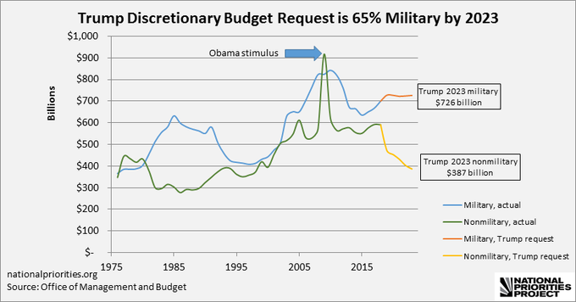

Slide 41
So, what are our priorities?

Slide 43
“Every gun that is made, every warship launched, every rocket fired, signifies in the final sense, a theft from those who hunger and are not fed, those who are cold and are not clothed. This world in arms is not spending money alone. It is spending the sweat of its laborers, the genius of its scientists, the hopes of its children.”
Notes:
Here’s what another president says.

Slide 44
“War will exist until that distant day when the conscientious objector enjoys the same reputation and prestige that the warrior does today.”

