Slide 1
Honoring U.N. International Day of Peace 2018 Theme ~The Right to Peace ~
September 22 afternoon workshop :
1:30 – 2:45
DEPARTMENTS & OTHER NATIONAL INFRASTRUCTURES FOR PEACE
A WAY FORWARD
Presenters:
Dr. Saul Arbess – Co-founder Global Alliance for
Ministries and Infrastructures for Peace (GAMIP) &
Canadian Peace Initiative
Anne Creter -- GAMIP (UN Liaison) & U.S. “Peace Alliance” Department of Peacebuilding Campaign – with Karen Johnson also of Department of Peacebuilding Campaign

Slide 2
Prominent Dignitaries Supporting Departments of Peace
Global:
UN Ambassador Anwarul K. Chowdhury
Canada:
The Hon. Lloyd Axworthy – Foreign Affairs Min.
Senator Douglas Roche – UN Disarmament
US:
Representative Barbara Lee (California-D13)

Slide 3
… by passing “laws” to establish governmental Departments and Infrastructures for Peace … because according to the United Nations Declaration and Programme of Action “governments have an essential role in promoting and strengthening a culture of peace.” REATE A DEP;;;A RTMENT OF PEACEBUILDING

Slide 4
Infrastructures for Peace (I4P)
New peacebuilding concept
UN Development Program : A network of interdependent systems, resources, values and skills held by government, civil society and community institutions that promote dialogue and consultation; prevent conflict and enable peaceful mediation when violence occurs in a society.
Berghof Foundation: A dynamic networking of skills, capacities, resources, tools and institutions that help build constructive social and political relationships and enhance sustainable resilience of societies against violence.

Slide 5
Rationale
Lack of coherence and coordination of peace-related policies in the federal government
Decline of Canadian peacebuilding, peacekeeping and peace diplomacy, including disarmament
Escalation of violent conflict, risk of nuclear weapon use and proliferation
Growth of military budget and war-fighting posture

Slide 6
Mandate of Minister of Peace
The core mandate of the Minister:
CONFLICT TRANSFORMATION BY PEACEFUL MEANS AT HOME AND ABROAD THAT WOULD:
Provide a peacebuilding voice in Cabinet
Develop long-range thinking re: root causes of violence
Serve as an incubator for creative responses to violence
Act as a sensor for the early detection and propose non-violent interventions where potential for violence exists
Implement UN policies and legislation in concert with the Canadian UN Ambassador and the Canadian government

Slide 7
Canada's Proposed Ambassador for Women,
Peace and Security
Domestic and international responsibilities to develop a culture of peace
Special emphasis on UN Resolution 1325 on the role of women in all peace-related work
To advocate for research and identification of root causes of conflicts
To support education, training and counselling in non-violent conflict resolution
To take all possible actions to reduce and prevent conflict and to empower women and girls
To lead the implementation of the Canadian National Action Plan on Women, Peace and Security
To promote the integration of gender perspectives into peacebuilding and peacekeeping

Slide 8
Department of Peace Thrusts
Peace Education and Training
Human and Economic Rights
Nuclear Disarmament
Civilian Peace Service
Domestic Violence Prevention (e.g. through Restorative Justice, Cities of Peace, and Local Peacebuilding Councils)

Slide 9
The U.S. Bill
7 Offices plus Intergovernmental Advisory Peace Council & Federal Interagency Peace Committee
40 Congressional Cosponsors
100+ Organizational and Celebrity Endorsers (ex: WBW, Shift Network, CA Democratic Party, Veterans for Peace, Walter Cronkite, Howard Zinn, Flea from Red Hot Chili Peppers, Sharon Stone)
Peace Academy, Peace Day …

Slide 10
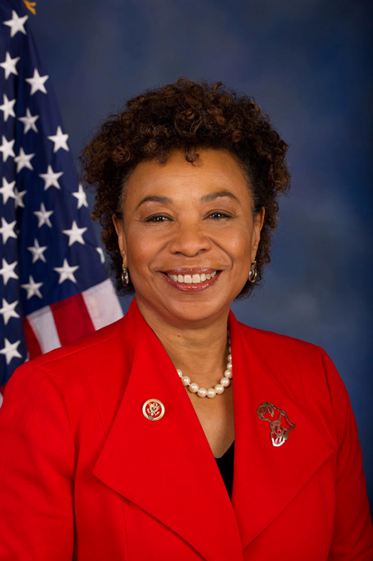
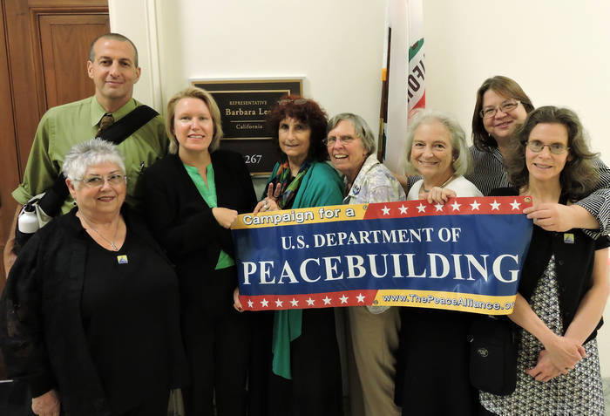
Bill Sponsor: Rep. Barbara Lee (CA-13)
U.S. Department of Peacebuilding Campaign of the Peace Alliance
National Department of Peacebuilding Committee on 2017 Advocacy Day

Slide 11
The Global Alliance for Ministries and Infrastructures for Peace is a network of 35+ country groups working towards this objective
Currently, Costa Rica (2009), Nepal (2007), the Solomon Islands and a province of Papua New Guinea have created Ministries of Peace

Slide 12
I4P ARE LINKS TO ACHIEVING UN SUSTAINABLE DEVELOPMENT GOALS AND UN CULTURE OF PEACE

Slide 13
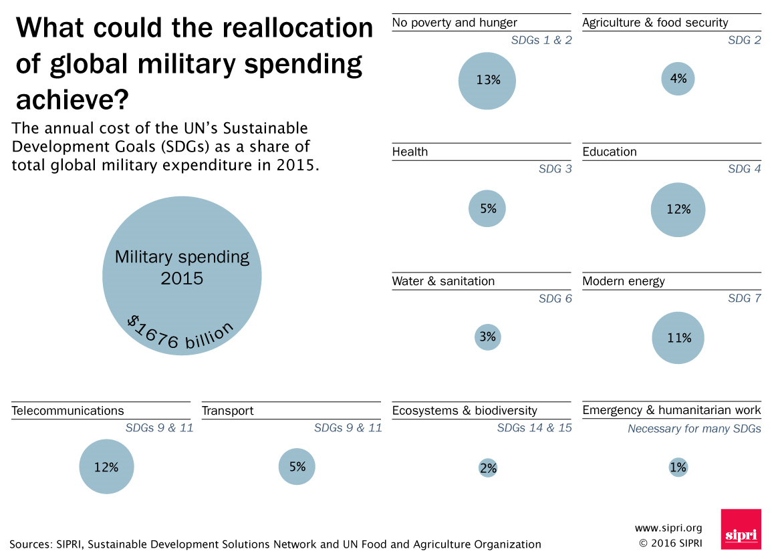

Slide 14
Departments and Other National Infrastructures for Peace Workshop
Q&A, discussion and take-aways for the Plenary Sharing

Slide 15
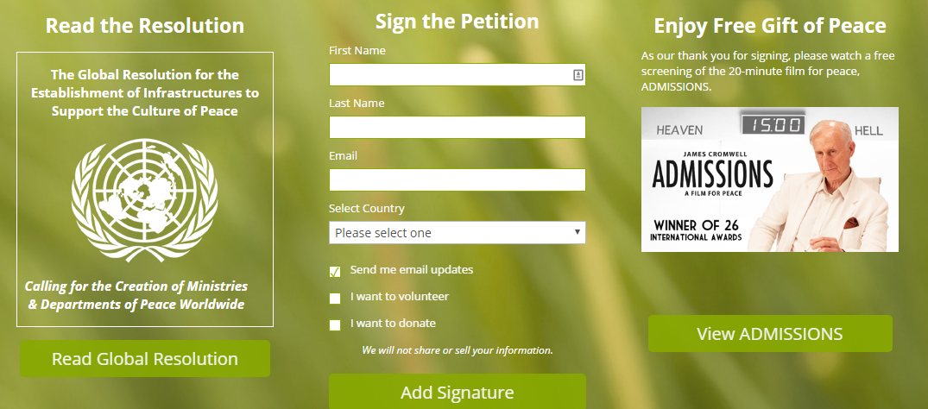
SIGN ON-LINE PETITION FOR UN GENERAL ASSEMBLY TO PASS RESOLUTION URGING DEPARTMENTS OF PEACE GLOBALLY

