Slide 1
U.S. Foreign military bases “Pushpins” of American foreign policy
World BEYOND War Conference
Toronto, Canada
September 21-22 2018
Notes:
Note taker/reporter
Caveat
Already involved with base closure activism?
Anyone from a country that has a U.S. base?

Slide 2
Military career
CMSU 1978, BFA Dallas, TX
OCS 1980 Newport, RI NWC, Newport, RI
Iceland Monterey, CA
Bermuda Tunisia
Norfolk, VA Boston, MA MIT
Virginia Beach, VA Newport, RI
Japan Retire 2000
Notes:
Stationed at 3 (4) overseas bases

Slide 3
Long history
90 FORTS
FORT HARMAR – 1785
FORT MEADE - 1878
Notes:
First Harmer--Ohio--then moved westward to the Pacific coast to support the
“Indian” wars displacing indigenous people and committing genocide.
MEADE—Defense Information Systems, U.S. Cyber Command, NSA, Army band
233 years since Fort Harmar

Slide 4
Destroyers for bases
September 2, 1940
FDR
Agreement with Britain
50 WWI-era destroyers
British colonies
Notes:
the real beginning of U.S. control
FDR unilateral--99-year leases, and near-sovereign powers—Bahamas, Caribbean
“Most important action in the reinforcement of our national security since the Louisiana Purchase”

Slide 5
u.s. foreign military bases
Notes:
Increased qualitatively and quantitatively >WWII—Japan and Europe—large bases in WWII loser countries.
”Pivot to Asia” Australia, South Korea but also big increase in Africa—
lots of lily pads
800 in 80.

Slide 6
Current
Ramstein air base, germany
Chabelly airfield, djibouti
Notes:
Example of big base and lily pad

Slide 7
Personnel deployed
Germany – 47,700
Japan – 50,900
South Korea – 28,500
Italy – 10,900
Total - >193,000
Notes:
WTF? 1.5 million A/D 1.5 million reserve

Slide 8
Why does the u.s. want them?
Establish global presence
Fight on someone else’s soil
Preposition weapons and supplies
Protect/acquire natural resources and trade routes
AWOL
Joint exercises/training with local military
Foreign “aid”
Notes:
Full Spectrum Dominance—Vision 2020 Superpower Foreign Aid—FMS
My experience in Tunisia
"Military Education and Training Program"

Slide 9
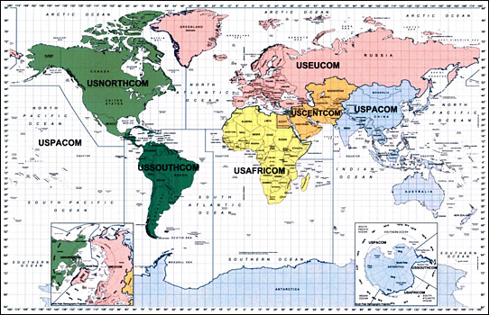
Unified commands
Notes:
Best demonstration of policy = Divide the world into sections--COM meaning.
>WWII superpower. Numbers ramped up
PLUS 11—Carriers TASK FORCE --more than one ship.
“Full Spectrum Dominance” Vision 2020 “Force Projection”
*Bases are now framework for foreign/military policy--PUSHPINS

Slide 10
Why do some countries want them?
Jobs
Economy
Security
Assets (airports, port facilities)
Lessen load on indigenous forces
Foreign aid
Maintain relationship with U.S.
Notes:
Foreign aid—beholden replacement parts and upgrades, training IRONY—want security, but make themselves a target.

Slide 11
problems
SOFA
Environmental damage
Crime
Inflation
Nukes
Notes:
Problems--reasons to close
SOFA—No extradition for crimes, no access to host country to inspect for enviro damage, not responsible for clean up.
U.S. military is biggest consumer of fossil fuels in the world. 2008 in Iraq = 1,210,000 cars Crime—Rape, prostitution

Slide 12
Why shut them down?
Improve relationships
Reduce provocative presence
Return real estate
Environmental damage
Demand by the population
Cost
Notes:
Real estate is invaluable to the country esp places like Okinawa. Chagossians from Diego Garcia Support for mafia/dictators/non-democratic states. Speaking of cost…

Slide 13
amenities
Housing
Schools
Churches
Dentists
Hospitals
Fitness center
Movie theater
Day care center
Fire Department
Youth recreation
Adult recreation
Commissary
Exchange
Swimming pool
Golf course
Gas station
Playgrounds
Police Department
Notes:
Huge cost—shipment of HHG and cars + $10-$40,000 per soldier
Total cost foreign bases: $150 B/year
Families--retention

Slide 14
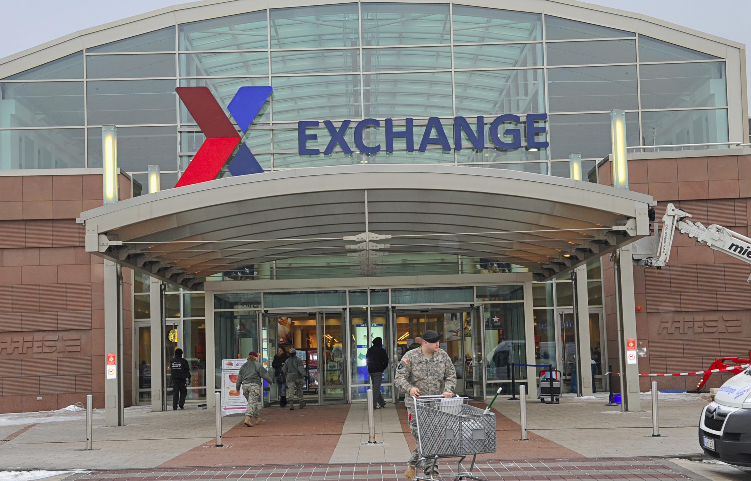
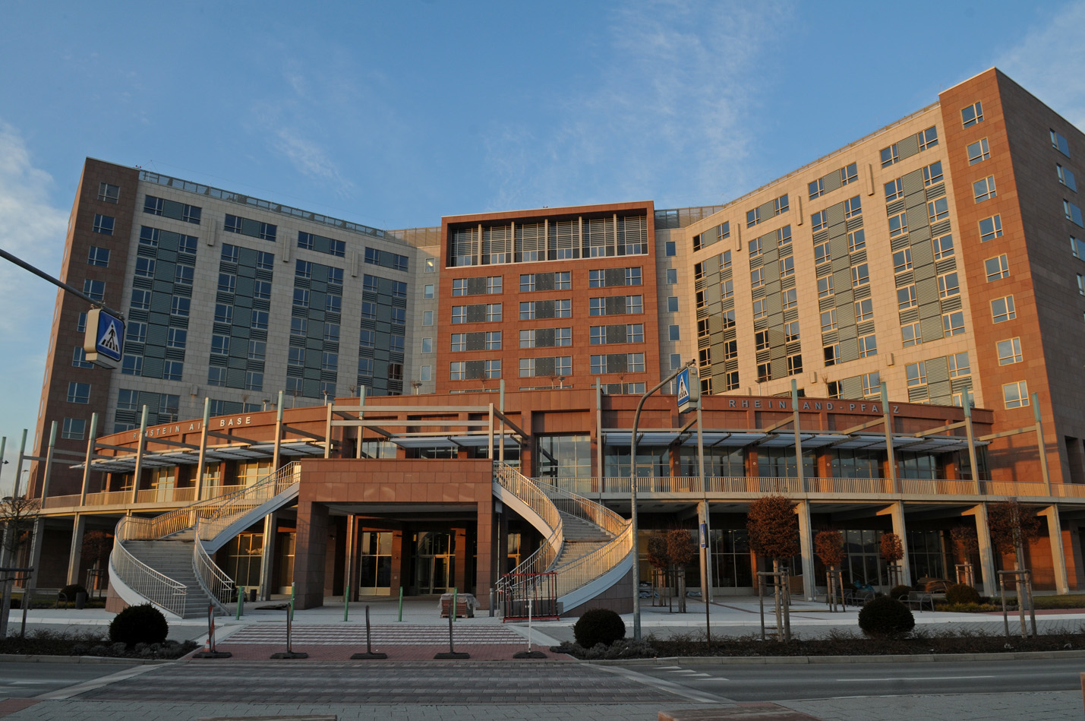
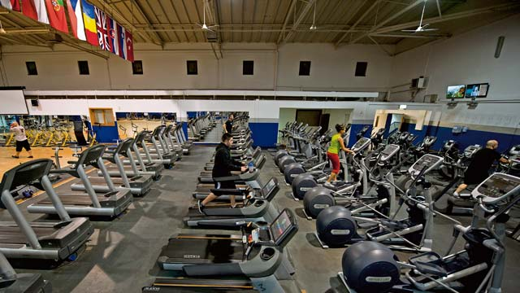
Notes:
Schools, shopping, commissary, gym, pool, golf course, fast food

Slide 15
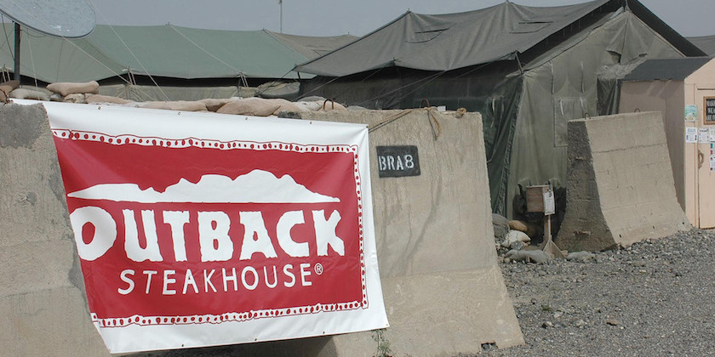
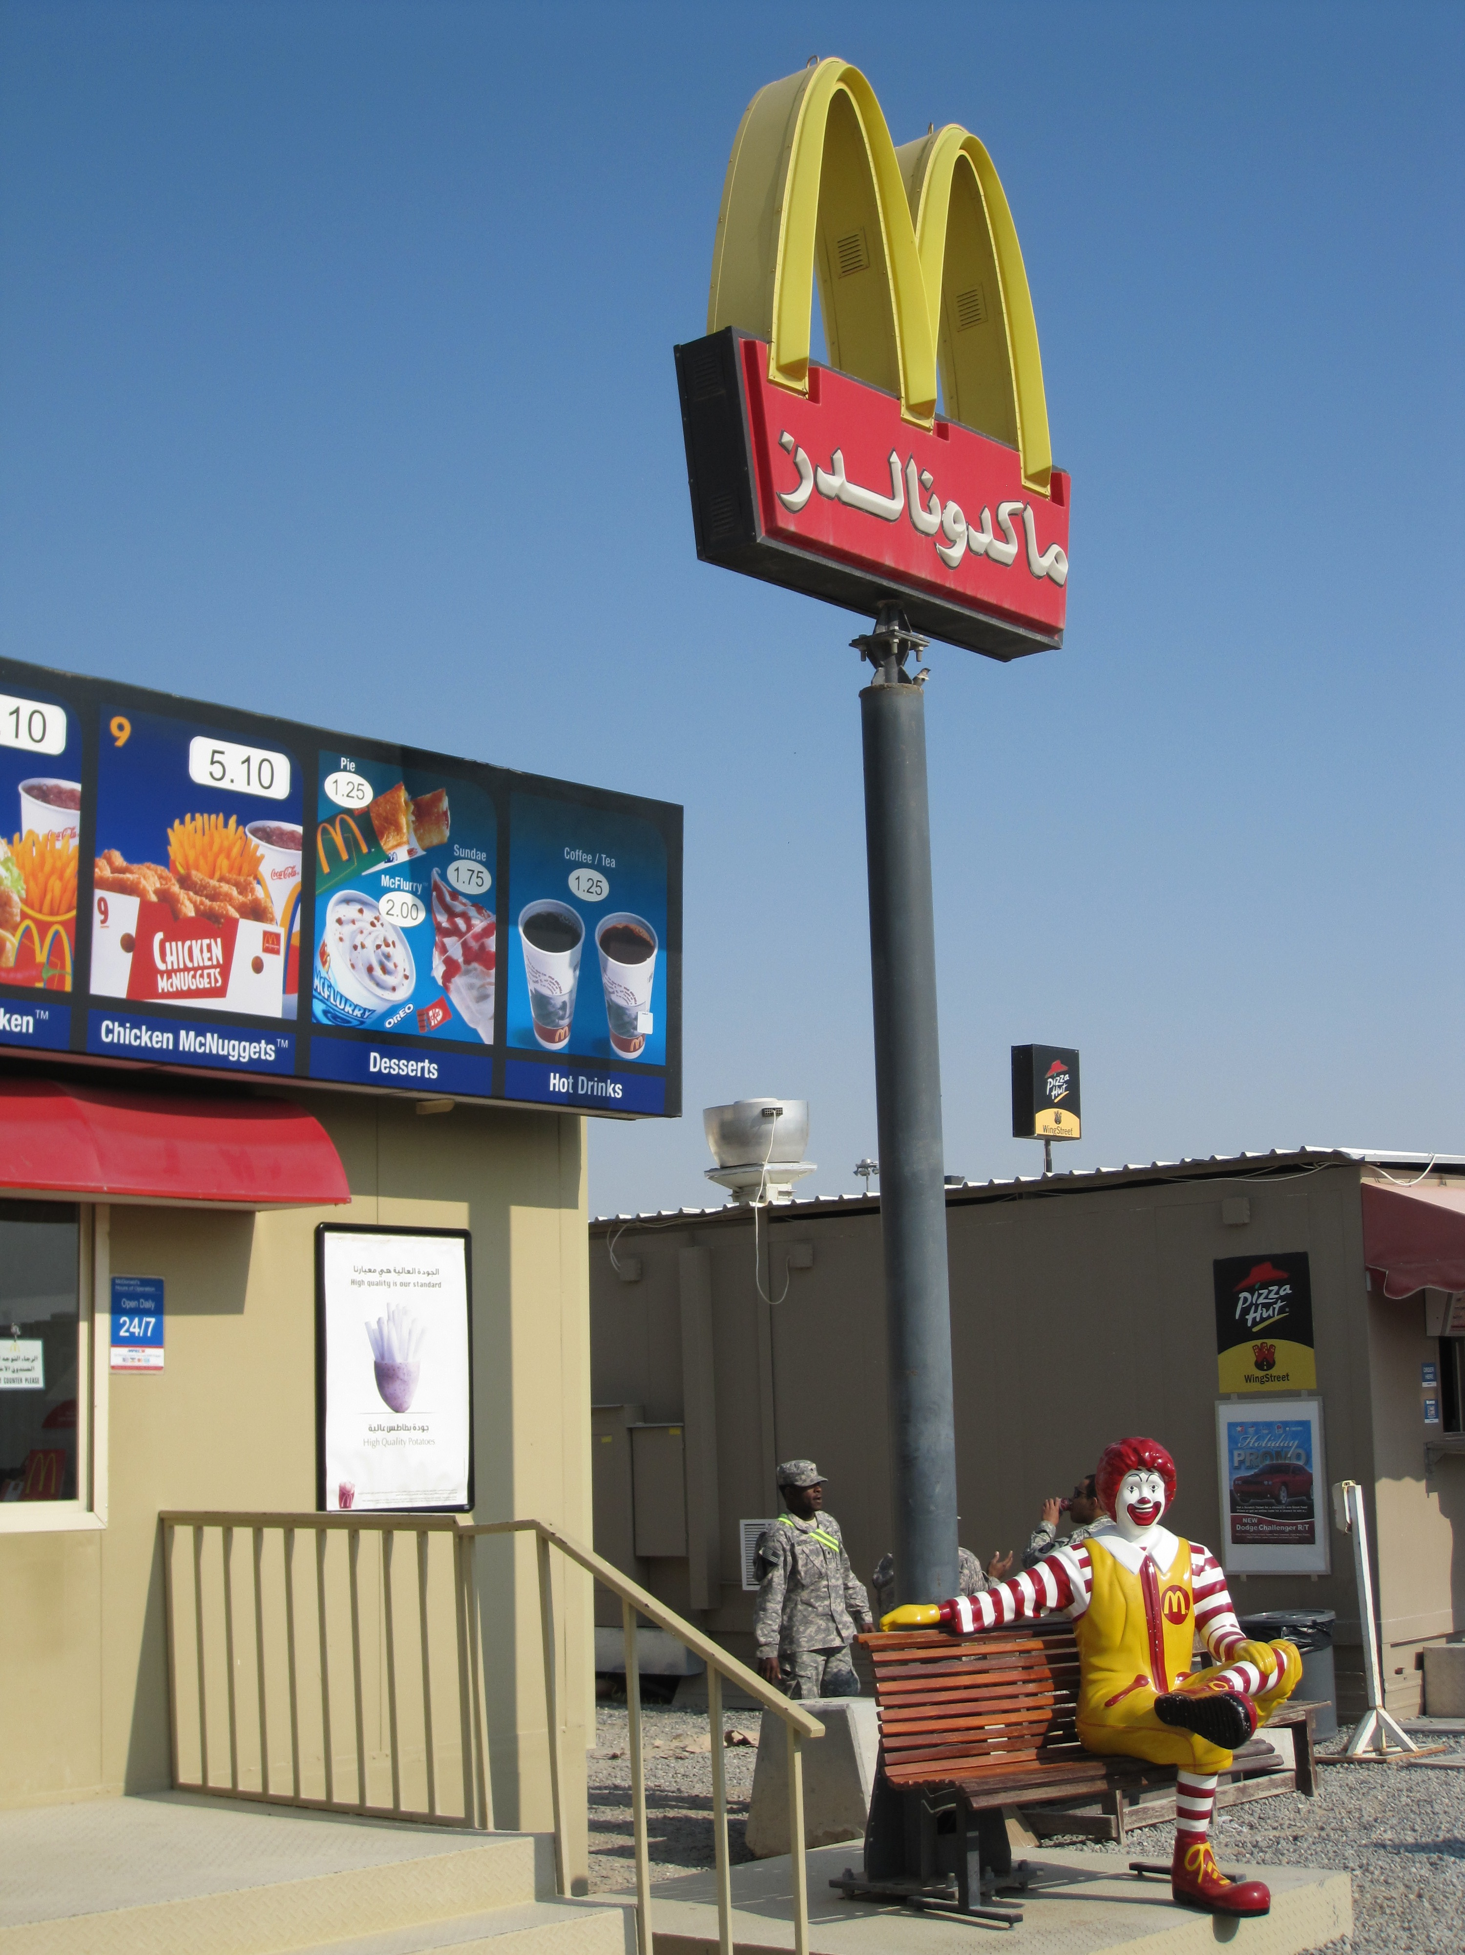
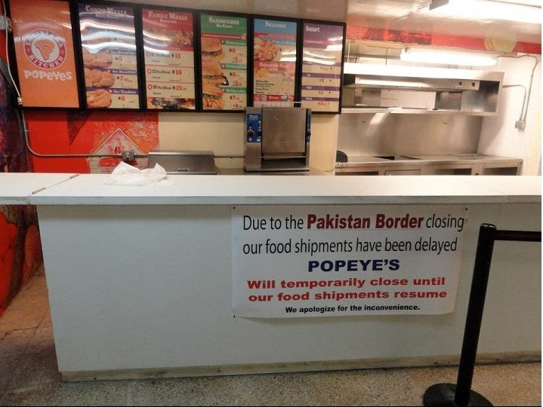

Slide 16
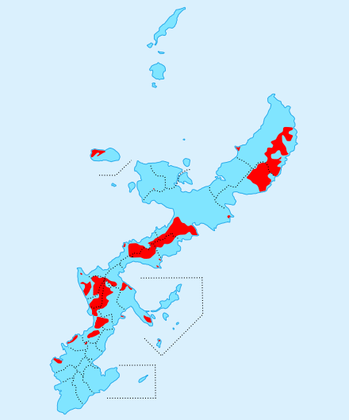
resistance
Notes:
Details about Okinawa
Heavily dependent on Okinawa during Viet Nam.

Slide 17
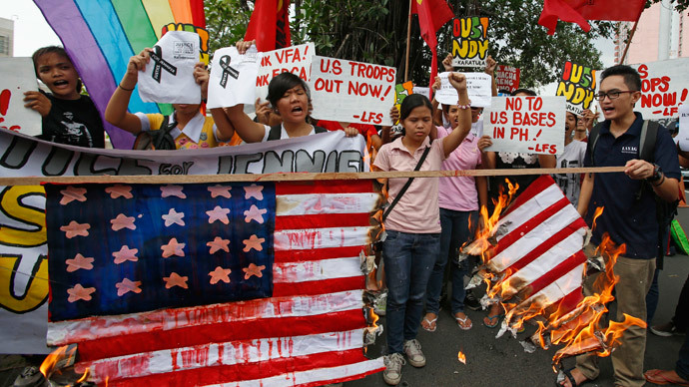
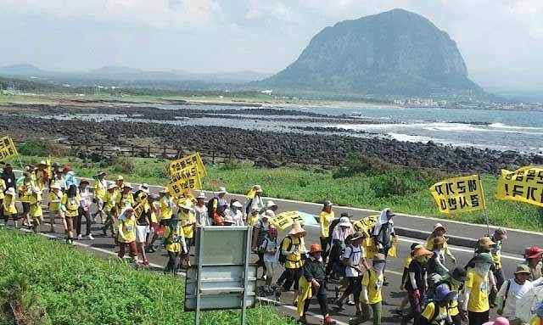
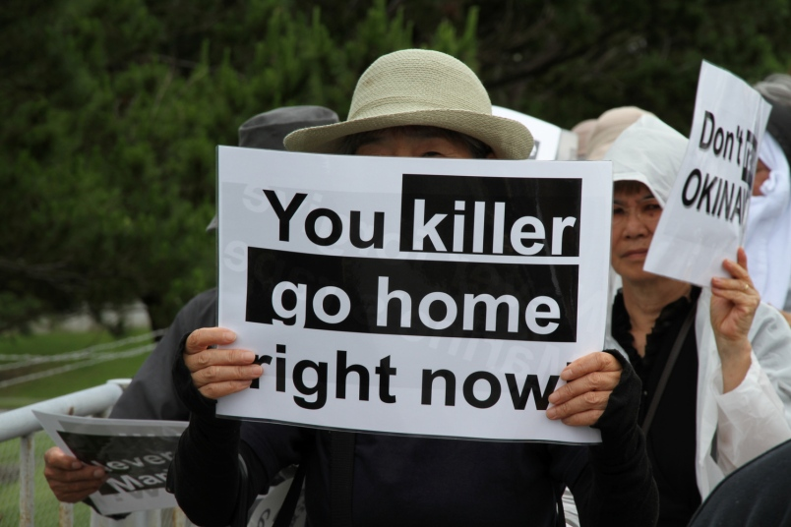
Notes:
Philippines, South Korea,

Slide 18
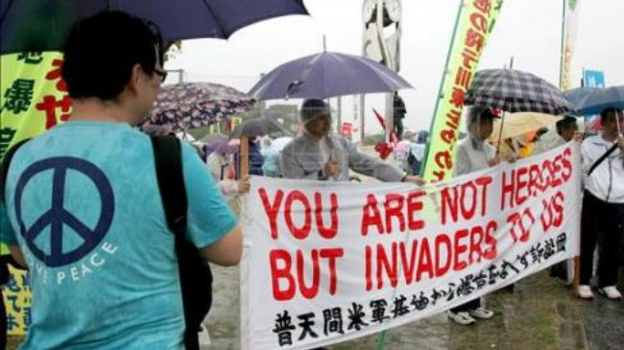
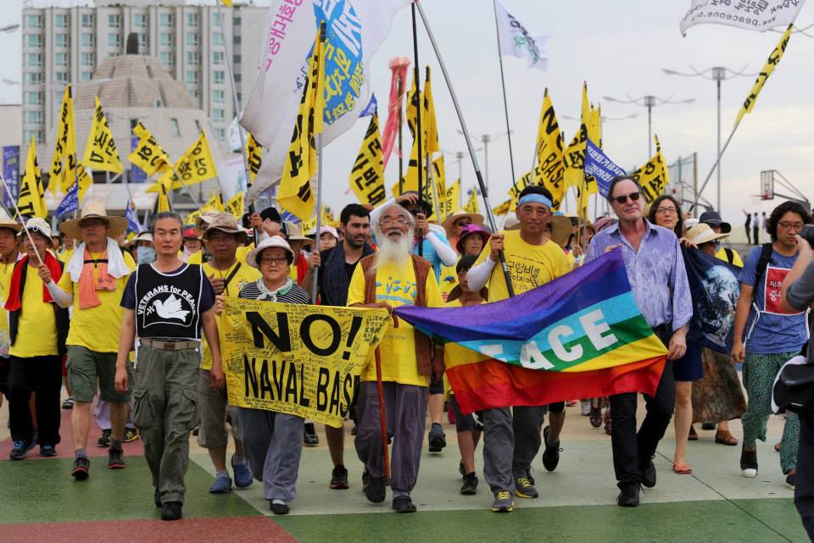
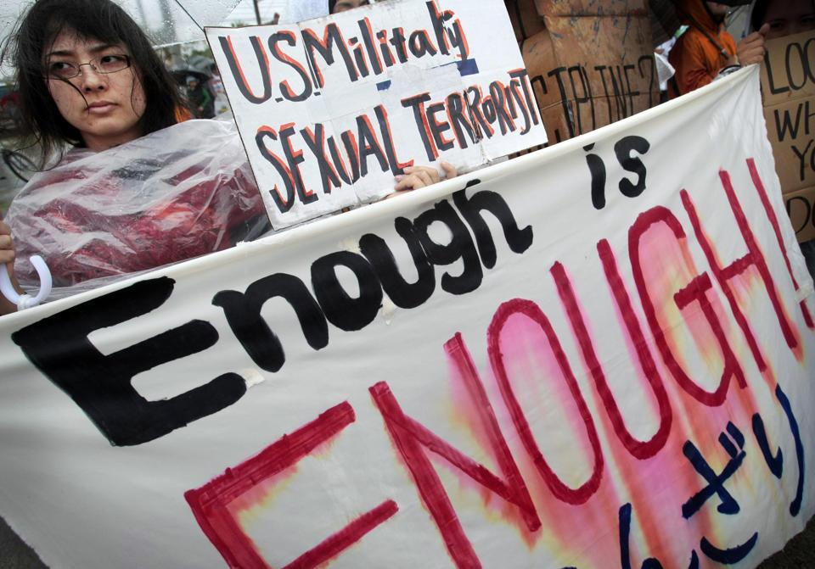

Slide 19
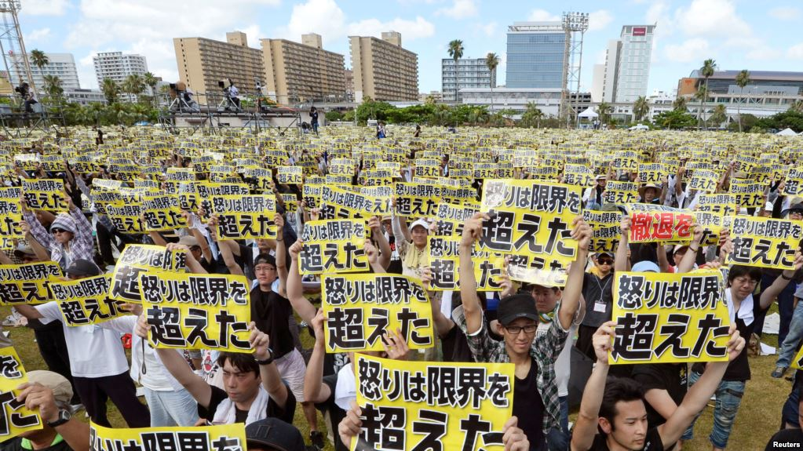
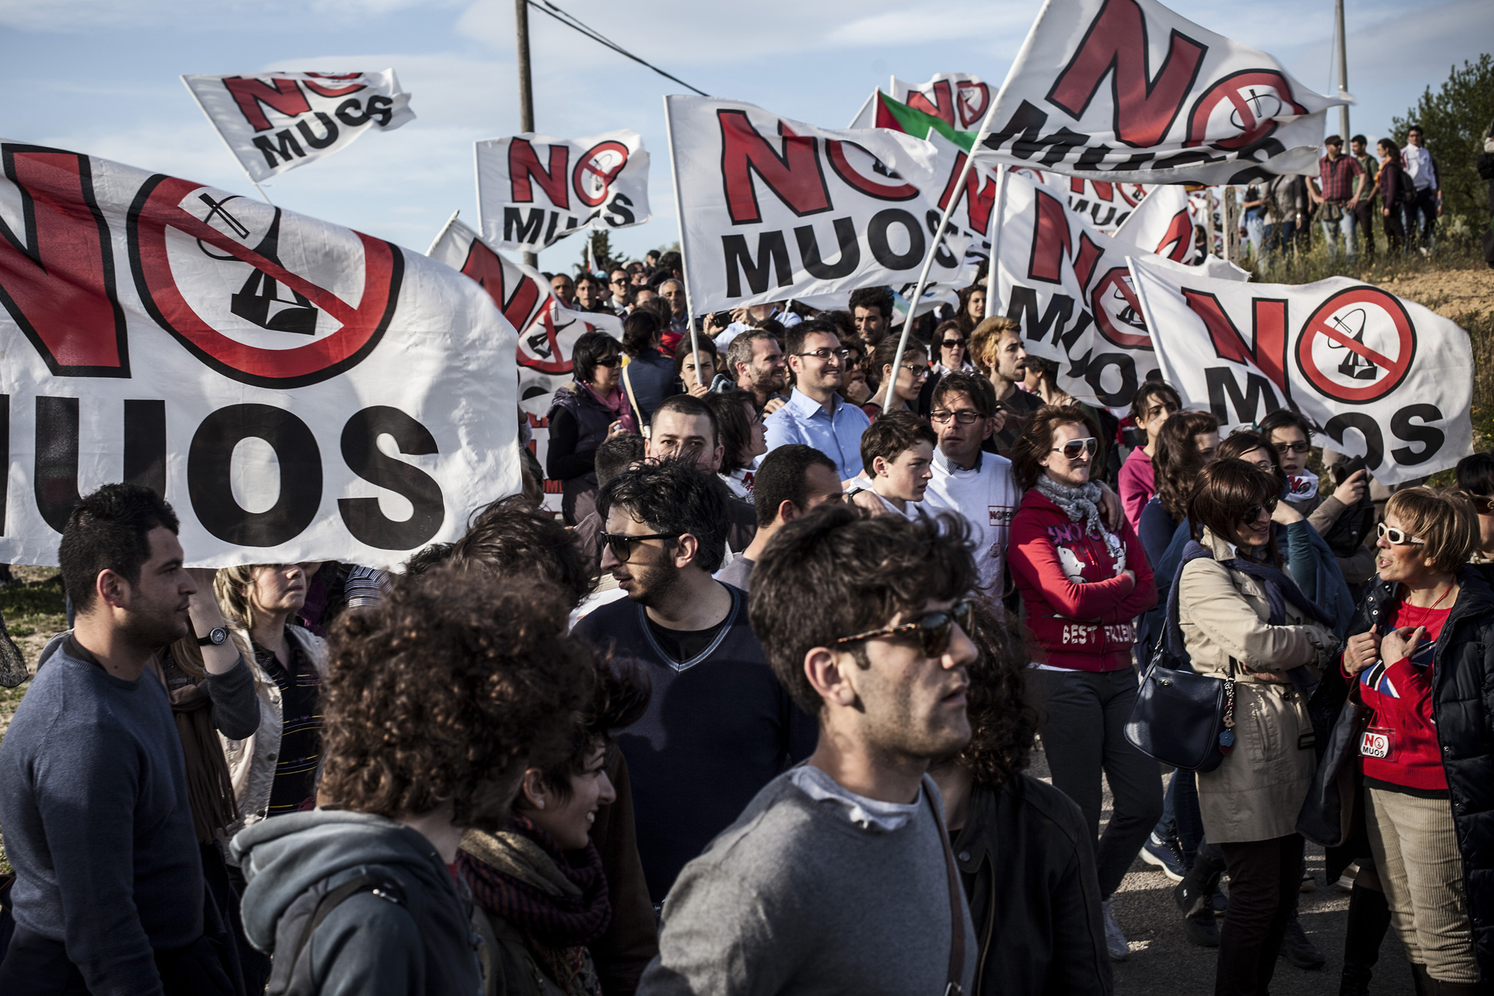
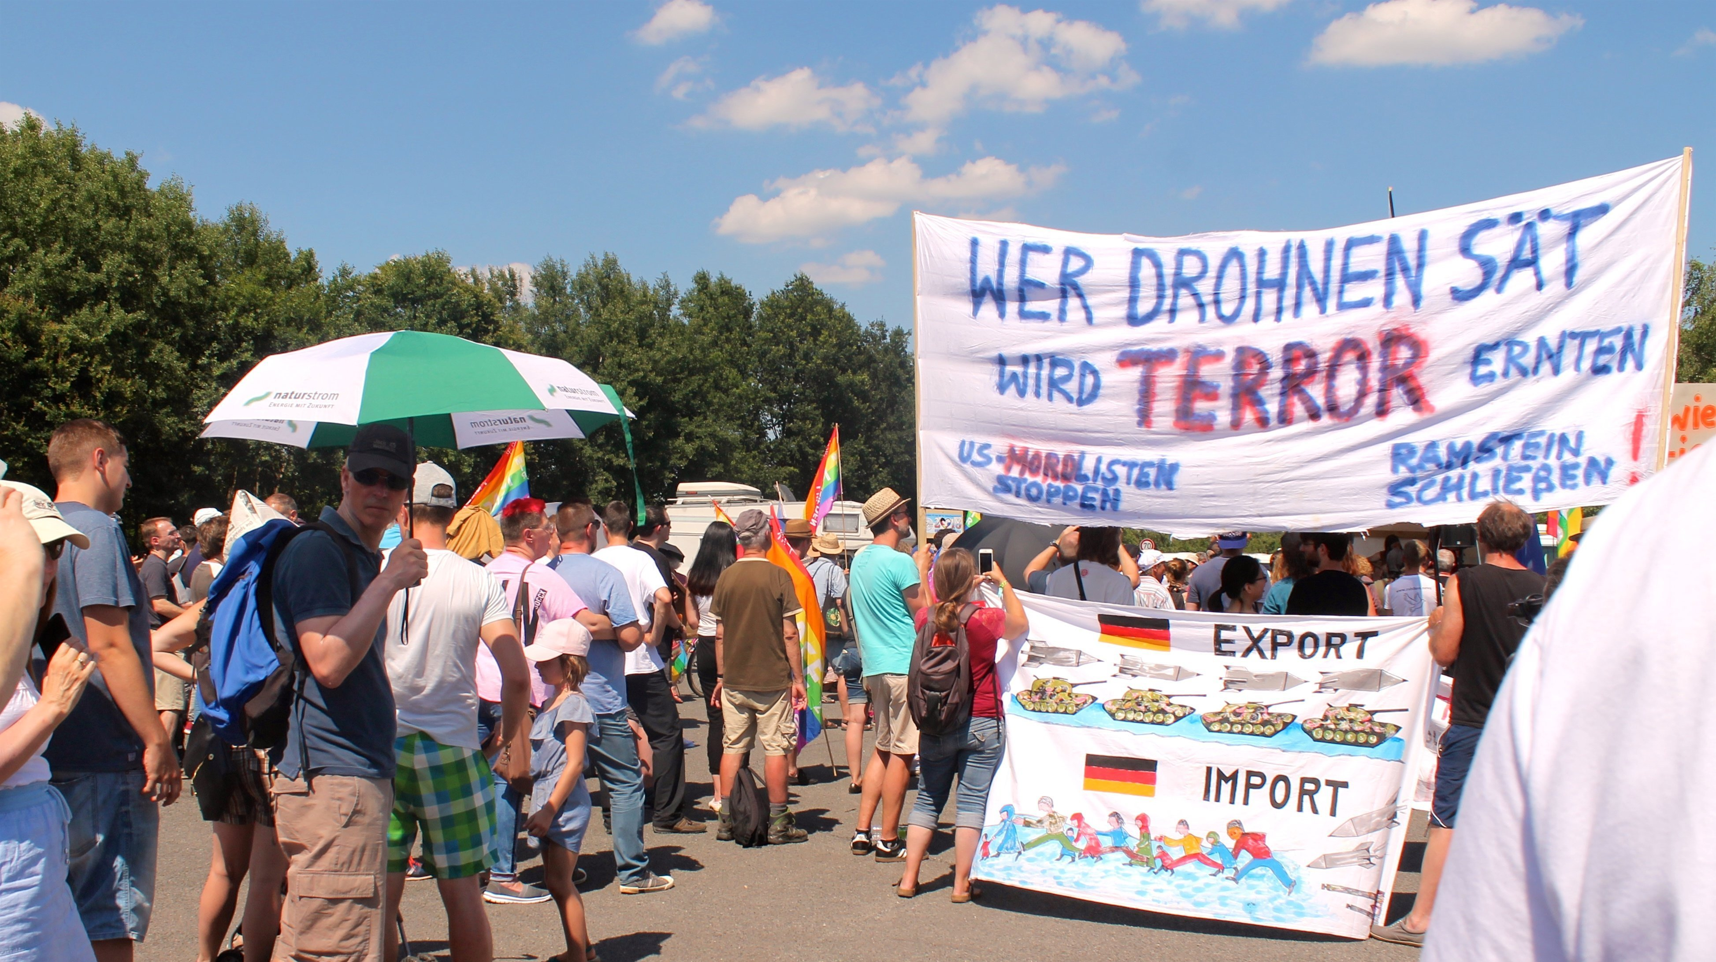
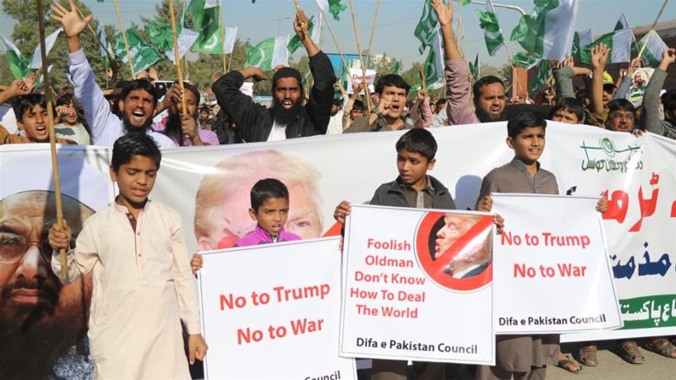
Notes:
Pakistan, Germany, Italy

Slide 20
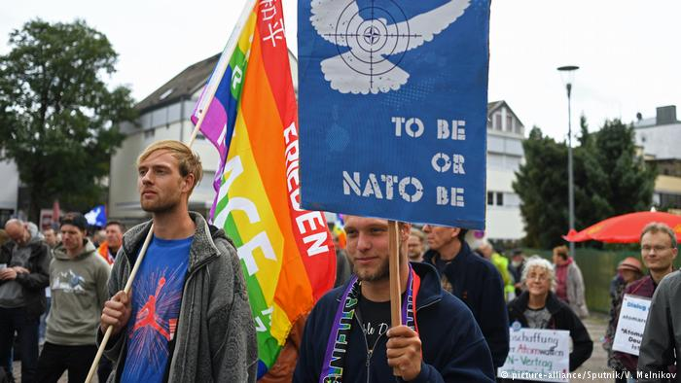
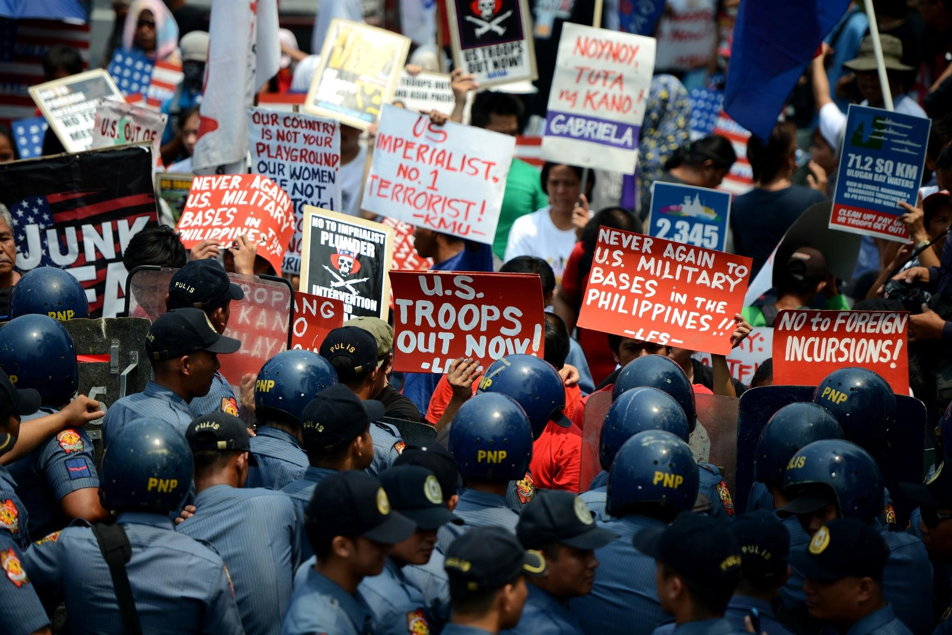
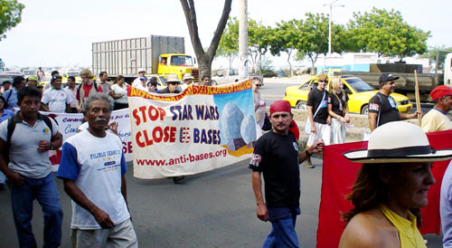
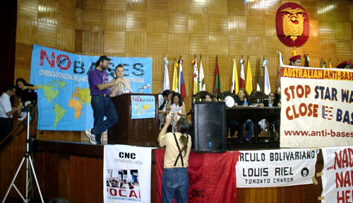
Notes:
Ecuador,

Slide 21
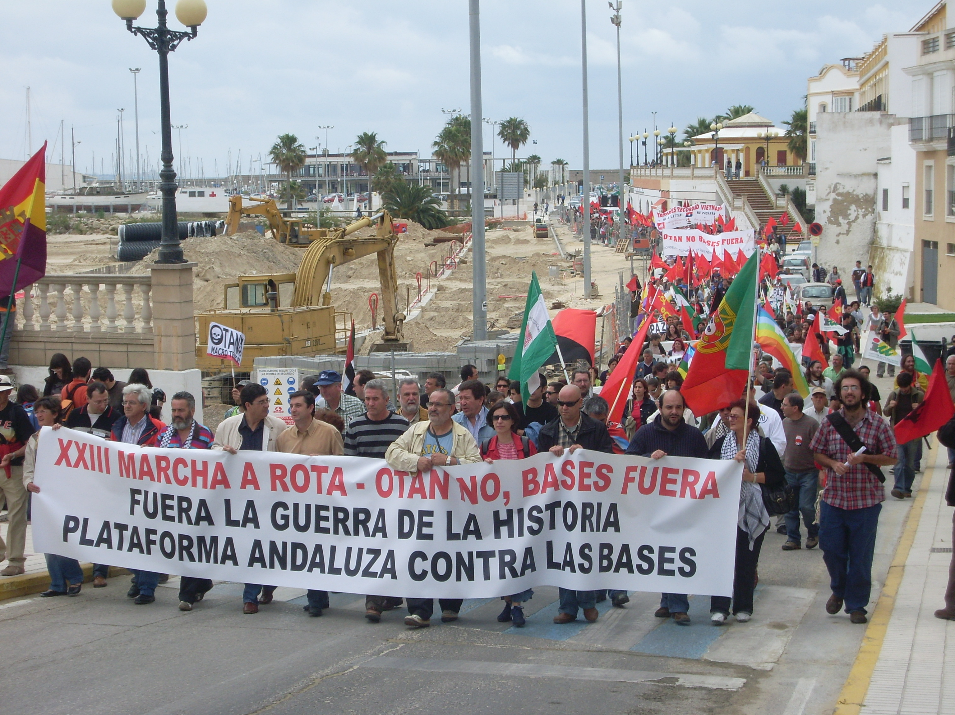
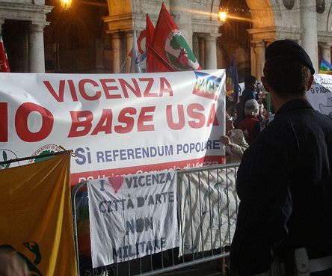
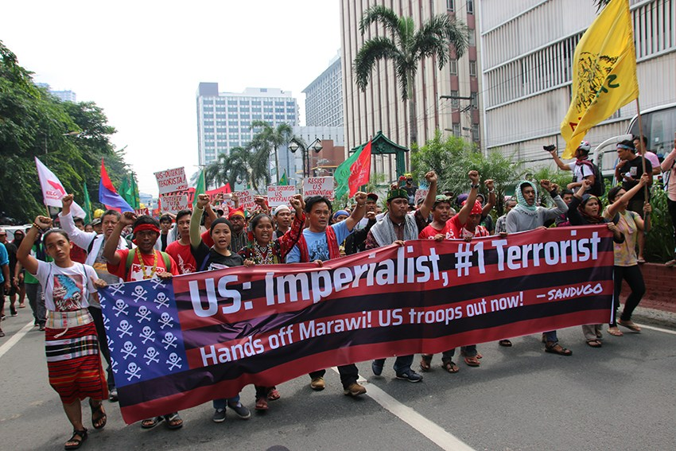

Slide 22
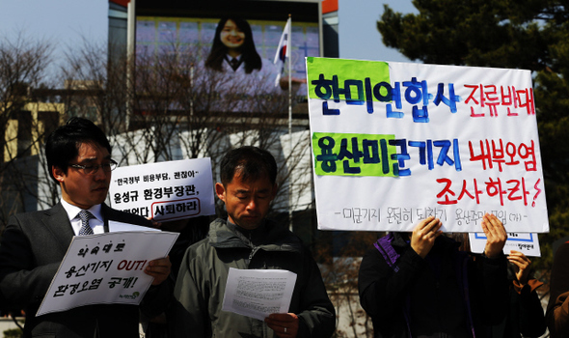
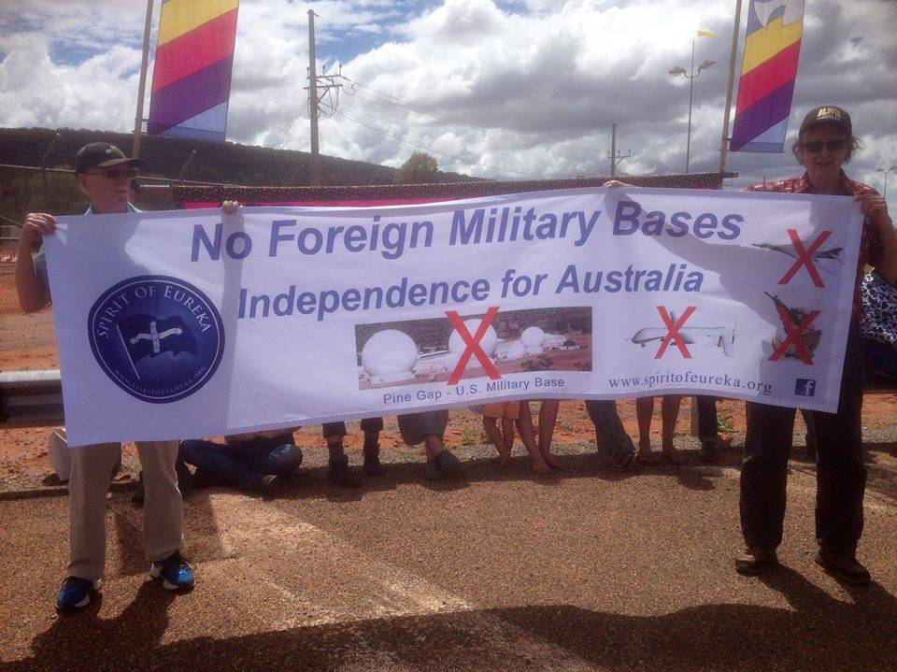
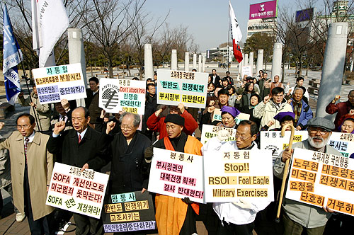

Slide 23
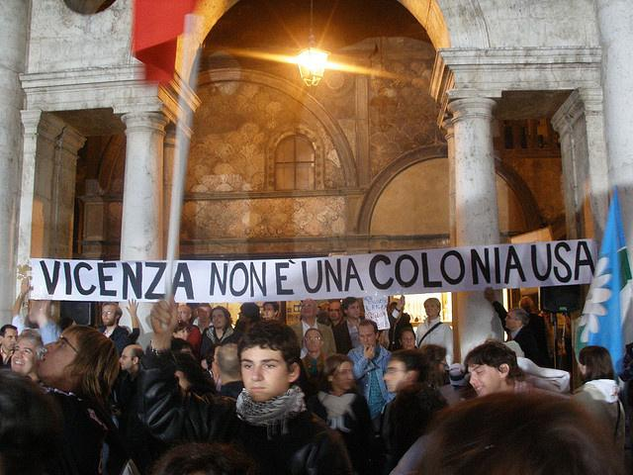
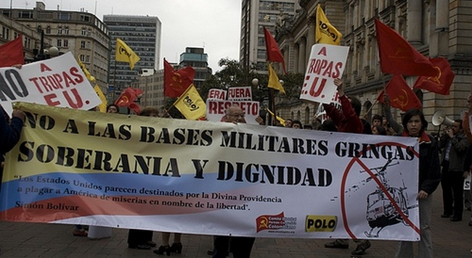
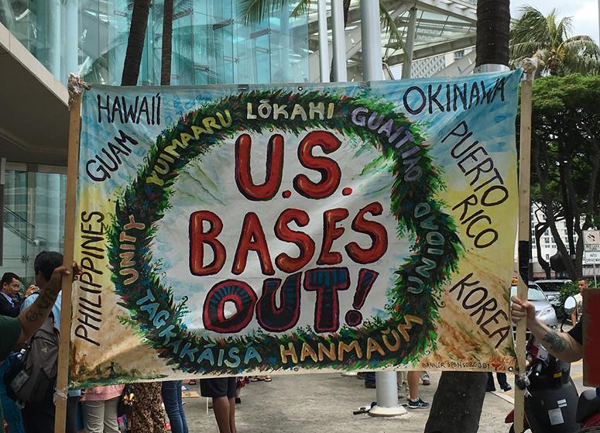

Slide 24
Success stories
Vieques, Puerto Rico
Ecuador
Philippines
Notes:
Vieques—Island municipal principality of Puerto Rico. 1941, Roosevelt Roads Naval Station on mainland “acquired” Bombing range/testing ground...sugar workers disposed .1999 civilian killed—protests/CD left 2003—now wildlife refuge
Ecuador—campaign promise Rafael Correa—not renew 10-year lease. New constitution approved in a referendum officially prohibited foreign military bases on Ecuadoran soil.
Philippines--Subic Bay reliant on economic benefit, but felt like "lackey" sovereignty, national pride—despite economic benefits. Subic bay deep water port—strategic—nothing else like it.

Slide 25
Coalition against u.s. foreign military bases noforeignbases.org
Alliance for Global Justice
BAYAN US
Black Alliance for Peace
CODEPINK
Global Network Against Weapons and Nuclear Power in Space
U.S. Peace Council
Task Force on the Americas
Veterans For Peace
International Action Center
Liberty Tree Foundation
MLK Justice Coalition
Nuclear Age Peace Foundation
Peace Action
Popular Resistance
United National Antiwar Coalition
Women’s International League for Peace and Freedom
World BEYOND War
Notes:
Nousnatobases.org Noforeignbases.org

Slide 26
Baltimore conference
Resolution on National Action Against Guantanamo
Resolution on National Day of Antiwar Action
Resolution in Support of Hiroji Yamashiro and Other Arrested Okinawa Anti-Bases Activists in Japan
Resolution on Global Conference Against U.S. and NATO Military Bases
International conference: November 16 – 19, Dublin, Ireland
Notes:
January 2018, University of Baltimore

Slide 27
Obracc Overseas Base Realignment and closure coalition
David Vine, Professor of Anthropology, American University
BRAC vs OBRACC
Broad group of military analysts, scholars and advocates
Letter to President Trump, SecDef Mattis, Congress outlining nine reasons overseas bases should be closed
Fact sheet
Notes:
Completely different approach “Inside vs Outside” BRAC—Congress, OBRACC--DoD

Slide 28
Discussion
Do you agree that U.S. foreign military bases should be closed?
What negative ramifications might result from closures?
What does “American Exceptionalism” mean? Does it play into U.S. foreign policy?
Strategic planning for “No Bases” activism—ideas?

