Slide 1
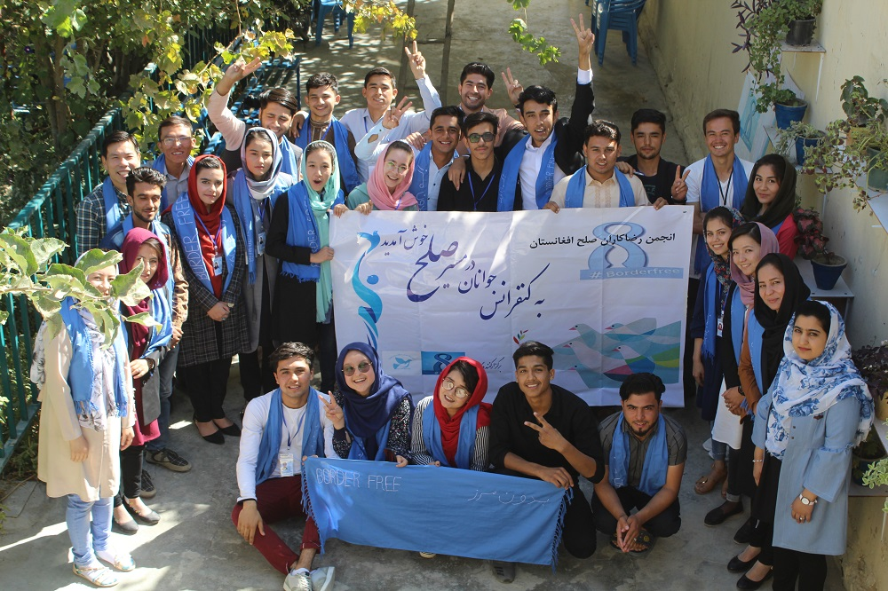
Thinking Skills For the Afghan War
Afghan Peace Volunteers
Afghan Youth on the Road to Nonviolent Peace

Slide 2
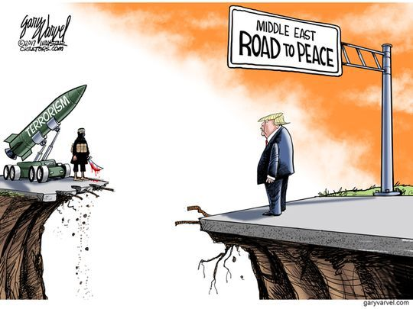
Thinking Skills For the Afghan War
Afghan Peace Volunteers
World on the Road to Violent Peace

Slide 3
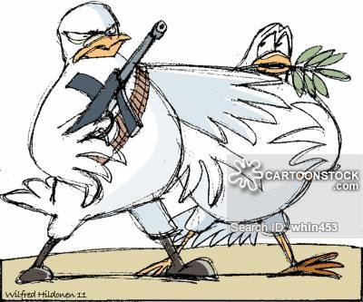
Thinking Skills For the Afghan War
Afghan Peace Volunteers
Violent Peace
Nonviolent Peace

Slide 4
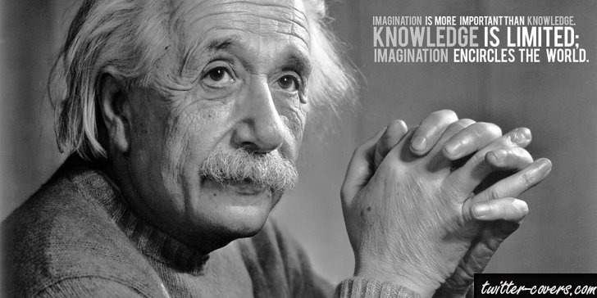
Thinking Skills For the Afghan War
Afghan Peace Volunteers
A. Critical Thinking Skills
B. Creative Thinking Skills
C. Relational Thinking Skills

Slide 5
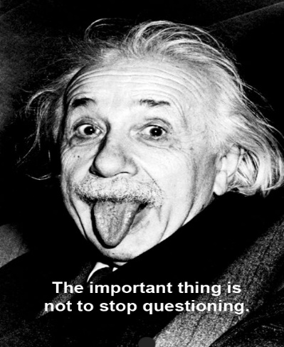
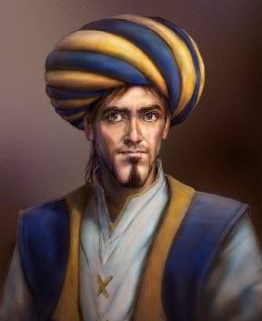
Thinking Skills For the Afghan War
Afghan Peace Volunteers
A. Critical Thinking Skills
Ask questions and have doubts
Test
3. Find evidence
An opinion, including even a majority opinion
A theory
A report or analysis by a think tank
A presumption /assumption
A guess
Propaganda
A biased/prejudiced opinion
A claim by a famous personality
A rumour
A fable
Fact
If no replicable evidence is found,
the subject matter cannot be accepted
as a scientific fact.

Slide 6
Thinking Skills For the Afghan War
Afghan Peace Volunteers
A. Critical Thinking Skills
“The crisis of neoliberalism — with its financial ruin for millions, its elimination of the welfare state, its deregulation of corporate power, its unchecked racism and its militarization of society — has to be matched by a crisis of ideas… Thinking critically and acting courageously in dark times is not an option, but a necessity.” Henry Giroux

Slide 7
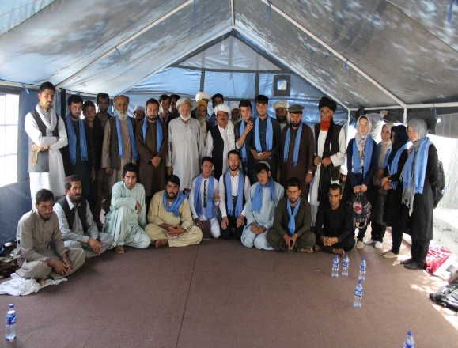
Thinking Skills For the Afghan War
Afghan Peace Volunteers
A. Critical Thinking Skills
Question and doubt
Test
3. Find evidence
؟؟؟
If no replicable evidence is found,
the subject matter cannot be accepted
as a scientific fact.

Slide 8
Thinking Skills For the Afghan War
Afghan Peace Volunteers
A. Critical Thinking Skills
If the US military withdraws completely, the Taliban
or ISIS will take control
of Afghanistan.
Ask questions and have doubts
Test
3. Find evidence
؟؟؟
If no replicable evidence is found,
the subject matter cannot be accepted
as a scientific fact.

Slide 9
Thinking Skills For the Afghan War
Afghan Peace Volunteers
B. Creative Thinking Skills
Imagine
Brainstorm and heart-storm
3. Experiment with ideas

Slide 10
Thinking Skills For the Afghan War
Afghan Peace Volunteers
B. Creative Thinking Skills

Slide 11
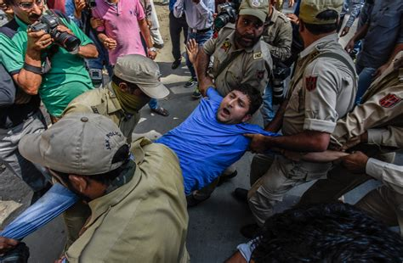
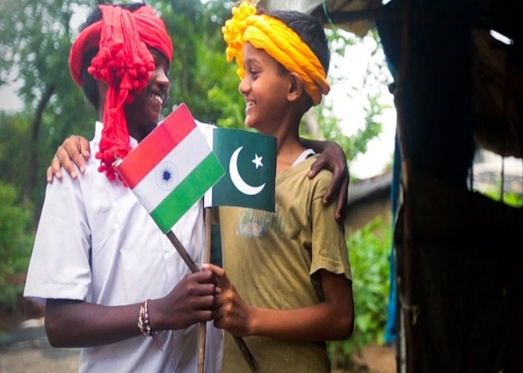
Thinking Skills For the Afghan War
Afghan Peace Volunteers
B. Creative Thinking Skills
Imagine
Brainstorm and heart-storm
3. Experiment with ideas
؟؟؟

Slide 12
Thinking Skills For the Afghan War
Afghan Peace Volunteers
B. Creative Thinking Skills
Imagine
Brainstorm and heart-storm
3. Experiment with ideas
What creative solutions
can you think of
to end the Afghan war?
؟؟؟

Slide 13
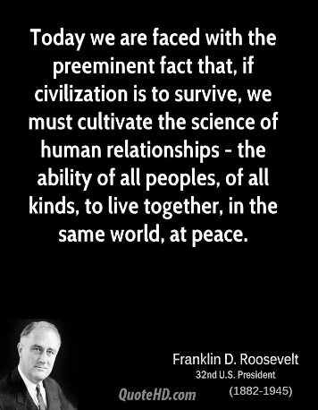
Thinking Skills For the Afghan War
Afghan Peace Volunteers
C. Relational Thinking Skills
Learn by relating with Nature and every person
Connect all the dots: climate change, inequality, war etc
“We tried war, we tried aggression, we tried intervention. None of it works.
Why don't we try peace, as a science of human relations,
not as some vague notion - as everyday work.”
Dennis Kucinich, Former U.S. Member of Congress

Slide 14
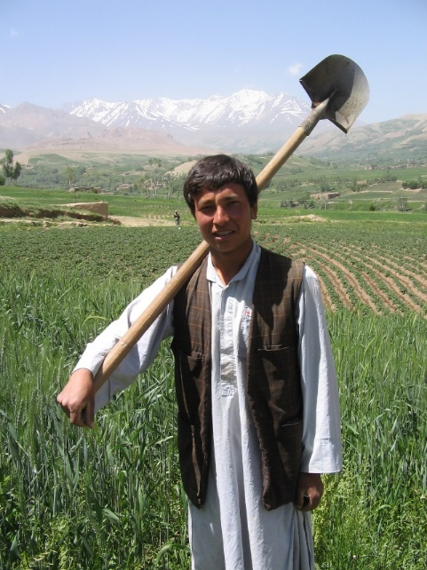
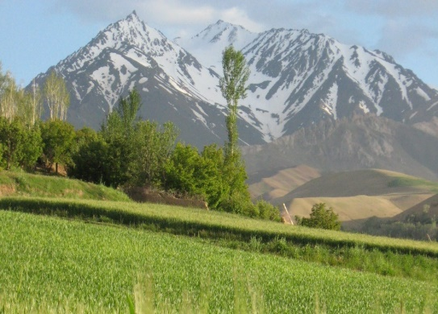
Thinking Skills For the Afghan War
Afghan Peace Volunteers
C. Relational Thinking Skills
Learn by relating with Nature and every person
2. Connect all the dots: climate change, inequality, war etc
؟؟؟

Slide 15
Thinking Skills For the Afghan War
Afghan Peace Volunteers
C. Relational Thinking Skills
How can we apply relational thinking skills to the Afghan and global refugee situation?
Learn by relating with Nature and every person
2. Connect all the dots: climate change, inequality, war etc
؟؟؟

