Slide 1
Bernie speaking at People’s Climate March, Montpelier Vermont

Slide 2
Ben & Jerry

Slide 3
F-16 Fighting Falcon fighter bomber

Slide 4
F-35 stealth fighter bomber

Slide 5
page

Slide 6
Colonel Rosanne Greco (with Colin Powell)

Slide 9
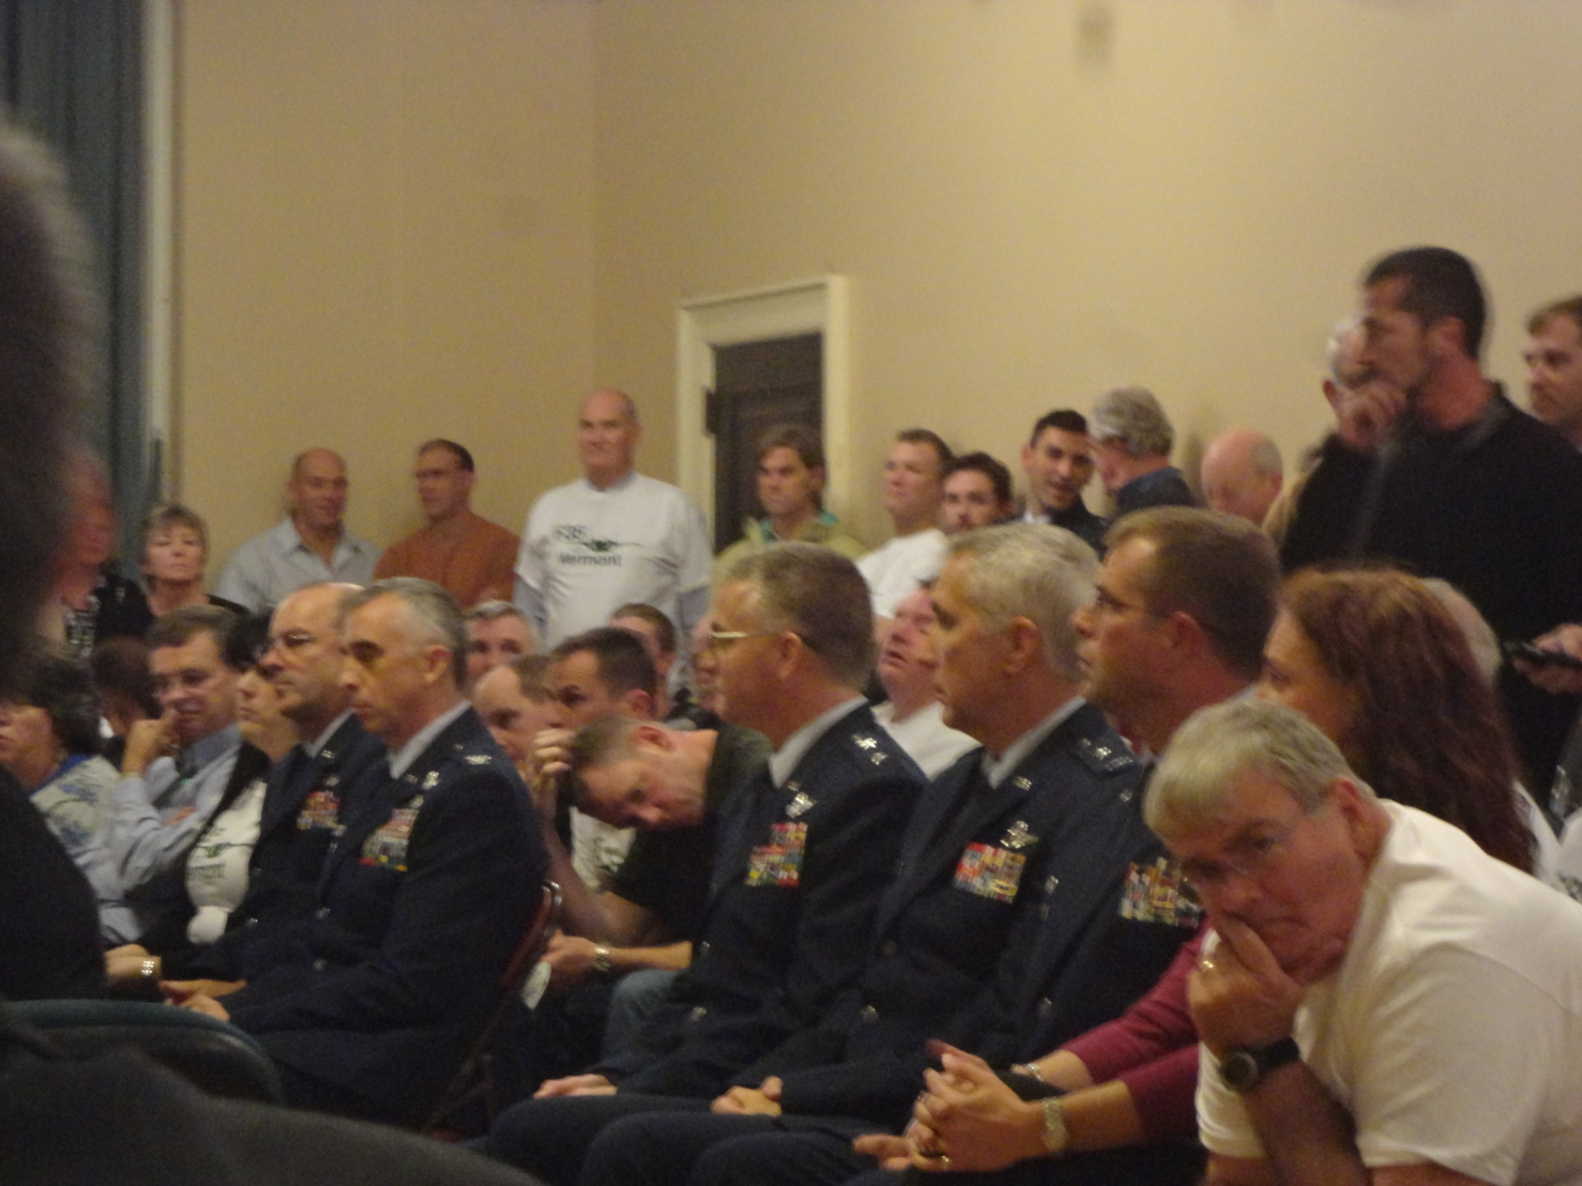

Slide 14
Ben Cohen speaking at rally opposing F-35 outside Senator Leahy’s Office

